Slide 1
﻿SKILLS FOR SUCCESS: Collaboration Skills for Success

Slide 2
Collaboration – Introduction
Welcome to this unit on collaboration!
Instructor’s intro
Participants’ intro

Slide 3
Collaboration – Introduction
What is collaboration?
Collaboration is your ability to work well with others to thrive at work.
Vocabulary
Thrive: become better, grow, do very well
Notes:
NOTE: This slide has animations.
Workbook, page 2
Ask learners, “What is collaboration?”
After some learners have shared, click to show the definition from the workbook.
Let learners know that this unit is about how they can collaborate to thrive at work.
Ask learners, “What does thrive mean?”
After some learners have shared, click to show the vocabulary box.
Activity time: 3 – 5 minutes

Slide 4
Collaboration – Introduction
What is collaboration?.
Thriving at work means:
Growing in your job
Taking steps to develop your career
Vocabulary
Career: the path you follow and the progress you make in a specific area of work. It includes your jobs, training and experience.
Notes:
NOTE: This slide has animations.
Workbook, page 2
Ask learners, “What does ‘thriving at work’ mean?”
After some learners have shared, click to show the explanation from the workbook.
Ask learners, “What is career?”
After some learners have shared, click to show the definition from the workbook.
Activity time: 3 – 5 minutes

Slide 5
Collaboration – Introduction
Learning outcomes
After completing this unit, you will be able to:
Identify when you need to collaborate to thrive at work
Identify the purpose for collaborating
Use strategies to collaborate effectively
Notes:
NOTE: This slide has animations.
Workbook, page 2
Click to show the learning outcomes of this unit.

Slide 6
Collaborating to thrive at work
Tell your co-workers when they do a good job
Suggest how to improve
Give clear instructions
Prioritize your tasks
Notes:
Workbook, page 3
Ask if anyone wants to volunteer to read the heading of the first example. Ask learners why it is an example of collaboration. Ask another volunteer to read the explanation from the workbook.
Repeat the same steps for each example.
NOTE: At the second example, discuss the key vocabulary: suggest
At the last example, discuss the key vocabulary: prioritize tasks
Activity time: 7-10 minutes

Slide 7
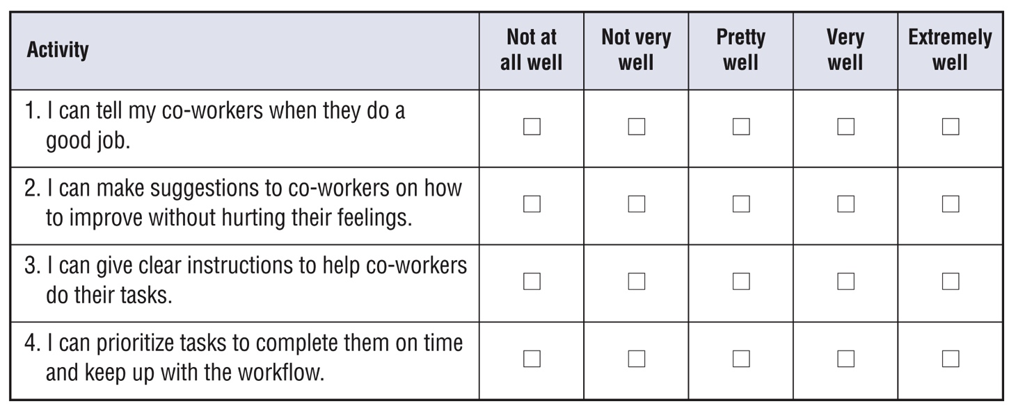
Self-evaluation
Self-evaluation
How well can you do these activities?
This self-evaluation asks you to think about your collaboration skills. Answer the questions as honestly as you can.
Notes:
Instructor guide, page 3 – scoring information
Instructor guide, page 4 – how to use the self-evaluation
Workbook, page 4 - Self-evaluation activity for participants
Explain to the learners what self-evaluation is and its purpose.
Explain the layout of the table and provide example to the learners on how to complete self-evaluation.
Allow them 5 minutes to complete it.

Slide 8
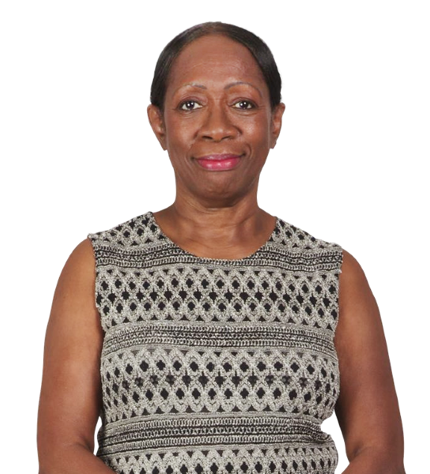
Denise’s story
Notes:
Workbook, page 5 – Denise’s story
Let learners know that in this unit, they will read about Denise. She wants to grow at work and become a team lead.

Slide 9
Denise’s story
Notes:
Workbook, page 5 – Denise’s story
Allow learners 3-5 minutes to read Denise’s story on their own.
Note: If some of the learners are struggling with reading, you can offer to read the story or ask someone to volunteer to do it for the class.
Go over key points of the story to make sure everyone understood it.
These are some of the questions you can ask:
Where does Denise work?
How does she want to thrive at work?
What has she been assigned to do?
Ask learners if there is any vocabulary that you need to discuss with them.
Activity time: 5 minutes

Slide 10
Denise’s story
When to collaborate? Identify areas
Denise wants to grow at work. To do this, she needs to collaborate well.
What areas should Denise work on to improve?
Do the task on page 6
Reflect
Notes:
NOTE: The slide has animations.
Workbook, page 6 - 7
Task (page 6)
Click to show the text.
Click to show “Do the task on page 6” and let learners know that they will be doing that task.
Ask a learner to read the instructions. Check for understanding.
Allow learners 3-5 minutes to complete the task. Remind them that they can find the answers in the story.
When they have completed, share the answers in small groups or as a class.
Reflect (page 7)
Click to show “Reflect”.
Give learners 5 minutes to reflect on the questions.
Ask some learners to share their answers.

Slide 11
Denise’s story
What does collaboration look like?
Identify actions
What could Denise do to collaborate better?
Do the task on page 8
Reflect
Notes:
NOTE: This slide has animations.
Workbook, page 8
Task
Click to show the question.
Click to show “Do the task on page 8” and let learners know that they will be doing that task.
Ask a learner to read the instructions. Check for understanding.
Allow learners 3-5 minutes to complete the task.
When they have completed, share the answers in small groups or as a class.
Reflect
Click to show “Reflect”.
Give learners 5 minutes to reflect on the questions.
Ask some learners to share their answers.

Slide 12
Denise’s story
Why collaborate? Identify the purpose
Collaborating at work can be very rewarding. It allows you to contribute to your team and help others become part of it. You become a valuable employee.
Collaborating well may not be easy. It often means you get more responsibilities and need to work with others more.
If you keep in mind how you, your team and your employer can benefit when you collaborate well, you can continue to improve and thrive at work.
Notes:
NOTE: This slide has animations.
Workbook, page 9
Ask learners “Why is collaboration important? How can it help you thrive at work?” Click to show the first paragraph. Read it for learners or ask one of them to do it.
Ask learners “Why can collaborating sometimes be hard?’ Click to show the second paragraph. Read it for learners or ask one of them to do it.
Click to show the third paragraph. Read it for learners.
Activity time: 3 – 5 minutes

Slide 13
Denise’s story
Why collaborate? Identify the purpose
Do the task on page 9 and 10
Reflect
Notes:
NOTE: This slide has animations.
Workbook, page 9 - 10
Task (page 9)
Click to show “Do the task on page 9” and let learners know that they will be doing that task.
Ask a learner to read the instructions. Check for understanding.
Allow learners 3-5 minutes to complete the task.
When they have completed, share the answers in small groups or as a class.
Reflect (page 10)
Click to show “Reflect”.
Give learners 5 minutes to reflect on the questions.
Ask some learners to share their answers.

Slide 14
Denise’s story
Identify and practise strategies
How can you collaborate effectively?
Identify and practise strategies
Reflect
Strategies to give feedback
Strategies to give clear instructions
Strategies to prioritize tasks
There are many strategies that can help you collaborate more easily.
Notes:
NOTE: This slide has animations.
Workbook, page 11
Click to show the text. Let learners know that in this section, they will discuss strategies.
Reflect
Click to show “Reflect.”
Allow learners 5 minutes to reflect on the questions.
Ask some of them to share their answers.
Click to show the sets of strategies one by one.

Slide 15
Denise’s story
Identify and practise strategies
Strategies to give feedback
Giving your co-workers feedback is a way to collaborate. When you give feedback in a positive way, you build relationships with your co-workers. Good relationships are important for thriving at work.
Giving feedback in a positive way can also help prevent conflicts. If you give feedback in a good way, it’s likely your co-workers will respond to it in a positive way too.
Notes:
NOTE: This slide has animations.
Workbook, page 12
Ask learners, “Why is giving feedback a way to collaborate? How can it help?”
Click to show the first paragraph.
Ask learners, “Why is it important to give feedback in a positive way?”
Click to show the second paragraph.
Let learners know that they will now discuss strategies to give feedback in a positive way.
Activity time: 3 – 5 minutes

Slide 16
Denise’s story
Identify and practise strategies
Strategies to give feedback
Decide if you should give feedback
Choose the right time
Use positive body language and tone of voice
Make suggestions
Ask for their ideas
Be respectful
Be a positive role model
Notes:
NOTE: This slide has animations.
Workbook, page 12 - 13
Ask learners, “What strategies can Denise use to give feedback in a positive way?”
Have some of them share their ideas.
Click to show first strategy.
Ask a learner to read to the class the explanation in the workbook for “Decide if you should give feedback”.
Discuss to reinforce the points for the strategy.
Have a brief discussion about boundaries (reminder in the orange box). Remind them that they can get a refresher about boundaries in Collaboration: Unit 2.
Repeat the process for the other strategies.
At the last strategy, discuss vocabulary: positive role model
Ask learners to think about who their positive role model is.
Ask why they are a positive role model.
Have a brief discussion about responding to feedback in a positive way. Remind learners that they can get a refresher on this in Collaboration: Unit 1.
As well, remind learners that giving and responding to feedback in a positive way is a transferable skill. Encourage them to use it in program, in their job and everyday life.
Activity time: 7 – 10 minutes

Slide 17
Denise’s story
Identify and practise strategies
Strategies to give feedback
Do task 1 on page 14
Do task 2 on page 15
Reflect
Notes:
NOTE: This slide has animations.
Workbook, page 14 - 16
Task 1 (page 14)
Click to show “Do task 1 on page 14” and let learners know that they will be doing that task.
Ask a learner to read the instructions. Check for understanding.
Allow learners 3-5 minutes to complete the task.
When they have completed, share the answers in small groups or as a class.
Task 2 (page 15)
Click to show “Do task 2 on page 15” and let learners know that they will be doing that task.
Ask a learner to read the instructions. Check for understanding.
Allow learners 3-5 minutes to complete the task.
When they have completed, share the answers in small groups or as a class.
Reflect (page 16)
Click to show “Reflect”.
Give learners 5 minutes to reflect on the questions.
Ask some learners to share their answers.

Slide 18
Denise’s story
Identify and practise strategies
Practise making suggestions
When you make a suggestion, you ask your co-worker to think about an idea or a different way to do something.
When you make a suggestion, you show respect for your co-worker. You don’t tell them what to do.
Notes:
NOTE: This slide has animations.
Workbook, page 17
Remind learners what “suggest” means. Remind them that making a suggestion is a strategy to give feedback in a positive way. Click to show the first sentence.
Then, click to show the second sentence. Discuss how making a suggestion can help collaborate better and how telling someone to do something can create conflict.
Let learners know that they will practise making suggestions now.
Activity time: 3 – 5 minutes

Slide 19
Denise’s story
Identify and practise strategies
Practise making suggestions
One way to make a suggestion is to use words that show you just want to give an idea:
I suggest…
You could try…
I find it works well when…
Maybe you could…
It might be a good idea to…
Notes:
NOTE: This slide has animations.
Workbook, page 17
Ask learners, “How do you make a suggestion? What words do you use?”
Click to show the text. Discuss the words and expressions. Ask learners if they can think of any other words and expressions.
Activity time: 3 – 5 minutes

Slide 20
Denise’s story
Identify and practise strategies
Practise making suggestions
Another way is to use questions:
How about holding the staple gun this way?
Why don’t you try cutting the fabric more slowly?
What about turning the machine off and on again?
Have you tried changing the blade on the machine?
Notes:
NOTE: This slide has animations.
Workbook, page 17
Click to show the text. Discuss the questions.
Ask learners if they can think of any other questions.
Activity time: 3 – 5 minutes

Slide 21
Denise’s story
Identify and practise strategies
Practise making suggestions
Do task 1 on page 18
Do task 2 on page 19
Notes:
NOTE: This slide has animations.
Workbook, page 18 -19
Task 1 (page 18)
Click to show “Do task 1 on page 18” and let learners know that they will be doing that task.
Ask a learner to read the instructions. Check for understanding.
Allow learners 3-5 minutes to complete the task.
When they have completed, share the answers in small groups or as a class.
Task 2 (page 19)
Click to show “Do task 2 on page 19” and let learners know that they will be doing that task.
Ask a learner to read the instructions. Check for understanding.
Allow learners 3-5 minutes to complete the task.
When they have completed, share the answers in small groups or as a class.

Slide 22
Denise’s story
Identify and practise strategies
Strategies to give clear instructions
It is important to give clear instructions if you want to thrive at work. When instructions are clear, it’s easy for co-workers to collaborate.
You give instructions when you train your co-workers or ask them to do something. You can give instructions when you talk to them. You can also give instructions when you send them an email or leave a note for them.
You can organize information in your instructions in a way that helps co-workers understand and follow them well.
Notes:
NOTE: This slide has animations.
Workbook, page 20
Ask learners, “Why is it important to give clear instructions?”
Click to show the first paragraph.
Ask learners, “When do you give instructions to your co-workers?”
Click to show the second paragraph.
Then, click to show the third paragraph.
Activity time: 3 – 5 minutes

Slide 23
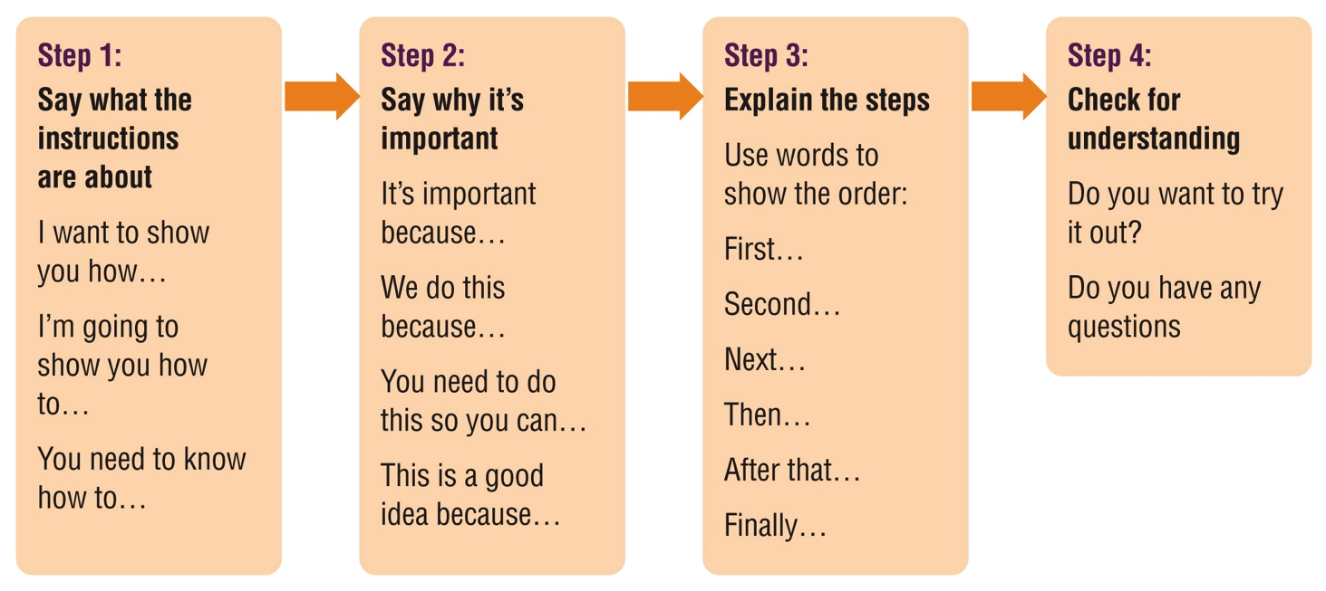
Denise’s story
Identify and practise strategies
Strategies to give clear instructions
Notes:
NOTE: This slide has animations.
Workbook, page 20
Ask learners, “How do you make sure your instructions are clear? How do you organize the information?”
Let learners know that they will discuss steps for clear instructions now.
Click to show the steps one by one. Discuss the language points where applicable.
Activity time: 7 – 10 minutes

Slide 24
Denise’s story
Identify and practise strategies
Strategies to give clear instructions
Tip for giving instructions
When you include important information, say:
Be sure to…
Be careful to…
It’s a good idea to…
Pay attention to…
Notes:
NOTE: This slide has animations.
Workbook, page 20
Ask learners, “What words and expressions do you use to emphasize important information in your instructions?”
Click to show the tip box. Encourage learners to use those words to make their instructions clearer.
Activity time: 3 – 5 minutes

Slide 25
Denise’s story
Identify and practise strategies
Strategies to give clear instructions
Do task 1 on page 21
Do task 2 on page 22 and 23
Do task 3 on page 24 and 25
Do task 4 on page 25
Notes:
NOTE: This slide has animations.
Workbook, page 21 - 25
Task 1 (page 21)
Click to show “Do task 1 on page 21” and let learners know that they will be doing that task.
Ask a learner to read the instructions. Check for understanding.
Discuss vocabulary: troubleshoot
Allow learners 3-5 minutes to complete the task.
When they have completed, share the answers in small groups or as a class.
Task 2 (page 22-23)
Click to show “Do task 2 on page 22” and let learners know that they will be doing that task.
Ask a learner to read the instructions. Check for understanding.
For this task, learners can rewrite all the instructions, or make changes in the box.
Allow learners 5 - 7 minutes to complete the task.
When they have completed, share the answers in small groups or as a class.
Task 3 (page 24-25)
Click to show “Do task 3 on page 24” and let learners know that they will be doing that task.
Ask a learner to read the instructions. Check for understanding.
Discuss vocabulary: activity log
Discuss the structure of the document (Activity log) if learners need to understand it better.
Allow them 5 - 7 minutes to complete the task.
When they have completed, share the answers in small groups or as a class.
Task 4 (page 25)
Click to show “Do task 4 on page 25” and let learners know that they will be doing that task.
Ask a learner to read the instructions. Check for understanding.
Allow learners 5 minutes to complete the task.
When they have completed, ask some learners to share their answers. Discuss if their instructions are clear.
If possible, have them try out following the instructions with each other in pairs.

Slide 26
Denise’s story
Identify and practise strategies
Strategies to prioritize tasks
Prioritizing tasks is important for thriving at work. It makes it easier to collaborate with you. When you prioritize your tasks, you can complete them on time and keep up with the workflow.
Notes:
NOTE: This slide has animations.
Workbook, page 26
Ask learners, “Why is it important to prioritize tasks? How does it help collaborate better?”
Click to show the text.
Activity time: 3 – 5 minutes

Slide 27
Denise’s story
Identify and practise strategies
Strategies to prioritize tasks
Prioritize tasks with close deadlines
Prioritize tasks that involve others
Ask when you aren’t sure
Do difficult tasks when you have more energy
Start big tasks early
Vocabulary
Prioritize tasks: understand which tasks are important and do them first
Notes:
NOTE: This slide has animations.
Workbook, page 26
Ask learners if they remember what “prioritizing tasks” means.
Remind learners that Denise fell behind with her tasks a few times because she has been doing extra tasks.
Ask learners, “What strategies can Denise use to prioritize tasks better?”
Have some of them share their ideas.
Click to show first strategy.
Ask a learner to read to the class the explanation in the workbook for “Prioritize tasks with close deadlines”.
Discuss to reinforce the points for the strategy.
Repeat the process for the other strategies.
At the last strategy, you can have a brief discussion on dividing big tasks into small ones. Let learners know that they can get a refresher on this in Collaboration: Unit 1.
As well, remind learners that prioritizing tasks is a transferable skill. Encourage them to use it in the program, in their job, and in everyday life.
Activity time: 7 – 10 minutes

Slide 28
Denise’s story
Identify and practise strategies
Strategies to prioritize tasks
Do task 1 on page 27
Do task 2 on page 28
Do task 3 on page 29
Reflect
Notes:
NOTE: This slide has animations.
Workbook, page 26 - 28
Task 1 (page 27)
Click to show “Do task 1 on page 27” and let learners know that they will be doing that task.
Ask a learner to read the instructions. Check for understanding.
Allow learners 3-5 minutes to complete the task.
When they have completed, share the answers in small groups or as a class.
Task 2 (page 28)
Click to show “Do task 2 on page 28” and let learners know that they will be doing that task.
Ask a learner to read the instructions. Check for understanding.
Allow learners 5 - 7 minutes to complete the task.
When they have completed, share the answers in small groups or as a class.
Task 3 (page 29)
Click to show “Do task 3 on page 29” and let learners know that they will be doing that task.
Ask a learner to read the instructions. Check for understanding.
Allow them 5 - 7 minutes to complete the task.
When they have completed, share the answers in small groups or as a class.
Reflect (page 29)
Click to show “Reflect”.
Give learners 3 - 5 minutes to reflect on the questions.
Ask some learners to share their answers.

Slide 29
Denise’s story
Apply what you’ve learned
Apply what you’ve learned
Now that you know more about how to collaborate, how would you handle the situations described in your workbook on page 30 and 31?
Notes:
Workbook, page 30-31
Allow the learners 7-10 minutes to complete the quiz. ​
​
Encourage them to use the strategies and tips that they have learned in this unit. ​
​
As the learners are completing the quiz, you can go around and check the answers with them one-on-one. There is no right or wrong answer. However, if the learner chooses an answer that indicates that they are not applying the strategies discussed in the unit, you can ask follow-up or probing questions to identify needs for coaching or other wraparound supports. ​
​
​

Slide 30
What’s next?
What’s next?
Talking about why you want to be promoted
You may want to be promoted because:
You can use your skills more in a higher-level role
You have other skills that could benefit the company, but you don’t get to use them in your current role
You can take on more responsibilities and handle more challenges
Notes:
NOTE: This slide has animations.
Workbook, page 32
Ask learners, “What are some reasons you would like to be promoted?
Click to show the reasons included in the workbook.
Activity time: 3-5 minutes

Slide 31
What’s next?
What’s next?
What’s next?
Talking about why you want to be promoted
Talk about positive things
Don’t talk about how the promotion could help solve personal problems.
Do task 1 on page 32
Do task 2 on page 33
Notes:
NOTE: This slide has animations.
Workbook, page 32 -33
Click to show the bullet points. Let learners know that they should talk about positive things. Encourage them not to talk about how the promotion could help solve personal problems.
Task 1 (page 32)
Click to show “Do task 1 on page 32” and let learners know that they will be doing that task.
Ask a learner to read the instructions. Check for understanding.
Allow learners 3-5 minutes to complete the task.
When they have completed, share the answers in small groups or as a class.
Task 2 (page 33)
Click to show “Do task 2 on page 32” and let learners know that they will be doing that task.
Ask a learner to read the instructions. Check for understanding.
Allow learners 3-5 minutes to complete the task.
When they have completed, share the answers in small groups or as a class.

Slide 32
Self-evaluation
Self-evaluation
How well can you do these activities?
Notes:
NOTE: If you used this self-evaluation at the beginning of the unit, learners can repeat it now to reflect on their skills and see if there was any improvement by comparing their answers from the first self-evaluation to this one.​
​
Remind the learners what self-evaluation is and its purpose.​
Review the layout of the table and provide examples to the learners on how to complete self-evaluation.​
​
Give them time (2-3 minutes) to complete the Self-evaluation 1 (page 34). Show them how to compare answers to the Self-evaluation they did at the beginning of this unit (page 4).

