Slide 1
﻿SKILLS FOR SUCCESS: Collaboration Skills for Success

Slide 2
Collaboration – Introduction
Welcome to this unit on collaboration!
Instructor’s intro
Participants’ intro
Vocabulary
Probationary period: the first three to six months of employment. This is when you learn the job. It gives you and the employer time to decide if the job is a good fit.
Notes:
Let learners know that this lesson is about collaboration during the first few weeks in a new job.
Explain what probationary period means and tell learners that being collaborative can help them pass the probationary period.

Slide 3
Collaboration – Introduction
What is collaboration?
Collaboration is your ability to work well with others so you can fit into the new workplace.
You show that you can collaborate when you work well with your team and other departments, respect the differences among co-workers and want to do more for your team.
Notes:
NOTE: This slide has animations.
Workbook, page 2
Determine prior knowledge by asking learners: “What is collaboration?”
Allow them 2 minutes to brainstorm and share ideas as a class.
Click to show the definition on the slide.
Ask:
- How do you show that you can collaborate?
Allow learners 2 minutes to brainstorm and share ideas as a class.
Click to show the definition on the slide.

Slide 4
Collaboration – Introduction
Learning outcomes
After completing this unit, you will be able to:
Identify when you need to collaborate when you start a new job
Identify the purpose for collaborating
Use strategies to collaborate with others effectively
Notes:
NOTE: This slide has animations.
Workbook, page 2
Let the class know what they will be learning.
Click to show learning outcomes one by one.

Slide 5
Collaborating to pass the probationary
period
Submit your documents on time
Do more than you are asked
Respect differences among co-workers
Set and respect boundaries
Notes:
Workbook, page 3
Ask learners to find in the workbook examples and explanations of how they can collaborate during their probationary period.
Discuss key vocabulary with the class.
Onboarding: when the employer welcomes you and introduces you to the team. This is when you learn how the company works.
Set a boundary: let others know how you would like to be treated so you feel respected and safe. This helps others know what is okay and not okay.
Ask if anyone wants to volunteer to read first example out loud.
Ask learners to explain how they can show collaboration in the first situation. They can use the examples in the workbook, or they can share their own ideas.
Repeat the same steps for each example.
Activity time: 7-10 minutes

Slide 6
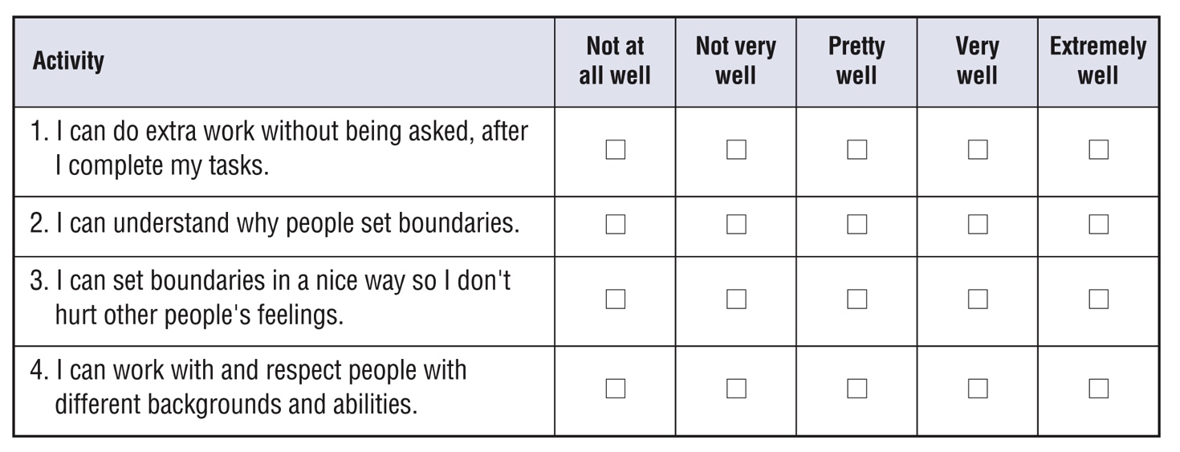
Self-evaluation
Self-evaluation
How well can you do these activities?
This will help your instructor target the lesson material to your needs. That is why you should answer the questions as honestly as you can.
Notes:
Instructor guide, page 3 – scoring information
Instructor guide, page 4 – how to use the self-evaluation
Workbook, pages 4 – Self-evaluation activity for participants
Explain to the learners what self-evaluation is and its purpose.
Explain the layout of the table and provide example to the learners on how to complete self-evaluation.
Allow them 5-7 minutes to complete Self-evaluation 1 (page 4) and Self-evaluation 2 (page 5).

Slide 7
Renee’s story
Jessica’s story
Notes:
Instructor guide, page 4 – Stories
Instructor guide, page 5 – How to use the stories
Instructor guide, page 5 – How to determine the learner’s needs
Workbook, page 5 – Renee’s story
Workbook, page 32 – Jessica’s story
Let the learners know that in this unit, they will read about Renee and/or Jessica. Both started new jobs recently and are trying to fit in and do the job well so they can pass the probationary period. They are sometimes not sure how to collaborate well with others.

Slide 8
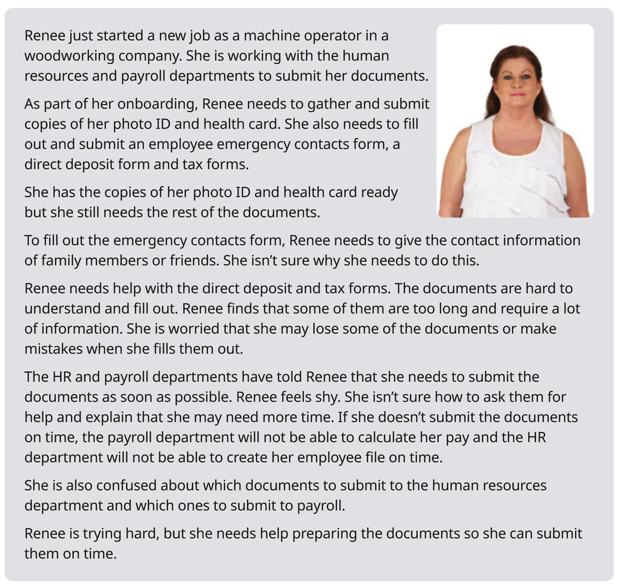
Renee’s story
Notes:
Workbook, page 6 – Renee’s story
Allow learners 3-5 minutes to read Renee’s story on their own.
Note: If some of the learners are struggling with reading, you can offer to read the story out loud or ask for someone to volunteer to read to the class (or group).
Go over key points and vocabulary from the scenario to make sure everyone understood the story.
These are some of the questions you can ask:
Who is this story about?
What is Renee struggling with? / What is hard for Renee to do?
Why is it important for Renee to submit the documents on time? (Use this question to expand the discussion with learners on how collaborating is important when there are a few people and departments involved in the process, and how one person/department not completing tasks on time can affect the work of others)
Vocabulary:
Direct deposit form: a form you fill out with your bank information. It allows employers to send your pay directly to your bank account.
Employee emergency contacts form: a form you fill out with the contact information of two people you know, such as family members or friends. Your employer contacts them if you are in an emergency.
Check with the learners if there are any other words they found confusing or they did not understand. Discuss/explain them as a class.
Activity time (for vocabulary and questions): 5 minutes

Slide 9
Renee’s story
When to collaborate? Identify areas
In the workplace, you are usually part of one department and work closely with your team. However, you also collaborate with other departments.
The most common departments that you collaborate with outside your department are human resources and payroll.
Notes:
Workbook, page 6
Ask:
Why do you need to collaborate with HR and payroll departments?
Allow a few minutes for class discussion.
Ask learners to read information in the workbook, on page 6.
Give learners time to read on their own or ask a few volunteers to read it out loud.
Ask:
When do you collaborate with HR?
When do you collaborate with payroll?
When do you collaborate with friends and family?
Learners can find the answers in the workbook.

Slide 10
Renee’s story
When to collaborate? Identify areas
Renee has to submit documents to HR and payroll departments in her company. She is not sure how to prepare and submit the documents. She needs help.
Do task 1 on page 7
Do task 2 on page 8 and 9
Reflect
Notes:
Workbook, pages 6-9
Read the information on slide.
Elicit prior knowledge and check understanding of Renee’s story by asking learners:
What type of documents does Renee need to submit to HR and payroll departments?
What does Renee need help with?
What is Renee confused about?
Remind them that they can refer back to the story to find information there.
Task 1: (page 7)
Explain what the task is and ask learners to repeat what they need to do.
Give them 2-3 minutes to complete the task
Check the answers together in class
Task 2: (page 8-9)
Ask learners to work in pairs to complete task 2.
Ask learners to read the instructions and then ask someone to explain what they should do.
Check the answers together in class
Reflect: (page 9)
Ask learners to think about their own experience. How is it similar or different from Renee’s?
Ask learners to answer the reflection questions on page 9.
Learners can share their answers in pairs or small groups.

Slide 11
Renee’s story
What does collaboration look like?
Identify actions
What could Renee do to collaborate with HR and payroll?
Do the task on page 10
Reflect
Notes:
Workbook, page 10
Task
Ask a learner to read the instructions for the task. Then ask the learners what they need to do, to check if they understood the instructions. Allow the learners 2-3 minutes to complete the task. Ask them to share their answers in pairs or as a class.
Reflect
Ask learners to think about the future and to answer reflection questions:
What documents can you prepare beforehand so you can submit them to HR or payroll on time?
Who can you ask to be your emergency contacts?
Learners can share their answers in pairs/small groups.

Slide 12
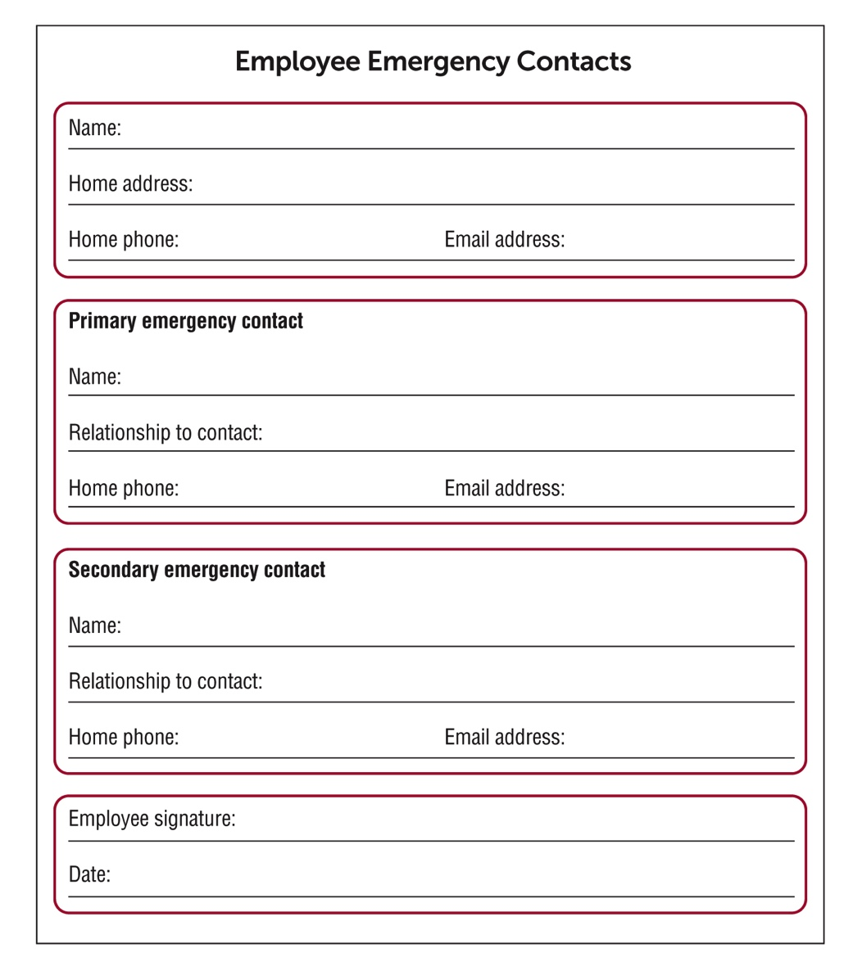
Renee’s story
Practise filling out an emergency contacts form
Do the task on page 12
Notes:
Workbook, page 11 and 12
Discuss with learners the parts of an emergency form and what type of information needs to put in each section.
Ask learners to read information on page 12 in their workbooks.
Task:
Read the scenario or ask a volunteer to read it out loud.
Discuss with the class what type of information they need to look for in the scenario. Talk about key words they need to look for: primary, secondary, employee, relationship, etc.
Ask learners to work in small groups or pairs to complete this task.
Go around the class to monitor the progress and offer help when/if needed.

Slide 13
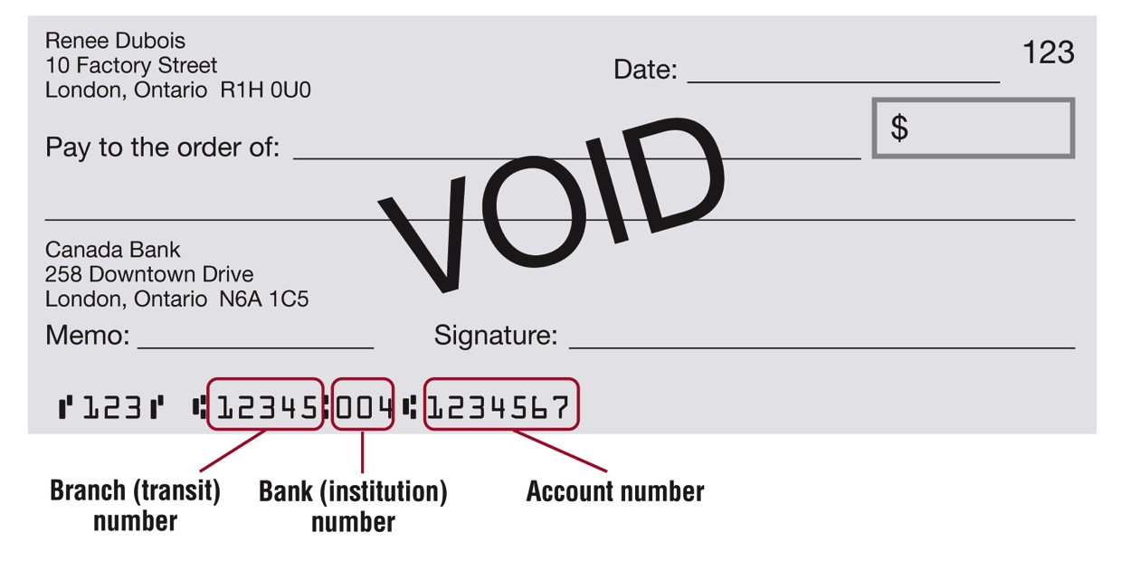
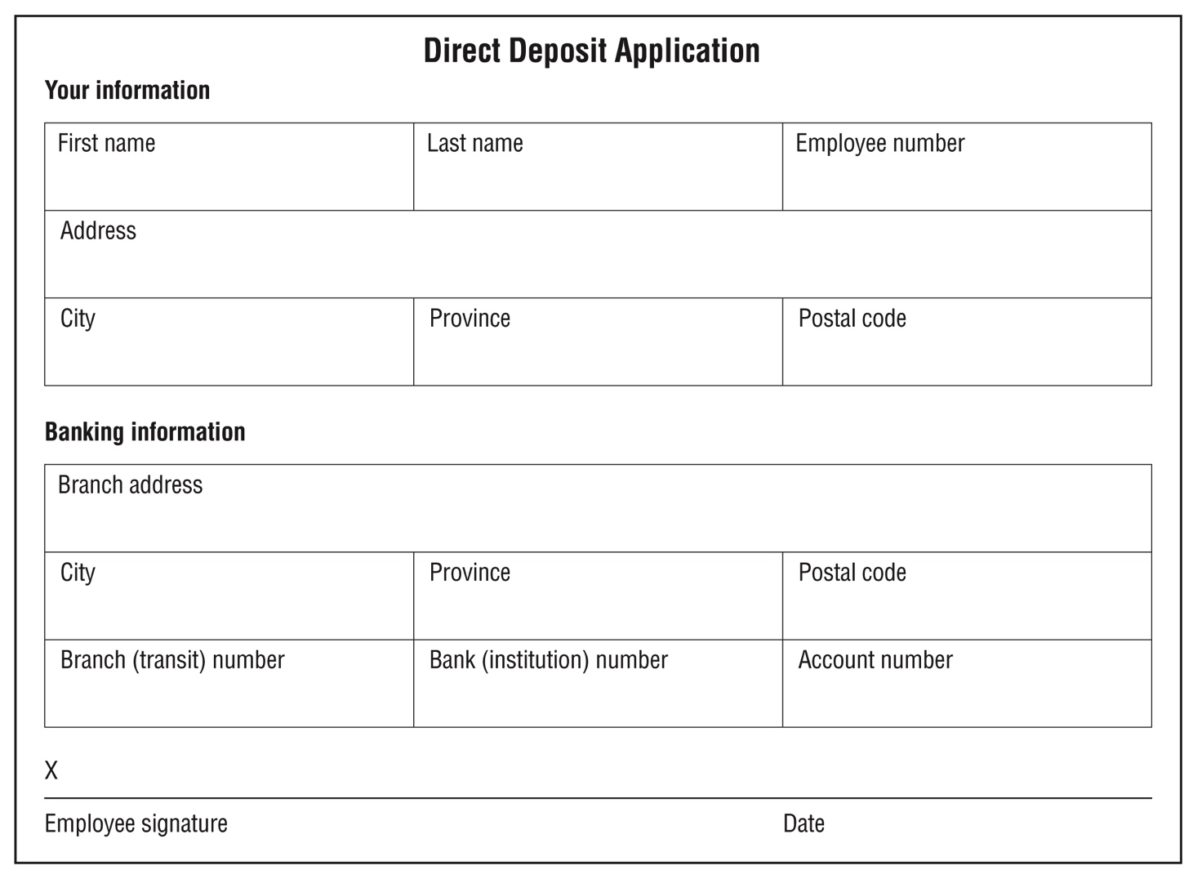
Renee’s story
Practise filling out direct deposit forms
Do the task on page 14
Notes:
Workbook, page 13 and 14
Ask learners if they know what a void cheque is and what it is used for.
Ask learners if they know what direct deposit is and if they have ever applied for one.
Ask learners to read information on page 14 in their workbooks.
After they have read the information point out to different parts of the void cheque on the slide and discuss what type of information is displayed.
Analyse the direct deposit application in the same way, point out to different parts and ask learners to identify what type of information needs to be entered/written. Once they identify the type of information, they need write on the application form, ask them where they can locate that information.
Task:
Ask learners to read the instructions and to fill out the direct deposit application form using the information provided in their workbooks.
Go around the class to check on the progress. Offer help when/if needed.

Slide 14
Renee’s story
Why collaborate? Identify the purpose
When you start a new job, collaborating can help you in many ways.
It can help you prepare and submit your documents on time.
When you collaborate with your friends and family members, you will be able to provide emergency contacts to your employer.
When you collaborate with HR and payroll departments, they will be able to create your employee file and calculate your pay so you get it on time.
It can be hard to collaborate when you are confused or overwhelmed because you have a lot of documents to submit. If you keep in mind how you could benefit from collaborating, you can stay motivated and keep going.
Notes:
NOTE: This slide has animations.
Workbook, page 15
Ask:
Is it easy or difficult for you to collaborate with others?
When is it hard to collaborate?
How does collaboration help?
Ask a few learners to share their answers.
Click to show the first paragraph. Read out loud from the slide to the class. Ask them if they agree and if they have another example to share.
Repeat the same steps for all 4 paragraphs.
Activity time: 10 minutes

Slide 15
Renee’s story
Why collaborate? Identify the purpose
Why should Renee collaborate?
Do the task on page 15 and 16
Reflect
Notes:
NOTE: This slide had animations.
Workbook, pages 15 and 16
Discuss with the class why Renee needs to collaborate.
Task (page 15-16)
Click to show instruction.
Ask a learner to read the instructions for the task. Then ask the learners what they need to do, to check if they understood the instructions. Point out the first sentence that has been done as an example. Or give the learners 1 minute to read it to themselves.
Allow them 5 minutes to complete the task.
When the learners complete the task, ask them to share their ideas as a class or in pairs.
Reflect (page 16)
Click to show instruction.
Allow the learners 5 minutes to think of answers to the reflection questions on page 18. Then ask them to work in pairs and discuss their answers.
They can use space in the workbook to write down their answers/ideas.

Slide 16
Renee’s story
Identify and practise strategies
How can you collaborate effectively?
Identify and practise strategies
When you start a new job, collaboration is one of the most important skills to use. You will need to prepare and submit a lot of documents on time. You may need to ask for help if you have trouble understanding and filling out a form. You may also have to negotiate a later deadline.
It’s a lot to handle, and you may feel confused or overwhelmed but there are many strategies that can help you. Why not use them and see what happens!
Reflect
Notes:
Workbook, page 17
Read the text in the blue text box.
Ask learners to think about Renee’s story and the challenges she is facing.
They can refer back to the story on page 6.
Reflect
Allow the learners 5 minutes to reflect on the questions.
Ask the learners to share their thoughts as a class or in pairs.

Slide 17
Renee’s story
Identify and practise strategies
How can you collaborate effectively?
Identify and practise strategies
There are many strategies that can help you collaborate more easily.
Strategies to prepare and submit documents on time
Strategies to communicate with HR and payroll departments
Notes:
NOTE: This slide has animations.
Workbook, pages 17-31
Strategies to prepare and submit documents on time (page 18)
Strategies to communicate with HR and payroll departments (page 22)
Say:
There are many strategies that can help you collaborate more easily. You can choose the ones that work for you. Experts recommend you use different types of strategies.
Say:
These are the strategies we will explore and practise in this section:
Click to show the first set: Strategies to prepare and submit documents on time
Click to show the second set: Strategies to communicate with HR and payroll departments

Slide 18
Renee’s story
Identify and practise strategies
Strategies to prepare and submit documents on time
Make a list of documents
Get more than one copy
Keep documents organized
Keep documents neat and clean
Submit documents in the right way
Submit documents as soon as possible
Do task 1 on page 19
Notes:
NOTE: This slide has animations.
Workbook, pages 18 and 19
Ask:
- What are the strategies Renee can use to prepare and submit her documents on time?
Allow learners to share their ideas.
Say:
- Open the workbooks on page 18.
Click to show first strategy.
Ask a learner to read to the class the explanation in the workbook for “make a list of documents”.
Repeat the process for the other strategies.
Task 1 (page 19)
Explain the task to learners.
Ask the learners where they can find the information they need to make the list (in Renee’s story on page 6)
Give learners 3-5 minutes to complete the task.
Check the answers with the class.

Slide 19
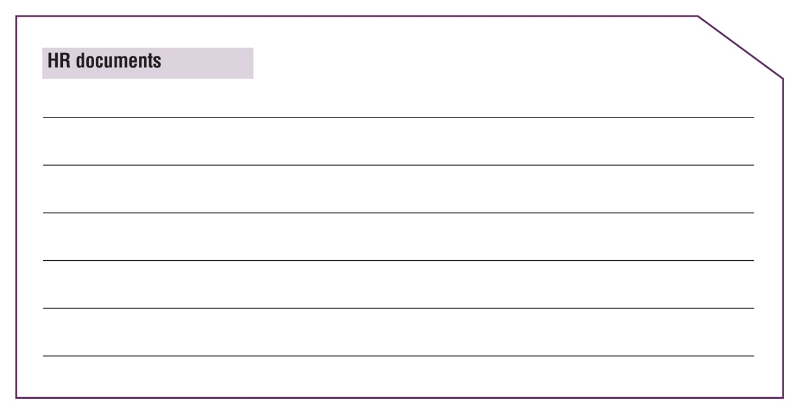
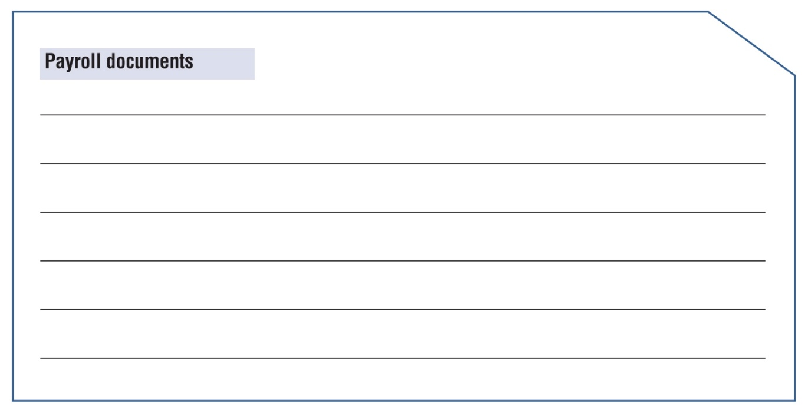
Renee’s story
Identify and practise strategies
Strategies to prepare and submit documents on time
Help Renee sort the documents she needs to submit
Do task 2 on page 20
Reflect
Notes:
Workbook, pages 20 and 21
Task 2 (page 20)
Explain the task to learners.
Ask a learner to repeat back what they need to do. Check with the learners they understand where to find the information about documents that need to be sorted (in the story on page 5 and/or the list they created in Task 1 on page 19)
Give learners 3-5 minutes to complete the task.
Check the answers with the class.
Reflect
Ask learners to think about the past when they had to submit some documents.
Ask them to answer the reflection questions
Ask learners to discuss their answers in pairs or small groups
Ask learners to think about the future.
Ask:
- What strategies will you use to prepare and submit your documents on time?
Ask learners to discuss their answers in pairs or small groups

Slide 20
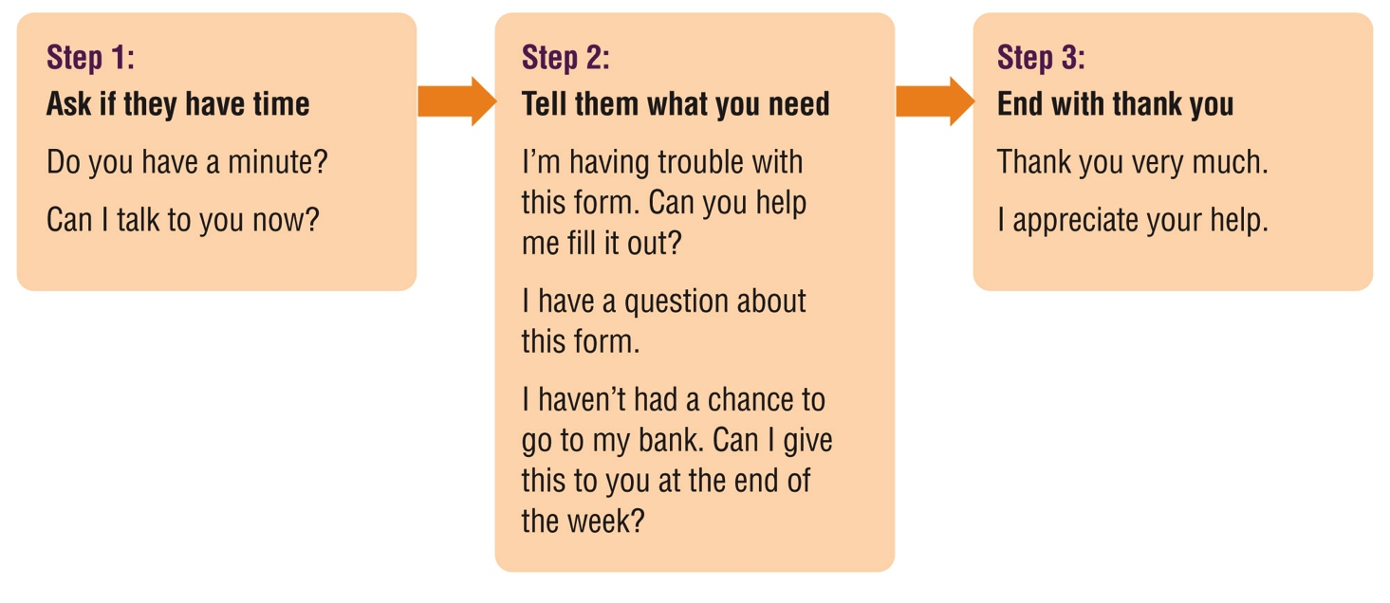
Renee’s story
Identify and practise strategies
Strategies to communicate with HR and payroll departments
Do the task on page 23
Reflect
Notes:
Workbook, page 22 and 23
Read the strategies from the slide.
Ask learners:
Why are these strategies presented in this way?
How do we call this way of presenting information?
NOTE: If learners completed Collaboration Unit 1 where the flow charts were discussed this can be used as a revision activity.
Follow up with an explanation of what a flow chart is: A flow chart is a graphical/visual representation of sequence of movements or actions or steps.
Say:
- Flow charts are often used in the workplace when there is a process that needs to be explained or series of steps/actions that need to be taken in certain order.
Task (page 23)
Ask a learner to read the instructions.
Do question #1 together with the whole class.
Ask learners to answer other questions. They can work in pairs or small groups.
Check the answers with the class.
Reflect (page 23)
Ask learners to think about the past when they had to submit some documents.
Ask them to answer the reflection questions.
Ask learners to discuss their answers in pairs or small groups.
Ask learners to think about the future.
Ask:
- What strategies will you use to communicate with HR or payroll?
Ask learners to discuss their answers in pairs or small groups.

Slide 21
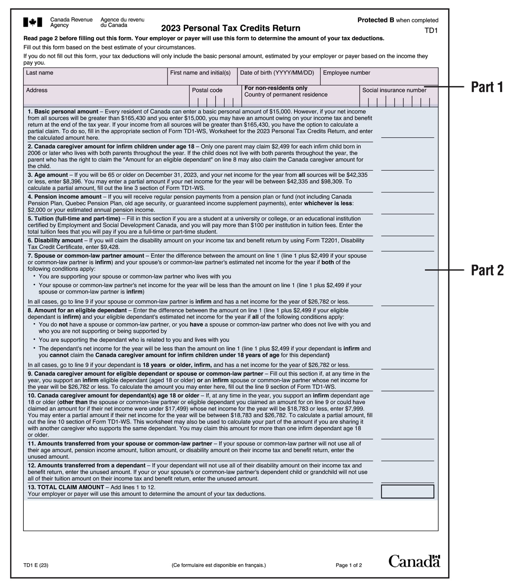
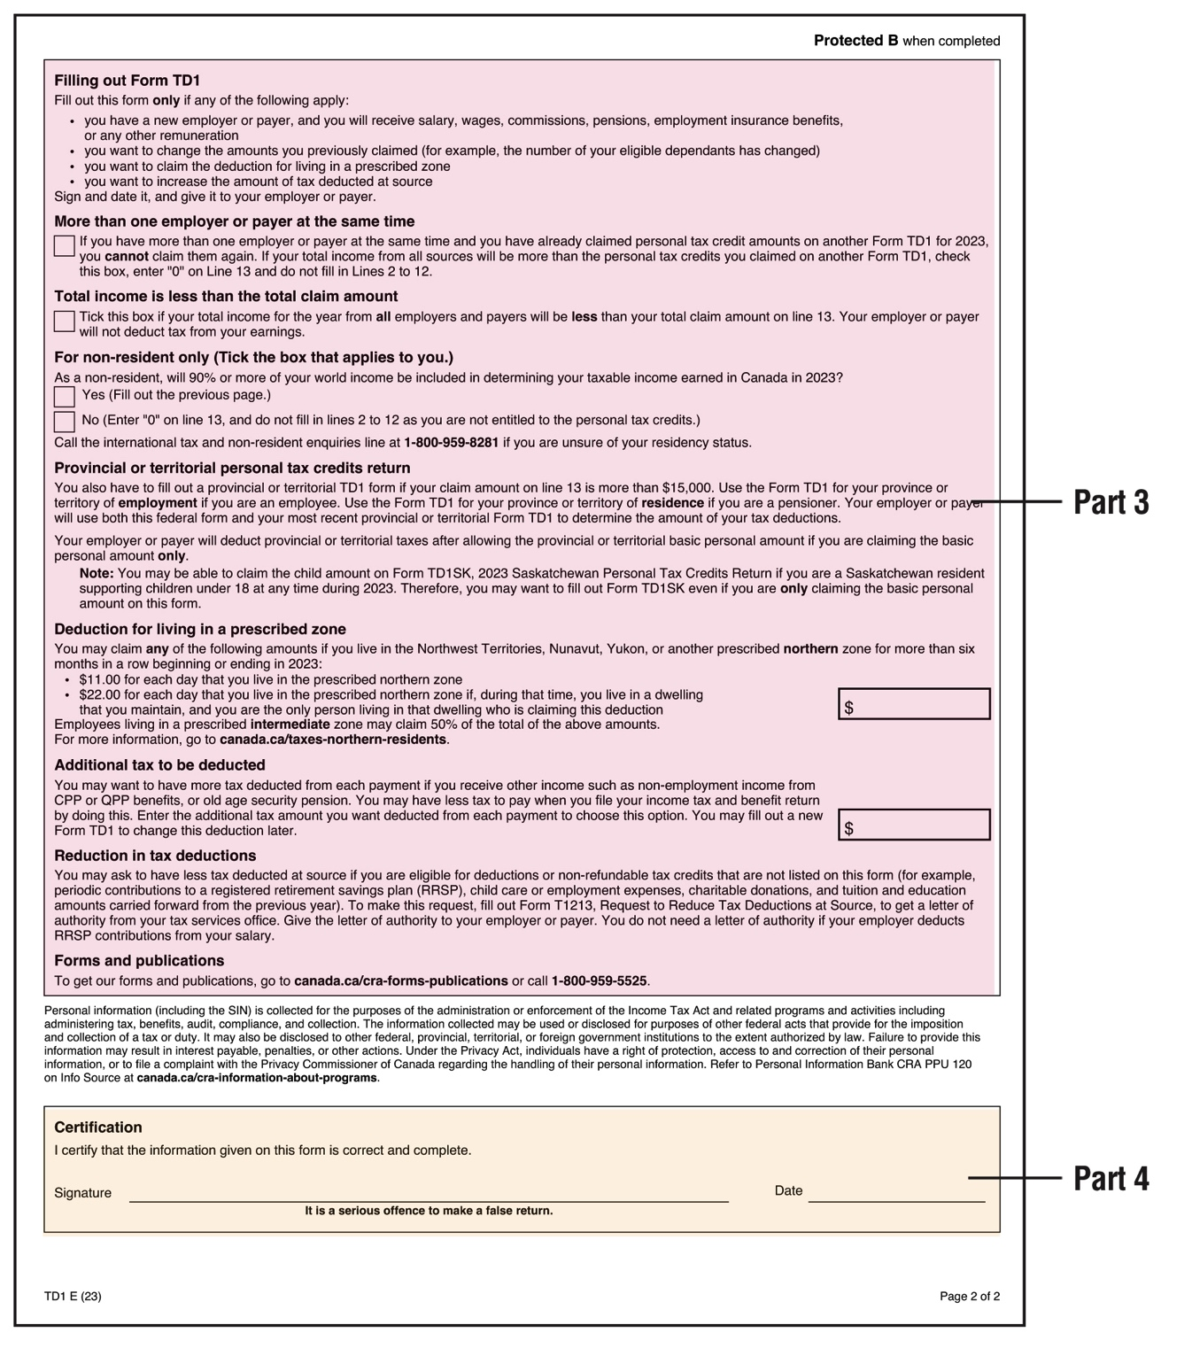
Renee’s story
Identify and practise strategies
Practise filling out personal tax credits returns
Notes:
Workbook, page 24 and 25
Ask learners to follow in their workbooks as you analyse together the tax form.
There is a form sample in the workbook on pages 29 and 30.
Explain and show on the slide the 4 key parts of the form:
Part one - personal information
Part two – additional personal information
Part three – employment information
Part four - confirmation
Part one:
Ask learners to read the information on page 24.
Ask learners to identify the parts mentioned in part one (page 26) on the form sample (page 29)

Slide 22
Renee’s story
Identify and practise strategies
Practise filling out personal tax credits returns
Part 1
There is not much space for your last name, first name, initials and address. Write small.
For your date of birth, follow the format on the form: YYYY / MM / DD
For postal code and social insurance number, there is a separate space for each number. Write one number or letter in each space.
Notes:
Workbook, page 29
Part one:
Ask learners to read the information on page 26.
Ask learners to identify the parts mentioned in part one (page 26) on the form sample (page 29).
Discuss the ways the dates can/should be written.
YYYY/MM/DD vs DD/MM/YYYY
Ask learners to practise writing their own birthday using different formats.
Discuss the vocabulary:
Initials: the first letters of your first and last names
Resident: someone who lives in Canada
Non-resident: someone who doesn’t live in Canada

Slide 23
Renee’s story
Identify and practise strategies
Practise filling out personal tax credits returns
Part 1
Task 1
Fill out part one with Renee’s information.
Renee’s full name is Renee Dubois. She lives at 10 Factory Street, London, Ontario. Her postal code is R1H 0U0.
She was born on January 3, 1986. Her employee number is 98765. Her social insurance number is 123 456 789.
Notes:
Workbook, page 26
Task 1
Use the slide to:
Work together with the class to identify the type of information in the mini scenario that needs to be entered into a tax form
Work together with the class to identify the fields on the form where the information should be written
Ask learners to use the form sample on page 30 and fill out part 1 with Renee’s information.

Slide 24
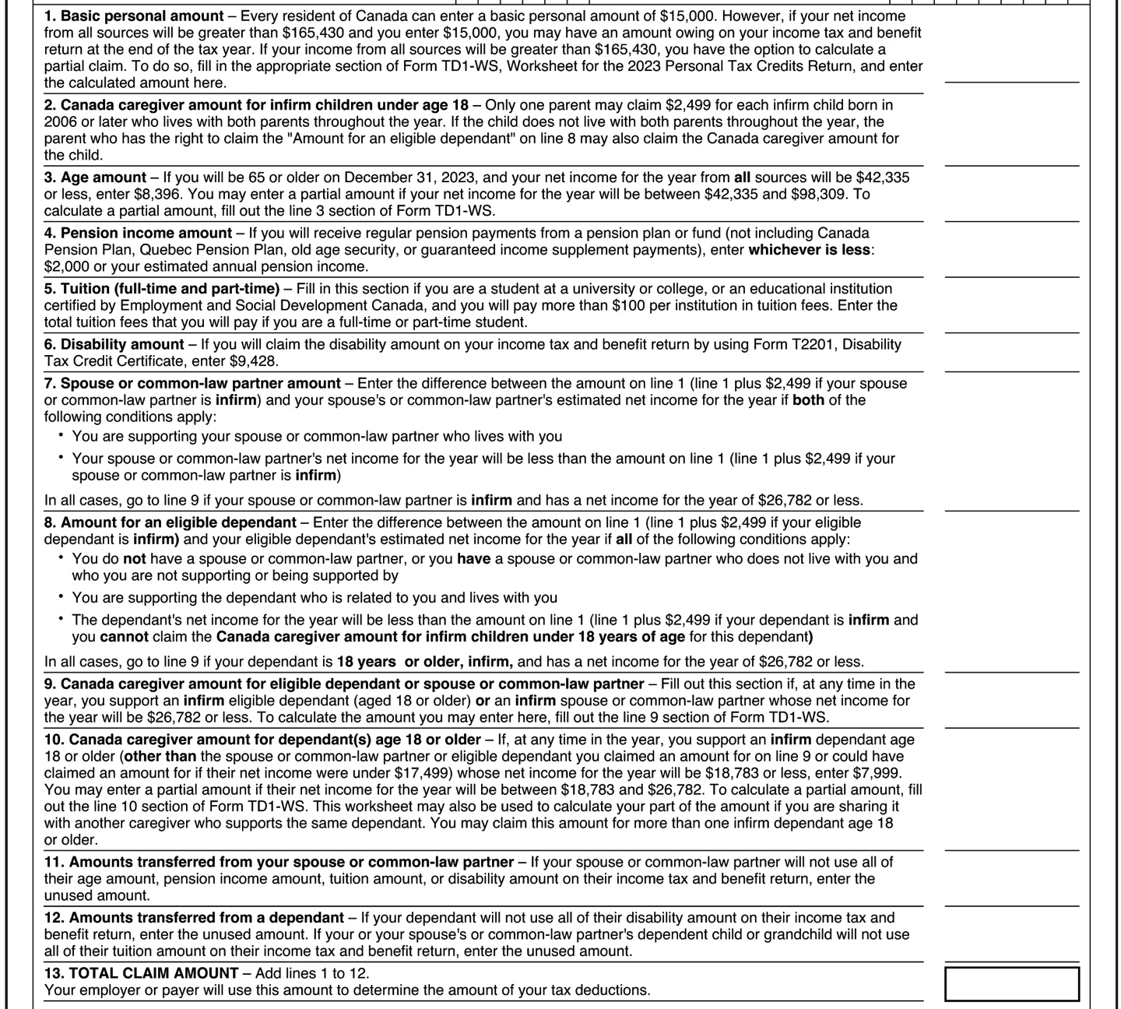
Renee’s story
Identify and practise strategies
Practise filling out personal tax credits returns
Part 2
This part has 13 sections. The sections have numbers from 1 to 13.
Everyone must fill out sections 1 and 13.
Sections 2 to 12 may or may not apply to you.
The sections start with words in bold. Use these words to ask yourself questions. This will help you decide if the section applies to you. For example, for section 4, you can ask: Do I get pension income?
Do task 2 on page 27
Notes:
Workbook, page 27
Part two:
Ask learners to read the information on page 27.
Ask learners to identify the parts mentioned in part one (page 26) on the form sample (page 29).
Discuss the vocabulary:
N/A: doesn’t apply, not applicable
Amount: how much money
Infirm: with disability
Tuition: money you pay for college or other education
Eligible dependant: for taxes, this is a family member such as a child or grandparent that you need to support financially
Task 2
Use the slide to:
Work together with the class to identify the type of information in the mini scenario (on page 27) that needs to be entered into a tax form
Work together with the class to identify the fields on the form where the information should be written; use the strategy of asking questions that is explained in the workbook and on the slide
Ask learners to use the sample form on page 29 and fill out part 2 with Renee’s information.

Slide 25
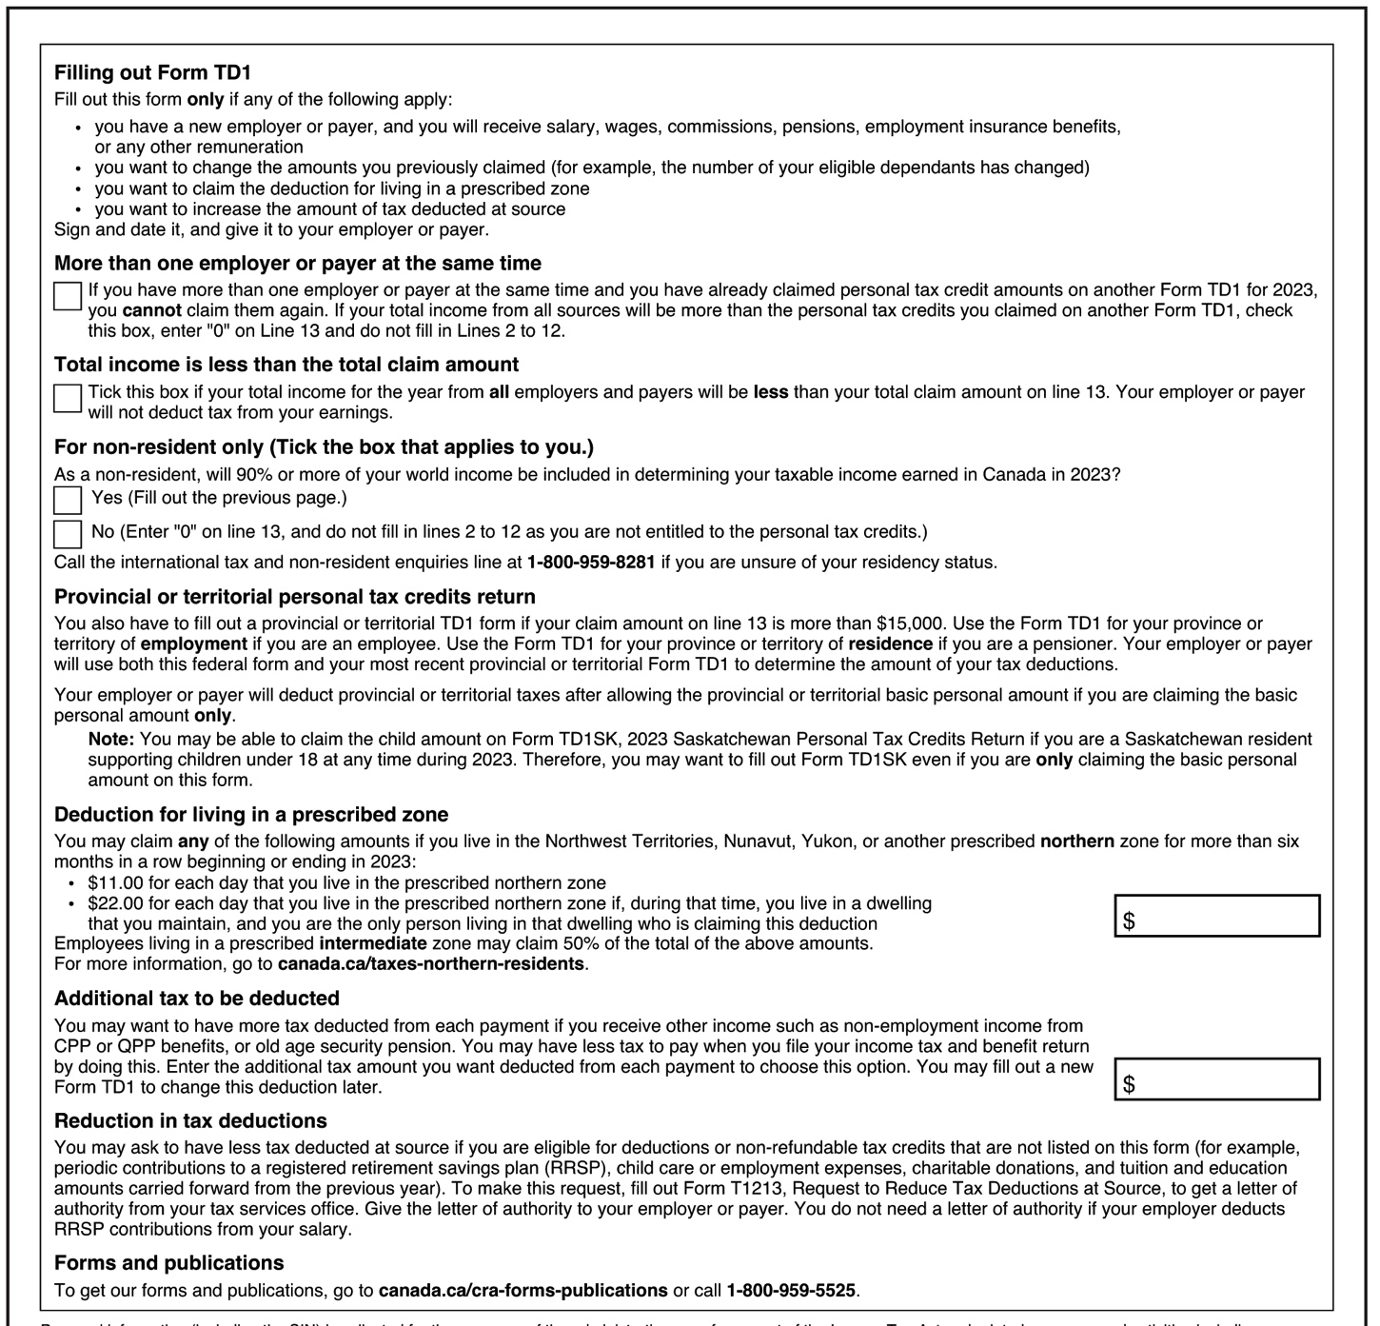
Renee’s story
Identify and practise strategies
Practise filling out personal tax credits returns
Part 3
This part has subheadings in bold. Use them to ask yourself questions.
This will help you decide if the section applies to you. For example, you can ask: Do I have more than one employer or payer at the same time?
Do task 3 on page 28
Notes:
Workbook, page 28
Discuss the vocabulary:
Additional: extra
Deduct: take out of your income
Part three:
Ask learners to read the information on page 28.
Ask learners to identify the parts mentioned in part one (page 29) on the form sample (page 30).
Task 3
Use the slide to:
Work together with the class to identify the type of information in the mini scenario (on page 28) that needs to be entered into a tax form
Work together with the class to identify the fields on the form where the information should be written; use the strategy of asking questions that is explained in the workbook and on the slide
Ask learners to use the sample form on page 30 and fill out part 2 with Renee’s information.

Slide 26
Renee’s story
Identify and practise strategies
Practise filling out personal tax credits returns
Part 4
This part asks you to confirm that you have given the right information.
Sign on the line beside “Signature” to confirm.
Put the date you fill out the form on the line beside “Date.”
Do task 4 on page 28
Notes:
Workbook, page 28
Part four:
Ask learners to read the information on page 28.
Ask learners to identify the areas on the form sample (page 30) where the signature is put and where the date needs to be written.
Task 4
Ask learners to sign the form for Renee using the form template.
Ask learners to put today’s date on the form.

Slide 27
Renee’s story
Apply what you’ve learned
Apply what you’ve learned
Now that you know more about how to collaborate, how would you handle the situations described in your workbook on page 31?
Notes:
Workbook, page 31
Allow learners 7-10 minutes to complete the quiz.
Encourage them to practise the strategies and tips that they have learned in this unit.
As the learners are completing the quiz, you can go around and check the answers with them one-on-one. There is no right or wrong answer. However, if the learner chooses an answer that indicates that they are not applying the strategies discussed in the unit, you can ask probing questions to identify needs for coaching or other wraparound supports.

Slide 28
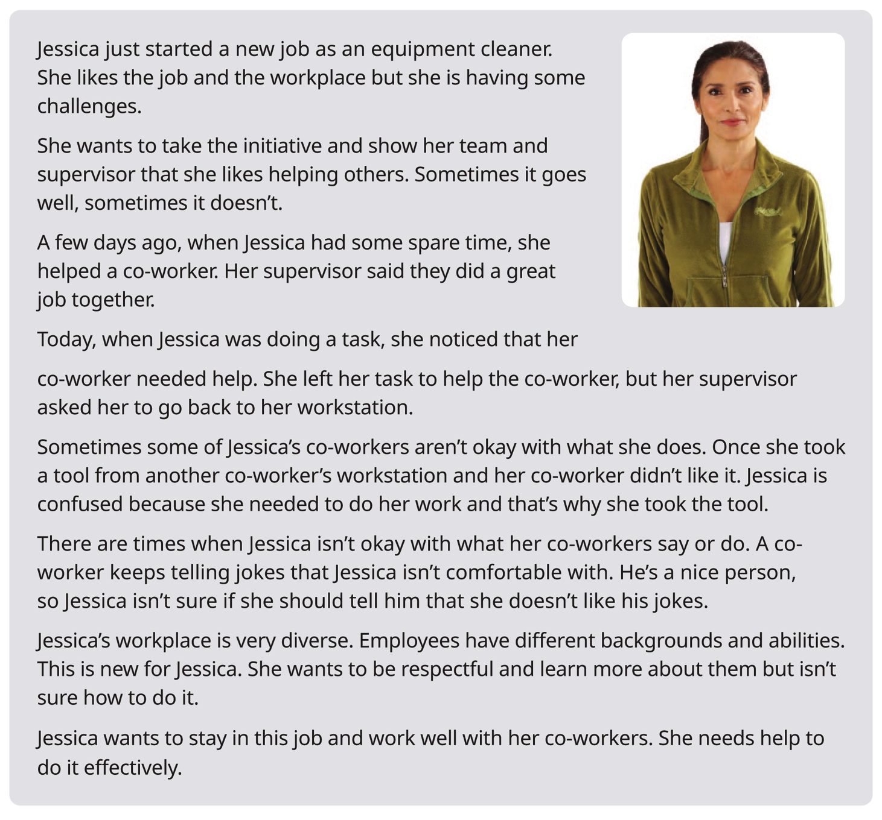
Jessica’s story
Notes:
Workbook, page 32
Jessica’s story
Give learners 3-5 minutes to read Jessica’s story or ask a learner to read it out.
Note: If some of the learners are struggling with reading, you can offer to read the story out loud or ask for someone to volunteer to read to the class (or group).
Go over key points and vocabulary from the scenario to make sure everyone understood the story.
Discuss the vocabulary:
Diverse: with people of different cultures, races, religions, abilities, ages, genders, and sexual orientations
Take the initiative: to do more than is expected of you
Check to see if there are any other words the learners find confusing
Ask:
Who is this story about?
What are some challenges Jessica faces in her new workplace?
Why does Jessica want to show initiative?
What else does Jessica want?
Inform the learners that the next set of activities will focus on Jessica’s story.

Slide 29
Jessica’s story
When to collaborate? Identify areas
Jessica wants to do well in her job. She wants to learn how to work with her co-workers effectively.
What areas should Jessica work on to improve her ability to collaborate?
Do the task on page 33
Reflect
Notes:
Workbook, page 33
Task
Ask a learner to read the instructions for the task. Then ask the learners what they need to do, to check if they understood the instructions.
Allow them 3-5 minutes to complete the task.
Ask learners to share their answers in pairs or as a class.
Reflect (page 34)
Ask learners to think about the past when they worked or had a volunteer position.
Ask them to think about how Jessica’s experience is similar or different from theirs and to answer the reflection questions.
Ask learners to discuss their answers in pairs or small groups.
Ask learners to think about the future.
Ask:
What are three areas you may need to work on to collaborate better?
Ask learners to discuss their answers in pairs or small groups.

Slide 30
Jessica’s story
What does collaborating look like?
Identify actions
What could Jessica do to collaborate better?
Do the task on page 35
Reflect
Notes:
Workbook, page 35
Task
Ask learners to read the instructions for the task. Then ask them what they need to do, to check if they understood the instructions. Allow them 2-3 minutes to complete the task.
Ask the learners to share their answers in pairs or as a class.
Reflect
Ask the learners to think about their past experience first and answer the reflection question.
Then ask them to think about the future and to answer the second reflection question.

Slide 31
Jessica’s story
Why collaborate? Identify the purpose
When you start a new job, collaborating can help you in many ways.
It can help you do more for your team, understand the differences between you and your co-workers, and help them understand you.
When you do more for your team, you show that you want to achieve better results together. When you understand the differences between you and your co-workers, you show respect.
It can be hard to collaborate when you are confused or overwhelmed. If you keep in mind how you could benefit from collaborating, you can stay motivated and keep going.
Notes:
NOTE: This slide has animations.
Workbook, page 36
Ask:
Is it easy or difficult for you to work well with others?
- How can collaborating with others help you in this program? How can collaborating help you at work?
Ask a few learners to share their answers.
Click to show the first paragraph. Read out loud from the slide to the class. Ask them if they agree and if they have another example to share.
Repeat the same steps for all 4 paragraphs.
Activity time: 10 minutes

Slide 32
Jessica’s story
Why collaborate? Identify the purpose
Why should Jessica collaborate?
Do the task on page 36
Reflect
Notes:
NOTE: This slide has animations.
Workbook, page 36-37
Elicit ideas from learners about why they think Jessica should collaborate, then ask them to do the task on pages 36-37.
Task (pages 36-37)
Have a learner read the instructions and the first sentence that has been done as an example. Or allow the learners 1 minute to read it to themselves.
Ask the learners to repeat what they need to do, to check if they understood the instructions. Allow them 5 minutes to complete the task. When the learners complete the task, ask them to share their ideas as a class or in pairs.
Reflect (page 37)
Allow the learners 5 minutes to reflect on the questions. They can use the space to write their answers/ideas.
When they complete, ask them to share their answers in pairs or as a class.

Slide 33
Jessica’s story
Identify and practise strategies
How can you collaborate effectively?
Identify and practise strategies
When you start a new job, collaboration is one of the most important skills to use. You will need to take the initiative, set boundaries and respect co-workers’ boundaries.
You will also need to learn about and respect differences among your co-workers.
It’s a lot to handle. You may feel confused or overwhelmed but there are many strategies that can help you. Why not use them and see what happens!
Reflect
Notes:
Workbook, page 38
Let the learners know you will be discussing some strategies for better collaboration.
Ask the learners:
What does “strategy” mean?
Note: if the learners have learned about strategies in previous units or scenarios, you can use this as an opportunity to review.
Reflect
Allow the learners 5 minutes to reflect on the questions.
Let the learners know they can refer back to the story (on page 32) if they cannot remember Jessica’s challenges.
They can use the space in the workbook to write their ideas.
Ask them to share their answers/ideas in pairs or as a class.

Slide 34
Jessica’s story
Identify and practise strategies
How can you collaborate effectively?
Identify and practise strategies
There are many strategies that can help you collaborate more easily.
Strategies to take the initiative
Strategies to set and respect boundaries
Strategies to work in a diverse and inclusive workplace
Notes:
NOTE: This slide has animations.
Workbook, pages 38-49
Strategies to take the initiative (page 39)
Strategies to set and respect boundaries (page 42)
Strategies to work in a diverse and inclusive workplace (page 46)
Say:
There are many strategies that can help you collaborate more easily. You can choose the ones that work for you. Experts recommend you use different types of strategies.
Say:
These are the strategies we will explore and practise in this section:
Click to show the first set: Strategies to take the initiative
Click to show the second set: Strategies to set and respect boundaries
Click to show the third set: Strategies to work in a diverse and inclusive workplace

Slide 35
Jessica’s story
Identify and practise strategies
Strategies to take the initiative
Learn what taking the initiative means
Know what taking the initiative looks like
Learn when to take the initiative
Do the task on page 40
Reflect
Notes:
NOTE: This slide has animations.
Workbook, pages 39-41
Ask:
- What are the strategies Jessica can use to know when to take the initiative?
Allow learners to share their ideas.
Say:
- Open the workbooks on page 39.
Read the information in the pink box out loud to the class.
Vocabulary:
Self-starter: a worker who takes the initiative
Workflow: the order of steps to complete a task
Click to show first strategy.
Ask a learner to read to the class the explanation in the workbook for “learn what taking initiative means”.
Repeat the process for the other strategies.
Task (pages 40)
Explain the task to learners.
Ask the learners to repeat back the steps to make sure they understood.
Give learners 5-6 minutes to complete the task.
Check the answers with the class.
Reflect (page 41)
Ask learners to think about their own experience from the past.
Ask them to answer the first two reflection questions.
Learners can work and share in small groups or pairs.
Ask learners to think about the future and to answer the other two reflection questions.
Learners can work and share in small groups or pairs.

Slide 36
Jessica’s story
Identify and practise strategies
Strategies to set and respect boundaries
Learn when to set boundaries
Understand why you need to set boundaries
Communicate your boundaries
Don’t feel guilty
Respect others’ boundaries
Do the task on pages 44 and 45
Reflect
Notes:
NOTE: This slide has animations.
Workbook, pages 42-44
Ask:
- What are the strategies Jessica can use to set and respect boundaries?
Allow learners to share their ideas.
Say:
- Open the workbooks on page 42.
Read the information in the pink box out loud to the class.
Vocabulary:
Set a boundary: let others know how you would like to be treated so you feel respected and safe. This helps others know what is okay and not okay.
Click to show first strategy.
Ask a learner to read to the class the explanation in the workbook for “learn what taking initiative means”.
Repeat the process for the other strategies.
Task (page 44)
Explain the task to learners.
Do the first example together with the whole class.
Give learners 5-6 minutes to complete the task.
Check the answers with the class.
Reflect (page 45)
Ask learners to think about their own experience.
Ask them to answer the reflection questions.
Learners can work and share in small groups or pairs.

Slide 37
Jessica’s story
Identify and practise strategies
Strategies to work in a diverse and inclusive workplace
Learn the difference between intent and impact
Show interest
Ask to understand
Apologize
Understand other people’s intent
Help co-workers learn about you
Do the task on pages 48 and 49
Notes:
NOTE: This slide has animations.
Workbook, pages 46-49
Ask:
- What are the strategies Jessica can use to work in a diverse and inclusive workplace?
Allow learners to share their ideas.
Say:
- Open the workbooks on page 46.
Read the information in the pink box out loud to the class.
Vocabulary:
Inclusive: welcoming and respecting people of different cultures, races, religions, abilities, ages, genders, and sexual orientations
Click to show first strategy.
Ask a learner to read to the class the explanation in the workbook for “learn what taking initiative means”.
Repeat the process for the other strategies.
Task (pages 48-49)
Explain the task to learners.
Do the first example together with the whole class.
Give learners 5-6 minutes to complete the task.
Check the answers with the class.

Slide 38
Jessica’s story
Apply what you’ve learned
Apply what you’ve learned
Now that you know more about how to collaborate, how would you handle the situations described in your workbook on page 50?
Notes:
Workbook, page 50
Allow the learners 7-10 minutes to complete the quiz.
Encourage them to practise the strategies and tips that they have learned in this unit.
As the learners are completing the quiz, you can go around and check the answers with them one-on-one. There is no right or wrong answer. However, if the learner chooses an answer that indicates that they are not applying the strategies discussed in the unit, you can ask follow up or probing questions to identify needs for coaching or other wraparound supports.

Slide 39
What’s next?
What’s next?
Qualifying for health benefits
When you pass your probationary period, most likely you will become a permanent employee.
In many companies this means that you will qualify for health benefits. When you qualify for health benefits, the employer and you share the cost of your health expenses.
Notes:
Workbook, pages 51
Read the information on the slide out loud to the class.
Ask learners to open their workbooks on page 51 and ask them to read the rest of the information.
Ask questions to check for understanding:
What usually happens when you pass your probationary period?
Who shares the cost of the health expenses?
How do you pay for your portion of the health benefits?
Who can you add to your benefits plan?
Who will tell you about the benefits the company offers?

Slide 40
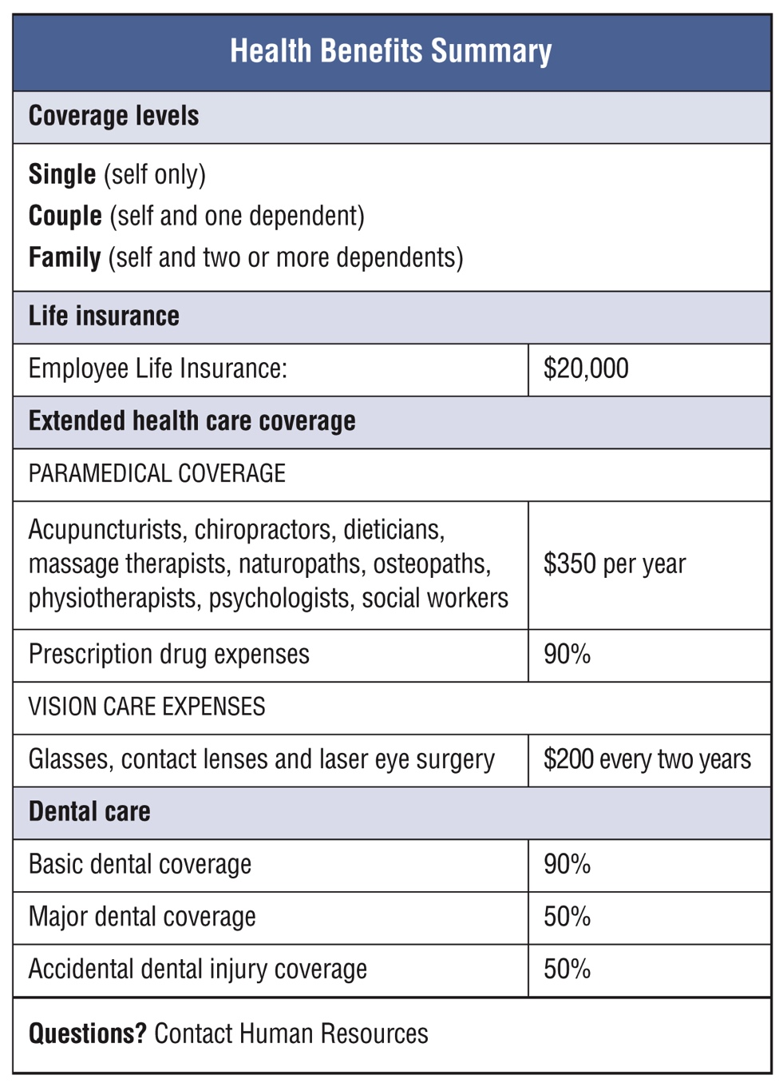
What’s next?
Practise reading a health benefits summary
Vocabulary
Coverage
Coverage level
Dependents
Life insurance
Extended health care
Paramedical coverage
Dental care
Basic dental coverage
Major dental coverage
Do the task on page 53
Notes:
Workbook, pages 53
Ask learners to locate the vocabulary words on the Health Benefits Summary form in their workbooks.
You can also use the slide to point to the words in question.
Go over the explanation for each word with the learners.
You can read the explanation, or you can ask a learner to read an explanation from the workbook.
Ask learners if there are any other words on the form they do not understand.
Explain if needed.
Task (page 53)
Ask learners to do the task. Explain the instructions.
Ask someone to repeat what they need to be doing.
Give the learners 5-6 minutes to complete the task.
Check answers with the class.

Slide 41
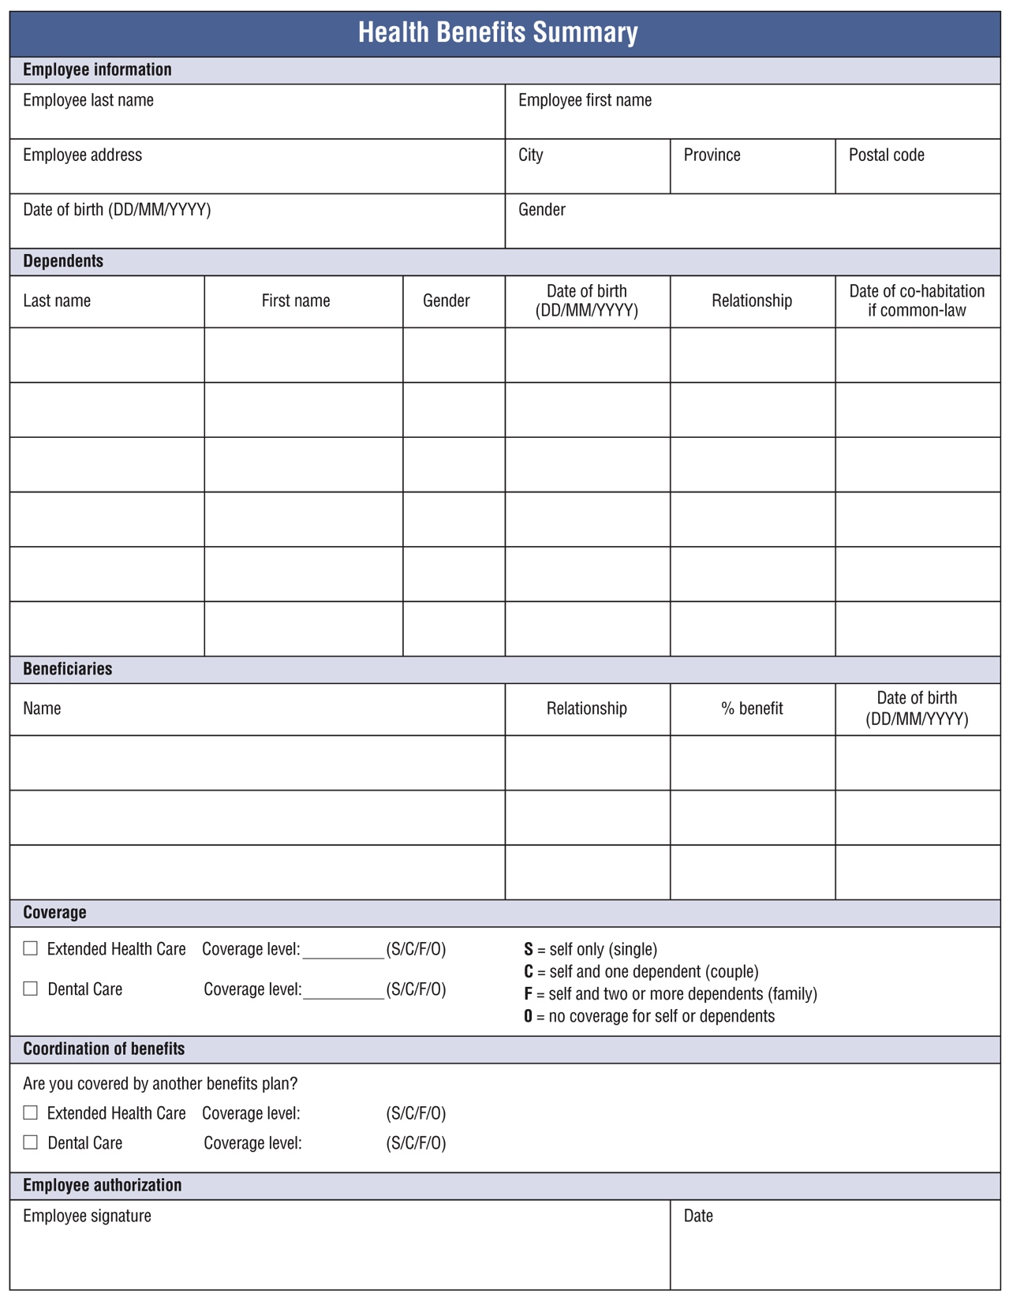
What’s next?
What’s next?
Practise filling out an application for health benefits
When you fill out forms:
Write in print. This makes it easy for others to read.
Write small if there isn’t much space.
Double check contact information: address, phone number and email.
Do the task on pages 54 and 55
Notes:
Workbook, pages 54 and 55
Ask learners the read the information on page 54.
Ask these questions to check for understanding:
What type of information do you need to write on most forms?
What choice do you need to make when filling out the application for health benefits?
Ask learners to locate the fields where the following information needs to be written:
type of coverage
coverage level
personal information
beneficiaries’ information
dependents’ information
signature and the date
They can use the form template on page 58 to do this or you can work together with the class and locate it on the form on the slide.
Review different formats for writing dates.
Task (pages 54-55)
Ask learners to do the task. Explain the instructions. Let the learners know they should use the form template on page 58 to complete the task.
Ask someone to repeat what they need to be doing.
Give the learners 5-6 minutes to complete the task.
Go around the class to check for progress and provide help/support if/when needed.

Slide 42
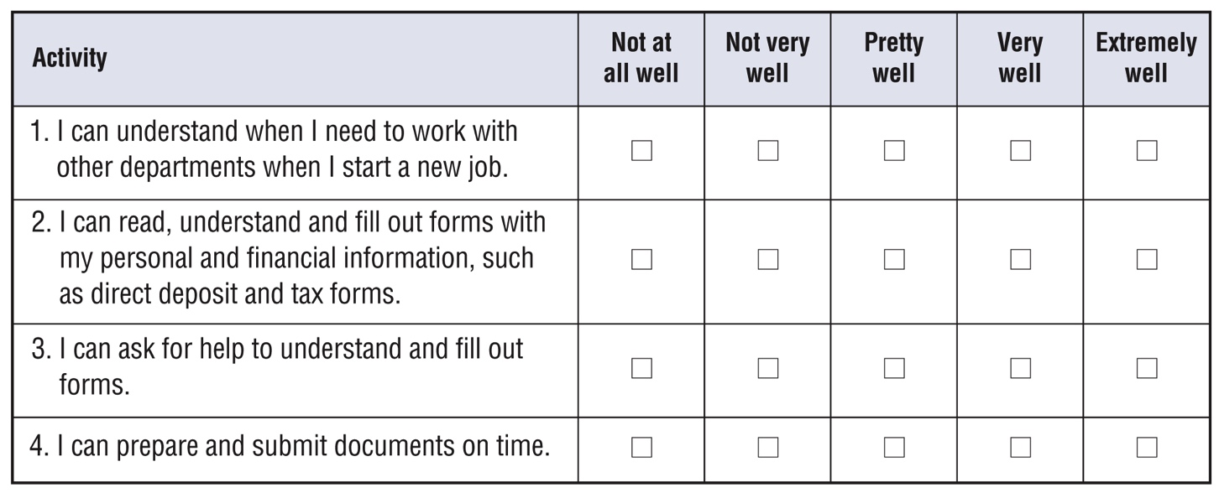
Self-evaluation
Self-evaluation
Self-evaluation
How well can you do these activities?
Notes:
NOTE: If you used this self-evaluation at the beginning of the unit, learners can repeat it now to reflect on their skills and see if there was any improvement by comparing their answers from the first self-evaluation to this one.
Remind the learners what self-evaluation is and its purpose.
Review the layout of the table and provide examples to the learners on how to complete self-evaluation.
Depending on which story the learners completed, they may repeat Self-evaluation 1 or Self-evaluation 2 or both.
Give them time (5-7 minutes) to complete Self-evaluation 1 and Self-evaluation 2 (page 56). Show them how to compare answers to the Self-evaluation 1 and/or Self-evaluation 2 (page 4) they have done before.

