Slide 1
﻿SKILLS FOR SUCCESS: Collaboration Skills for Success

Slide 2
Collaboration – Introduction
Welcome to this unit on collaboration!
Instructor’s intro
Participants’ intro

Slide 3
Collaboration – Introduction
What is collaboration?
Collaboration is your ability to work with others to achieve goals.
You show that you can collaborate when you follow rules and requirements, complete tasks on time, want to improve your work and find solutions when you don’t agree.
Notes:
NOTE: This slide has animations.
Workbook, page 2
Determine prior knowledge by asking learners: “What is collaboration?”
Allow them 2 minutes to brainstorm and share ideas as a class.
Click to show the definition on the slide.
Ask:
- How do you show that you can collaborate?
Allow learners 2 minutes to brainstorm and share ideas as a class.
Click to show the definition on the slide.

Slide 4
Collaboration – Introduction
Learning outcomes
After completing this unit, you will be able to:
List when you need to collaborate with to prepare for employment
Identify the purpose for collaborating
Use strategies to collaborate with others effectively
Notes:
Workbook, page 2
NOTE: This slide has animations.
Let the class know what they will be learning.
Click to show learning outcomes one-by-one.

Slide 5
Collaborating to prepare for employment
Meet program requirements
Work with program staff
Share household chores with family
Resolve conflicts in a calm manner
Notes:
Workbook, page 3
Ask learners to find examples and explanations in the workbook.
Discuss key vocabulary with the class.
Ask if anyone wants to volunteer to read first example out loud.
Ask learners to explain how they can show collaboration in the first situation. They can use the examples in the workbook, or they can share their own ideas.
Repeat the same steps for each example.
Activity time: 7-10 minutes

Slide 6
Self-evaluation
Self-evaluation
How well can you do these activities?
This will help your instructor target the lesson material to your needs. That is why you should answer the questions as honestly as you can.
Notes:
Instructor guide, page 3 – scoring information
Instructor guide, page 4 – how to use the self-evaluation
Workbook, pages 4 – Self-evaluation activity for participants
Explain to the learners what self-evaluation is and its purpose.
Explain the layout of the table and provide example to the learners on how to complete self-evaluation.
Allow them 5-7 minutes to complete Self-evaluation 1 and Self-evaluation 2 (page 4).

Slide 7
Oluwa’s story
Amanda’s story
Notes:
Instructor guide, page 4 – Stories
Instructor guide, page 5 – How to use the stories
Instructor guide, page 5 – How to determine the learner’s needs
Workbook, page 5 – Oluwa’s story
Workbook, page 33 – Amanda’s story
Let the learners know that in this unit, they will read about Oluwa and/or Amanda. They are both looking for a job. In the past, they have both struggled with completing their tasks and working well with others. They need strategies and tips to do these things effectively.

Slide 8
Oluwa’s story
Notes:
Workbook, page 5 – Oluwa’s story
Allow learners 3-5 minutes to read Oluwa's story on their own.
Note: If some of the learners are struggling with reading, you can offer to read the story out loud or ask for someone to volunteer to read to the class (or group).
Go over key points and vocabulary from the scenario to make sure everyone understood the story.
These are some of the questions you can ask:
Who is this story about?
Who is Oluwa working with?
What challenges does Oluwa have that stop her from participation in her program?
Why did Oluwa miss training and assignment deadlines?
Vocabulary:
Deadline = the latest time or day that you have to finish something
Other potentially confusing words:
Affect
Require/requirements
Check with the learners if there are any other words they found confusing or they did not understand. Discuss/explain them as a class.
Activity time (for vocabulary and questions): 5 minutes

Slide 9
Oluwa’s story
When to collaborate? Identify areas
Oluwa wants to learn new skills and get a job. To do this, she needs to collaborate with others.
What areas should Oluwa work on to improve her ability to collaborate?
Do the task on page 6
Notes:
Workbook, page 6
NOTE: This slide has animations.
Task
Ask a learner to read the instructions for the task. Then ask the learners what they need to do, to check if they understood the instructions.
Let learners know they should use the information from Oluwa’s story to find the right answers. Allow them 3-5 minutes to complete the task.
Pair up learners to compare their answers or check the answers as a class.

Slide 10
Oluwa’s story
When to collaborate?
Employment programs often collaborate with employers.
Employment programs also collaborate with job seekers.
Who does Oluwa need to work with in her program?
Where can Oluwa find contact information about people she needs to collaborate with in her program?
Notes:
Workbook, page 6
NOTE: This slide has animations.
Read the information on slide.
Elicit prior knowledge and check understanding of Oluwa’s story by asking learners:
Who does Oluwa need to work with in her program? Click to show this question on the slide.
Where can Oluwa find contact information about people she needs to collaborate with in her program? Click to show this question on the slide.
Remind them that they can always refer back to the story to find information there.
Ask learners to read information in box on page 6 in their workbooks.
Note: If some of the learners are struggling with reading, you can offer to read the story out loud or ask for someone to volunteer to read to the class (or group).

Slide 11
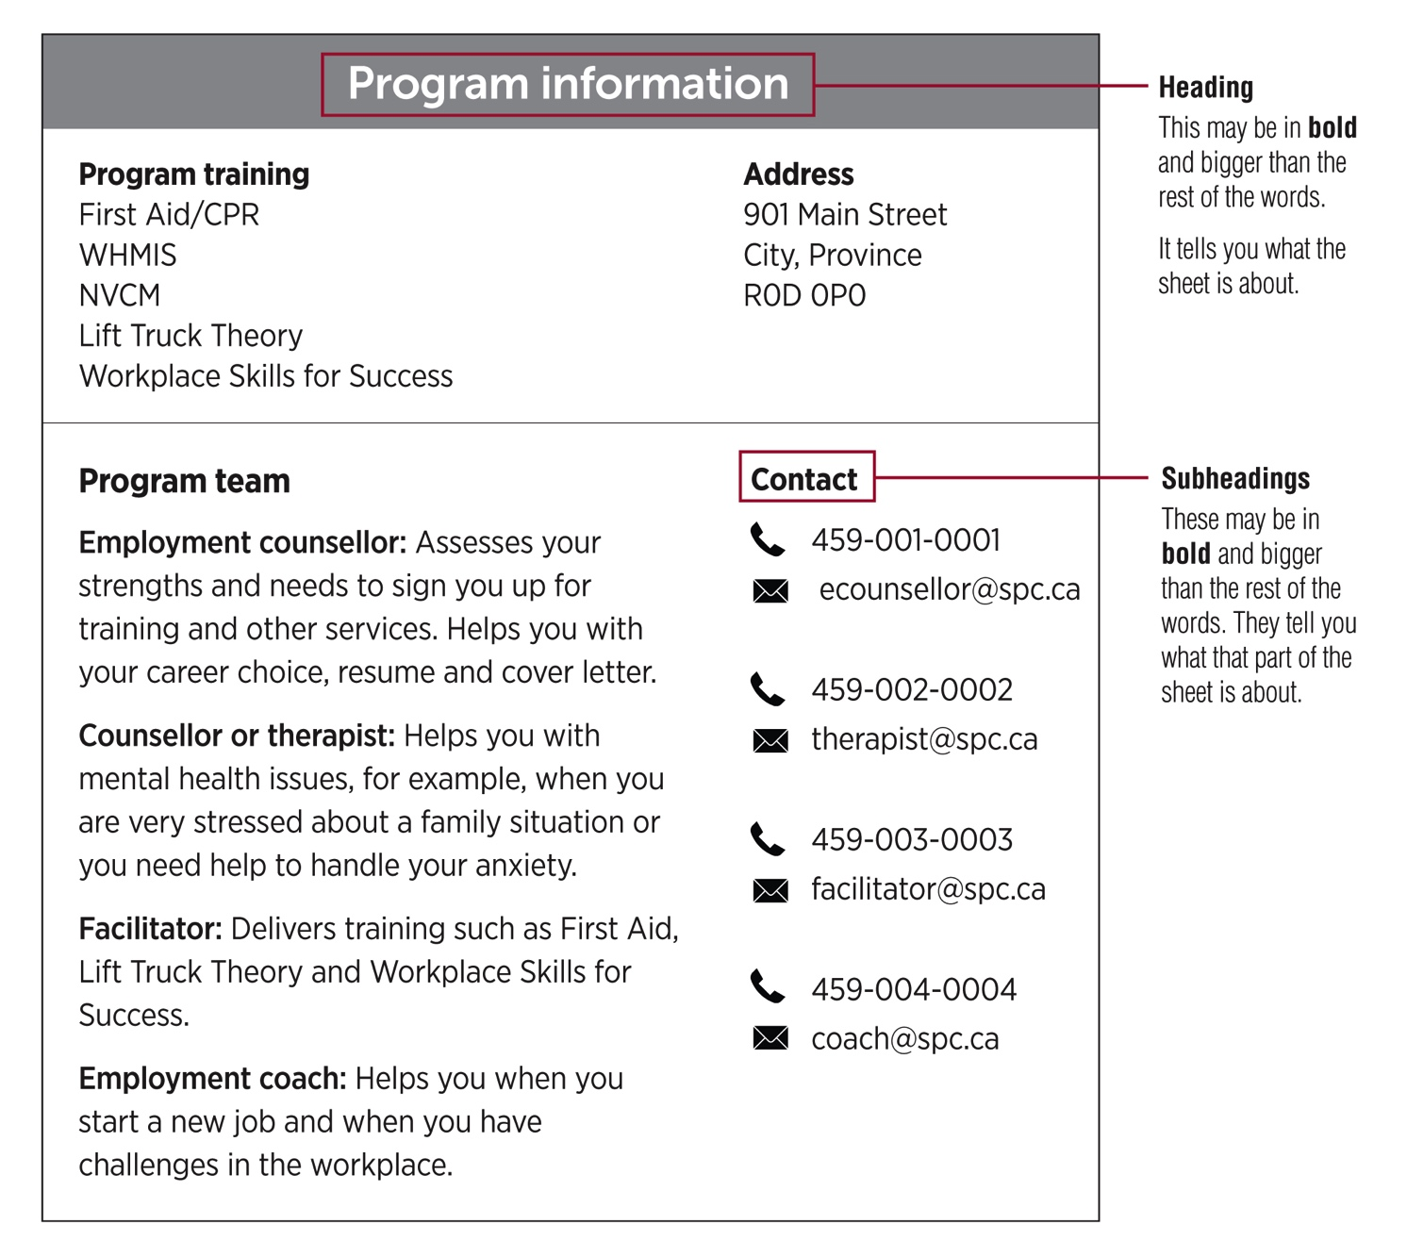
Oluwa’s story
Practise reading information sheets
Program information sheets give you important information about your program.
Do task 1 on page 8
Do task 2 on page 9
Notes:
Workbook, pages 7 - 9
Skill building – how to read documents (Reading / Document Use), workbook page 8
Discuss the program information layout/format with the class.
Identify what the headings and subheadings are.
Explain and show to learners how to read an information sheet:
Use the heading and subheadings to help you find information you need.
Look for other words in bold. They usually have important information.
Give learners time to do tasks on pages 8 and 9.
Say:
- Read the instructions for task 1 on page 8. What do you need to do?
Go around the class to check if learners need help.
Check the answers together.
Repeat the same steps for task 2 on page 9.
Activity time: 7-10 minutes

Slide 12
Oluwa’s story
Reflect
How is Oluwa’s story similar to your own?
Are there any differences? What are they?
What are two areas you need to work on to collaborate with others better?
What program staff members are you collaborating with while you look for a job? List at least two.
How will each staff member help you achieve your goal of getting a job?
Notes:
Workbook, page 10
Ask learners to discuss the questions in small groups or pairs.
Follow up by asking each group/pair to share a few highlights from their discussion with the whole class.
Allow 10-12 minutes for discussion and sharing.

Slide 13
Oluwa’s story
What does collaboration look like?
Identify actions
What could Oluwa do to collaborate better?
Do task 1 on page 11
Notes:
Workbook, page 11
Task
Ask a learner to read the instructions for the task. Then ask the learners what they need to do, to check if they understood the instructions. Allow the learners 3-5 minutes to complete the task. Ask them to share their answers in pairs or as a class.

Slide 14
Oluwa’s story
What does collaboration look like?
Workplace culture tip
﻿Workplaces expect employees to go to work when the weather is bad. Examples of bad weather are rain, snow and wind. Wake up earlier than you normally do and take an earlier bus because there can be traffic delays on such days.
Workplaces may allow employees to stay home or arrange transportation for you when it is extreme weather. Examples of extreme weather are a hurricane, a blizzard and a flood. Stay in contact with your team lead, supervisor or manager to know if you should go to work or stay home.
Practise this tip in your employment program to make it a habit.
Do task 2 on page 12
Notes:
Workbook, pages 11 and 12
NOTE: This slide has animations.
Discuss with learners the attendance expectations in the workplace and why it is important to meet them.
Ask learners to think about how it can affect others on a team when a team member does not show up for work.
Click to show workplace culture tip.
Ask learners to read the workplace culture tip. They can do it themselves from the slide or the workbook (page 12). You can also ask if there is a volunteer to read it out loud to the class.
Ask learners to think about their own experience:
Have you ever had to miss work because the weather was bad?
What happened? What did you do?
Have you ever had to miss work for any other reason?
What was the reason? What happened? What did you do?
Ask learners to do task 2 on page 12.
Do the first question together with the whole class to make sure the learners understand what they need to do.
Give learners 5-6 minutes to answer the rest of the questions. They can write full answers or take notes.
Ask them to share their answers in pairs or as a class after they have completed.

Slide 15
Oluwa’s story
What does collaboration look like?
Workplace culture tip
﻿﻿When you are sick and can’t go to work, you must let your team lead, supervisor or manager know (call in sick) as early as you can.
Employers expect you to call in sick when you really can’t perform that day or when you may spread a virus. For example, you should call in sick if you have fever.
However, employers expect you to still go to work if you don’t have severe symptoms and can work. For example, you should go to work even if you don’t have a lot of energy or didn’t sleep very well last night.
Notes:
Workbook, page 12
Ask learners to read the workplace culture tip on page 12. They can do it themselves from the slide or the workbook (page 12). You can also ask if there is a volunteer to read it out loud to the class.

Slide 16
Oluwa’s story
What does collaboration look like?
When to call in sick
How to call in sick
What to say
How soon to call in sick
Do task 1 on page 14
Do task 2 on page 15
Notes:
Workbook, pages 12-15
NOTE: This slide has animations.
Ask learners:
What does “calling in sick” mean?
Explain that calling in sick is part of workplace communication and collaboration.
Click to show the questions one-by-one. Ask learners:
When do you need to call in sick?
How can you call in sick?
What should you say when you call in sick?
How soon should you call in sick?
Let learners know they can find answer to these questions in the workbook on page 14.
Ask learners to do task 1 on page 14 in the workbook.
Do the first question together as a class.
Give them 2-3 minutes to do the task. Ask them to share their answers with a partner, in a small group or as a class.
Read the scenario on page 15 to the class.
Explain task 2. Ask learners to repeat back what they need to do.
Give learners 5 minutes to do the task.
Invite learners to share their answer with a partner, in a small group or as a class.

Slide 17
Oluwa’s story
Why collaborate? Identify the purpose
When you collaborate with others, you can achieve your goals faster. For example, you can get hired faster when you work with your employment coach to prepare for interviews.
When you collaborate with others, you feel more supported, such as when you work with your therapist to manage stress better.
When you collaborate with others, you feel rewarded. For example, you feel good when you help your co-worker or classmate who is struggling.
When you keep in mind how you benefit when you collaborate, you can stay motivated and focus on your goal.
Notes:
NOTE: This slide has animations.
Workbook, page 17
Ask:
Is it easy or difficult for you to collaborate with others?
When is it hard to collaborate?
How does collaboration help?
Ask a few learners to share their answers.
Click to show the first paragraph. Read out loud from the slide to the class. Ask them if they agree and if they have another example to share.
Repeat the same steps for all 4 paragraphs.
Activity time: 10 minutes

Slide 18
Oluwa’s story
Why collaborate? Identify the purpose
Why should Oluwa collaborate?
Do the task on page 16
Reflect
Notes:
Workbook, pages 16 and 17
NOTE: This slide has animations.
Task
Ask a learner to read the instructions for the task. Then ask the learners what they need to do, to check if they understood the instructions. Point out the first sentence that has been done as an example. Or give the learners 1 minute to read it to themselves.
Allow them 5 minutes to complete the task.
When the learners complete the task, ask them to share their ideas as a class or in pairs.
Reflect
Allow the learners 5 minutes to think of answers to the reflection questions on page 18. Then ask them to work in pairs and discuss their answers.
They can use space in the workbook to write down their answers/ideas.

Slide 19
Oluwa’s story
How can you collaborate effectively?
Identify and practise strategies
Vocabulary
Strategy: a plan or way to do something so you can achieve a goal
Reflect
Notes:
NOTE: This slide has animations.
Workbook, page 18
Ask:
- What does "strategy" mean?
Click to show the vocabulary box for “strategy.”
Reflect
Allow the learners 5 minutes to reflect on the questions.
Ask the learners to share their thoughts as a class or in pairs.

Slide 20
Oluwa’s story
Identify and practise strategies
How can you collaborate effectively?
Identify and practise strategies
There are many strategies that can help you collaborate more easily.
Strategies to complete tasks on time
Strategies to negotiate
Strategy to make a good impression on others
Notes:
NOTE: This slide has animations.
Workbook, pages 18-32
Strategies to complete tasks on time (page 19)
Strategies to negotiate (page 26)
Strategy to make a good impression (page 28)
Say:
- There are many strategies that can help you adapt more easily. You can choose the ones that work for you. Experts recommend you use different types of strategies. Why not try and see what happens!
Say:
These are the strategies we will explore and practise in this section:
Click to show the first set: Strategies to complete tasks (on time)
Click to show the second set: Strategies to negotiate (timelines and solutions)
Click to show the third set: Strategy to make a good impression on others

Slide 21
Oluwa’s story
Identify and practise strategies
Strategies to complete tasks
Reflect
• Is it easy or hard for you to complete tasks on time?
• How do you feel when you can’t complete a task on time?
• What two strategies do you use to complete tasks on time?
• How do those strategies help?
Notes:
Workbook, page 19
Discuss the reflection questions with the whole class
After some of the learners share their ideas/answer ask all learners to reflect on the questions on their own and write down their answers/ideas in the space provided in the workbook.
Allow the learners 5-6 minutes to complete the task.

Slide 22
Oluwa’s story
Identify and practise strategies
Strategies to complete tasks on time
Notes:
Workbook, page 20
Read the strategies from the slide
Ask learners:
Why are these steps presented in this way?
What do we call this way of presenting information?
Follow up with an explanation of what a flow chart is. A flow chart is a graphical/visual representation of sequence of movements or actions or steps.
Say:
- Flow charts are often used in the workplace when there is a process that needs to be explained or a series of steps/actions that need to be taken in certain order.

Slide 23
Oluwa’s story
Identify and practise strategies
Oluwa’s task:
Apply for 30 jobs, fill out her Job Search Tracker and submit it.
Oluwa’s small tasks:
Apply for some jobs each day
Fill out the Job Search Tracker each day
Check Job Search Tracker
Submit the Job Search Tracker to the employment counsellor
Step 1:
Divide the task into small tasks
Notes:
NOTE: This slide has animations.
Workbook, page 20
Ask a learner to read out loud Oluwa’s main task.
Ask the class:
What are some smaller tasks that Oluwa needs to do to complete this main task?
Allow a few minutes for brainstorming.
Click to show Oluwa’s task breakdown.
Before moving on to the next slide, ask learners if they remember what the next step is.

Slide 24
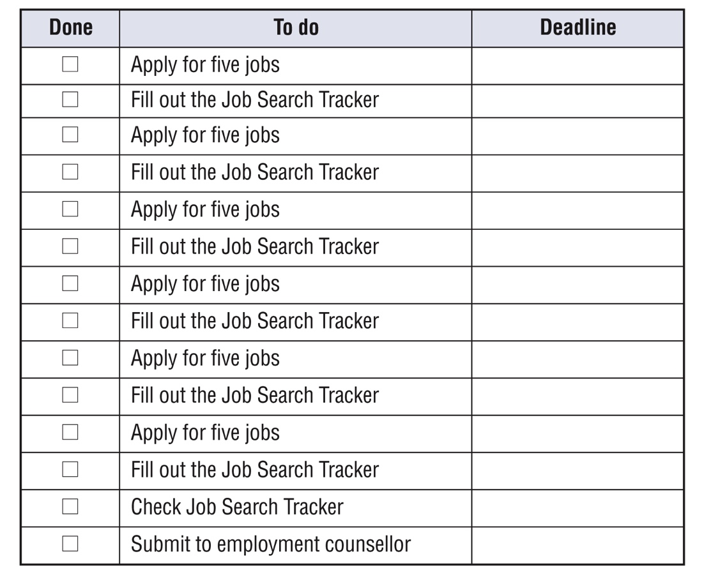
Oluwa’s story
Identify and practise strategies
Step 2:
Make a to-do list of the small tasks
To-do lists help you organize and remember all the tasks you need to complete
Notes:
Workbook, page 22
Ask learners to read information about to-do lists on page 22 of their workbooks.
Discuss with learners what the main parts of a to-do list are and how to use it.
Parts of a to-do list
To-do lists are like tables. They have columns (from top to bottom).
Columns have headings. In the to-do list below, the headings are: “Done”, “To do”, and “Deadline”.
To-do lists have rows (from left to right). Information in a row is connected. You can see all you need to know about a task. You can see its deadline and if it is done.
How to use a to-do list
Under “To do” write the tasks that you need to complete.
Under “Deadline” write the due date for each task.
When you complete a task, check the box (□) under “Done”.
Go over the task Oluwa has to do and talk to the learners about her approach.
Skill building – Numeracy:
When talking about how Oluwa has divided her tasks over the course of 6 days, show learners how she calculated this:
30 jobs total
6 days to apply for all of them
30/6 = 5
If your learners are struggling with numeracy, you can bring in more numeracy/calculation practise here.

Slide 25
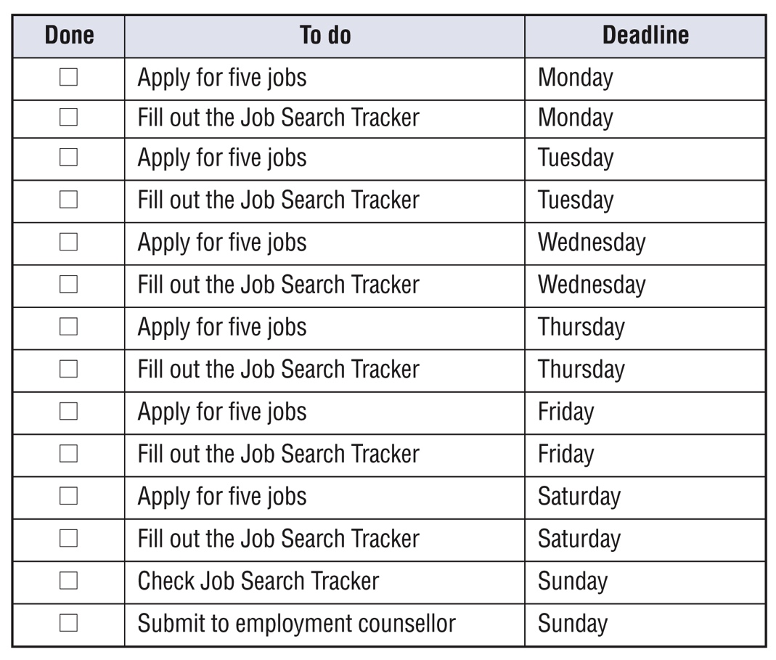
Oluwa’s story
Identify and practise strategies
Step 3:
Set a deadline for each task
Notes:
Workbook, page 22
Discuss with learners steps to set up deadlines:
How to set deadlines
Count the small tasks you need to complete.
Count how many days you have to complete the tasks.
Divide the tasks over the days.
Refer back to the numeracy skills used in the previous slide to divide the number of job applications over the period of 6 days.
Ask students to use the same approach to set up deadlines for Oluwa’s tasks
Oluwa’s to-do list with deadlines:
Oluwa has 14 small tasks. She has seven days.
She can divide the small tasks so that she does two each day.
14/7=2

Slide 26
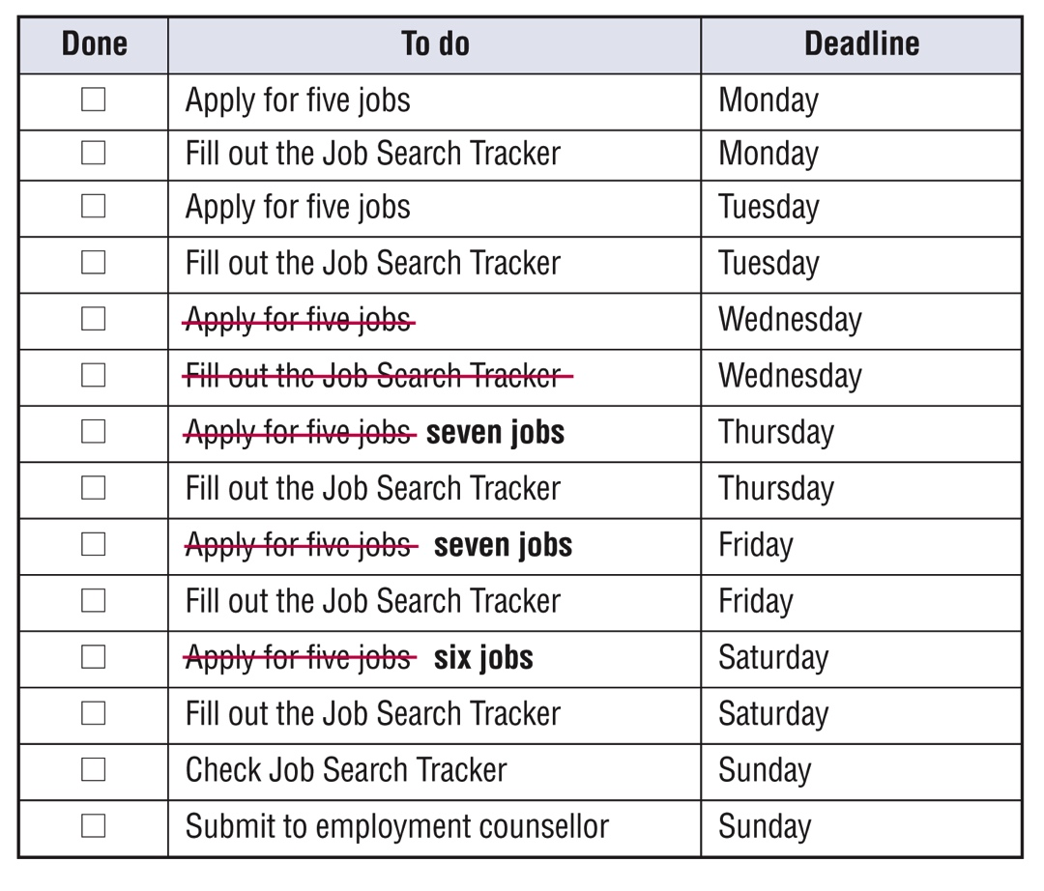
Oluwa’s story
Identify and practise strategies
Step 4:
Adjust the to-do list if change happens
There can be times when something unexpected happens. It can be difficult to complete a task. That’s okay! You can adapt by thinking of ways to complete your task by the deadline.
Notes:
Workbook, page 23
Ask students to read information in their workbooks on page 23.
Discuss with the class how Oluwa has made the adjustments to her to-do list.
Numeracy skill building:
Walk learners through the math of distributing 5 tasks over the 3 days left in order for Oluwa to adjust her to-do list and still meet the final deadline.

Slide 27
Oluwa’s story
Identify and practise strategies
Strategies to complete tasks
Follow these steps to complete the tasks in your workbook.
Do task 1 on page 24
Do task 2 on page 25
Notes:
NOTE: This slide has animations.
Workbook, pages 24 and 25
NOTE: Oluwa’s to-do list is at the end of the workbook. (page 68)
Task 1 (page 24)
Ask a learner to read task 1 instructions out loud.
Ask learners what the first step is that Oluwa needs to complete?
Step 1: Divide the task into small tasks
Give learners a few minutes to divide Oluwa’s main task into small tasks. Ask them to write the tasks in the space provided in the workbook.
Check the answers with the whole class.
Ask learners what the next step is.
Step 2: Make a to-do list of the small tasks
Ask learners to write the tasks in Oluwa’s to-do list.
Ask learners what the next step is.
Step 3: Set a deadline for each task
Discuss with the class how they would set up deadlines, i.e., divide up the tasks with the number of days.
Ask learners to write the deadlines in Oluwa’s to-do list.
Walk around the class to check if the learners can complete this step.
Invite a few learners to share their answers with the class.
Ask learners what Oluwa needs to do when something changes in her plan.
Step 4: Adjust the to-do list if change happens
Discuss with the class how to make adjustments to Oluwa’s to-do-list and task deadlines.
Ask learners to write the adjustments in the to-do-list.
Walk around the class to check if the learners can complete this step.
Invite a few learners to share their answers with the class.
Task 2 (page 25)
Ask learners to think about one task they need to complete and create a to-do list for it. Note: a template for learners’ to do list is at the end of the workbook on page 69.
Ask them to follow the same step/approach they did for Oluwa’s example.
Give learners 8-10 minutes to complete the task.
Walk around the class to check how they are doing. Offer help if/when needed.
Invite a few learners to share their answers with the class

Slide 28
Oluwa’s story
Identify and practise strategies
Strategies to negotiate
Vocabulary
Negotiate: discuss a solution
Sometimes it’s very hard to complete a task on time. That’s okay. You can negotiate to make the deadline later or get help. For example, you can negotiate with your instructor to extend an assignment deadline or you can negotiate with your family members to get help with household chores.
Negotiating is a transferable skill. Use it in your employment program, in your job and in your daily life.
Reflect
Notes:
Workbook pages 26-27
NOTE: This slide has animations.
Discuss what negotiating is. Click to show the vocabulary box.
Ask learners to think of times they negotiated. Ask if it was at work, at home or in the community. Click to show the blue box and let learners know that negotiating is a transferable skill.
Click to show the blue box. Ask a learner to read the text in the blue box or allow them 1 minute to read it to themselves.
Reflect
Allow the learners 5 minutes to reflect on the questions.
Ask the learners to share their thoughts as a class or in pairs.

Slide 29
Oluwa’s story
Identify and practise strategies
Strategies to negotiate
Do task 1 on page 27
Do task 2 on page 28
Notes:
NOTE: This slide has animations.
Workbook pages 26-28
Ask learners what steps they usually take when they have to negotiate something.
Click to show the flowchart that lists the usual steps. Read the steps out loud to the class.
Click to show to the learners what tasks they need to do.
Task 1
Ask someone to read the instructions for Task 1 on page 27.
Do one example together with the class to make sure they understand the task.
Give learners 6-7 minutes to fill out the chart.
Task 2
Ask learners to think about their own situation that requires negotiation.
Ask learners to write the reason, request, and how they would say thank you. They can write in the space provided in their workbooks on page 28

Slide 30
Oluwa’s story
Identify and practise strategies
Strategy to to make a good impression on others
Body language is what you tell others with your posture, the expression on your face and the movements of your hands and eyes.
﻿Making a good impression on others can help you in many ways. When you make a
good impression on the employer at a job interview, you can get hired faster. When you make a good impression on your co-workers, they will feel comfortable working with you.
Notes:
NOTE: This slide has animations.
Workbook pages 28-31
Discuss with the class why making a good impression is important in the workplace, and how it is connected with collaboration.
Click to show the explanation in the blue box. Ask a learner to read it. If there are no volunteers, read it to the class or allow 1 minute for learners to read it to themselves.
Ask learners:
What is body language?
Do you think body language is important? Why?
Click to show the paragraph on body language. Ask a learner to read it. If there are no volunteers, read it to the class or allow 1 minute for learners to read it to themselves.

Slide 31
Oluwa’s story
Identify and practise strategies
Strategy to to make a good impression on others
What are two examples of positive body language? What do they mean?
What are two examples of negative body language? What do they mean?
Do task 1 on page 29
Do task 2 on page 30
Reflect
Notes:
NOTE: This slide has animations.
Workbook pages 28-31
Reflect (workbook page 28)
Ask learners to read the paragraphs about body language in their workbook on page 31.
Ask learners to work in small groups or pairs and to answer the questions about positive and negative body language:
What are two examples of positive body language? What do they mean?
What are two examples of negative body language? What do they mean?
Invite a few learners/groups to share their answers with the class.
Activity time 5-6 minutes.
Task 1 (page 29)
Ask a learner to read instructions for task 1. Do one example together with the class.
Give learners 2-3 minutes to fill out the table. Ask them to check the answers in pairs/small groups.
Task 2 (page 30)
Ask a learner to read instructions for task 2. Do one example together with the class.
Give learners 2-3 minutes to fill out the table. Ask them to check the answers in pairs/small groups.
Reflect (page 31)
Ask learners to think about their own body language and to answer the questions in writing in their workbooks.
Invite a few learners to share with the class.

Slide 32
Oluwa’s story
Apply what you’ve learned
Apply what you’ve learned
Now that you know more about how to collaborate, how would you handle the situations described in your workbook on page 32?
Notes:
Workbook, page 32
Allow learners 7-10 minutes to complete the quiz.
Encourage them to practise the strategies and tips that they have learned in this unit.
As the learners are completing the quiz, you can go around and check the answers with them one-on-one. There is no right or wrong answer. However, if the learner chooses an answer that indicates that they are not applying the strategies discussed in the unit, you can ask probing questions to identify needs for coaching or other wraparound supports.

Slide 33
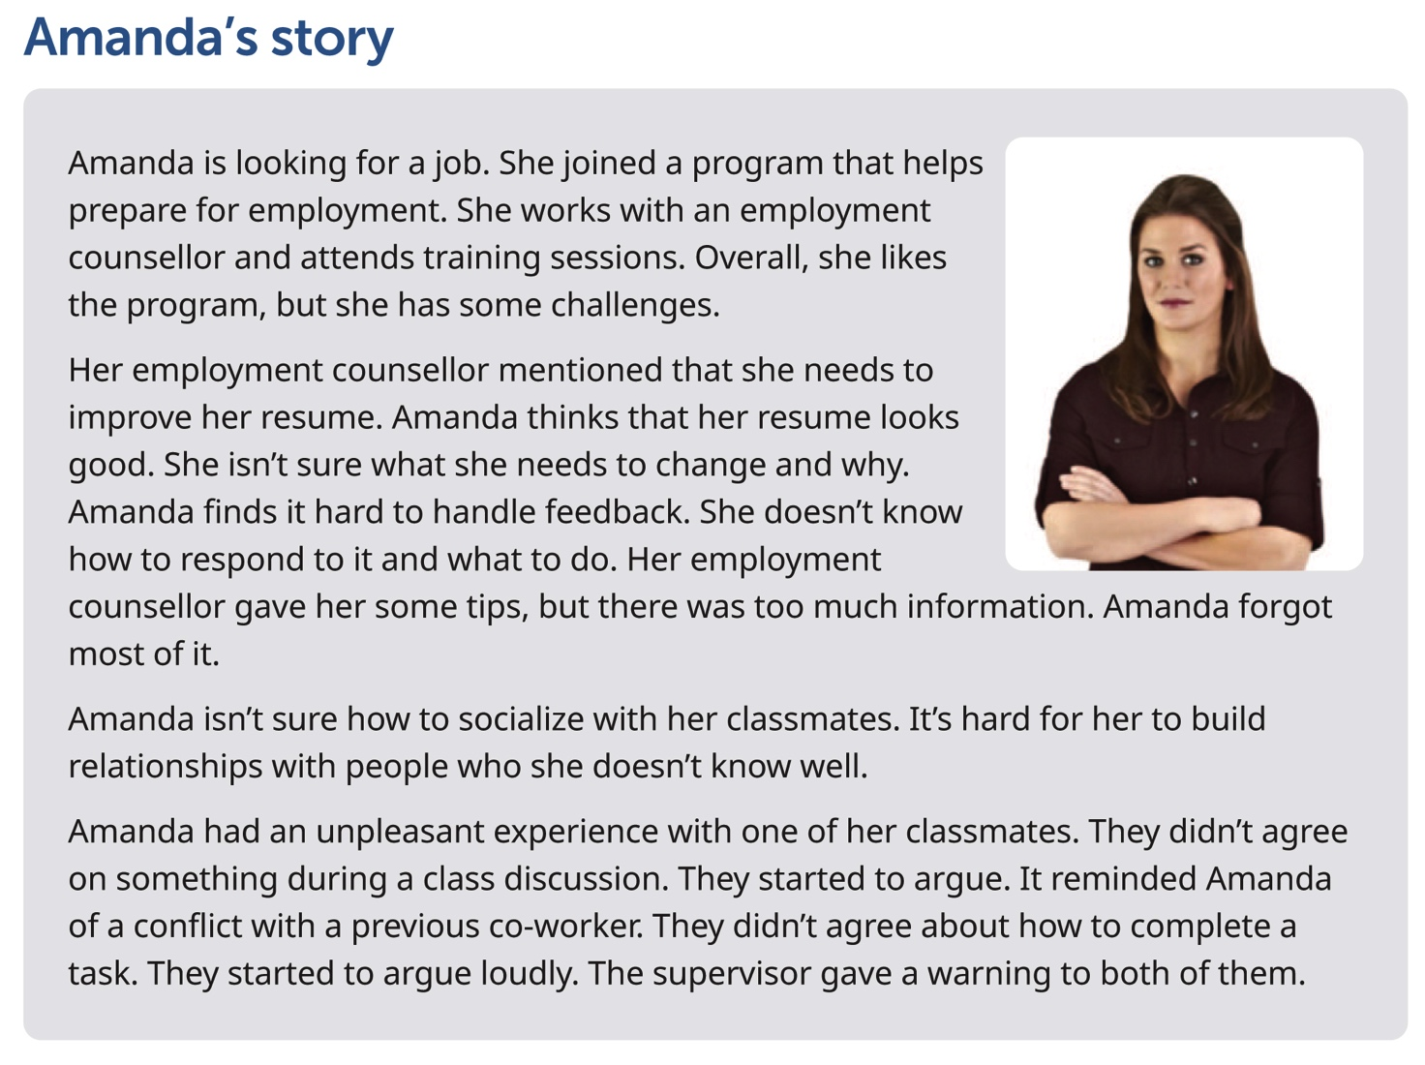
Amanda’s story
Notes:
Workbook, page 33
Amanda’s story
Give learners 3-5 minutes to read Amanda’s story or ask a learner to read it out.
Note: If some of the learners are struggling with reading, you can offer to read the story out loud or ask for someone to volunteer to read to the class (or group).
Go over key points and vocabulary from the scenario to make sure everyone understood the story.
Ask:
Who is this story about?
What does Amanda struggle with?
How does Amanda handle disagreements?
Inform the learners that the next set of activities will focus on Amanda’s story.

Slide 34
Amanda’s story
When to collaborate? Identify areas
Amanda wants to learn new skills and get a job. To do this, she needs to collaborate with others.
Which are the three areas that Amanda needs to work on to collaborate better?
Do the task on page 34
Notes:
Workbook, page 34
Task
Ask a learner to read the instructions for the task. Then ask the learners what they need to do, to check if they understood the instructions.
Allow them 3-5 minutes to complete the task.
Ask learners to share their answers in pairs or as a class.

Slide 35
Amanda’s story
When to collaborate? Identify areas
Think about yourself.
How is Amanda’s story similar to your own?
Are there any differences? What are they?
What are three areas you need to work on to collaborate with others better?
Who are you collaborating with while you look for a job? List at least two people.
Notes:
Workbook, page 35
Reflect
Allow learners 5-6 minutes to reflect on the questions. Then ask to discuss their answers in pairs or as a class.
They can use space in the workbook to write down their answers/ideas.

Slide 36
Amanda’s story
What does collaborating look like?
Identify actions
What could Amanda do to collaborate better?
Do task 1 on page 36
Notes:
Workbook, page 36
Task
Ask learners to read the instructions for the task. Then ask them what they need to do, to check if they understood the instructions. Allow them 2-3 minutes to complete the task.
Ask the learners to share their answers in pairs or as a class.

Slide 37
Amanda’s story
What does collaborating look like?
Identify actions
What would you do to collaborate?
Do task 2 on page 36
Notes:
Workbook, page 36
Divide learners into pairs or small groups. Ask them to read the scenarios and think about the situations listed and share what they would do.
Allow 5-6 minutes for the activity.

Slide 38
Amanda’s story
Why collaborate? Identify the purpose
When you collaborate with others, you can achieve your goals faster. For example, you can get hired faster when you work with your employment coach to prepare for interviews.
When you collaborate with others, you feel more supported, such as when you work with your therapist to manage stress better.
When you collaborate with others, you feel rewarded. For example, you feel good when you help your co-worker or classmate who is struggling.
When you keep in mind how you benefit when you collaborate, you can stay motivated and focus on your goal.
Notes:
NOTE: This slide has animations.
NOTE: If you have completed the same activity when working on Oluwa’s story, you can skip this slide or you can use it as a revision.
Workbook, page 37-39
Ask:
Is it easy or difficult for you to work well with others?
- How can collaborating with others help you in this program? How can collaborating help you at work?
Ask a few learners to share their answers.
Click to show the first paragraph. Read out loud from the slide to the class. Ask them if they agree and if they have another example to share.
Repeat the same steps for all 4 paragraphs
Activity time: 10 minutes

Slide 39
Amanda’s story
Why collaborate? Identify the purpose
Why should Amanda collaborate?
Do the task on page 37-38
Reflect
Notes:
Workbook, page 37 and 38
NOTE: This slide had animations.
NOTE: If you have completed the same activity when working on Elaine’s story, you can skip this reflection, or you can use it as a revision
Ask, “Why should Amanda collaborate?” and tell learners that they will be completing a task to help Amanda identify why she needs to collaborate.
Task (page 37-38)
Have a learner read the instructions (on page 37) and the first sentence that has been done as an example. Or allow the learners 1 minute to read it to themselves.
Ask the learners to repeat what they need to do, to check if they understood the instructions. Allow them 5 minutes to complete the task. When the learners complete the task, ask them to share their ideas as a class or in pairs.
Reflect (page 38)
Allow the learners 5 minutes to reflect on the questions. They can use the space to write their answers/ideas.
When they complete, ask them to share their answers in pairs or as a class.

Slide 40
Amanda’s story
How can you collaborate effectively?
Identify and practise strategies
Vocabulary
Strategy: a plan or way to do something so you can achieve a goal
Reflect
Notes:
NOTE: This slide has animations.
Workbook, page 39
NOTE: If you have completed the same activity when working on Oluwa’s story, you can skip this question, or you can use it as a revision.
Ask the learners:
- What does "strategy" mean?
Click to show the vocabulary box for “strategy.”
Reflect
Allow the learners 5 minutes to reflect on the questions.
They can use the space in the workbook to write their ideas.
Ask them to share their answers/ideas in pairs or as a class.

Slide 41
Amanda’s story
Identify and practise strategies
How can you collaborate effectively?
Identify and practise strategies
There are many strategies that can help you collaborate more easily.
Strategies to respond to feedback
Strategies to build relationships
Strategies to resolve conflict
Notes:
NOTE: This slide has animations.
Workbook, pages 39-53
Strategies to respond to feedback (page 40)
Strategies to build relationships (page 47)
Strategies to resolve conflict (page 51)
Say:
- There are many strategies that can help you collaborate more easily. You can choose the ones that work for you. Experts recommend you use different types of strategies. Why not try and see what happens!
Say:
These are the strategies we will explore and practise in this section:
Click to show the first set: Strategies to respond to feedback
Click to show the second set: Strategies to build relationships
Click to show the third set: Strategies to resolve conflict

Slide 42
Amanda’s story
Identify and practise strategies
Strategies to respond to feedback
Feedback is helpful information about how you do something.
Feedback gives you the chance to grow and learn new skills. Remember that feedback is about making your performance better and it doesn’t have anything to do with your personality.
Reflect
Notes:
NOTE: This slide has animations.
Workbook, page 40
Ask:
What is feedback?
Invite the class to share their ideas.
Click to show the answer.
Ask:
Why is feedback important?
Invite the class to share their ideas.
Click to show the answer.
Ask learners to complete the reflection activity. They can work in pairs to discuss the questions from the workbook, and they can use the space provided to write down their answers:
How do you feel when someone tells you that you need to improve your work?
What are two strategies you use to respond to feedback in a good way?
How do those strategies help?

Slide 43
Amanda’s story
Identify and practise strategies
Strategies to respond to feedback
Listen and don’t interrupt
Say thank you
Apologize if you have made a mistake
Ask for specific examples
Commit to improve your work
Make a checklist
Follow up to check your progress
Do task 1 on page 42 and 43
Do task 2 on page 44
Notes:
Workbook, page 40-44
NOTE: This slide has animations.
Ask learners to read information in the workbook on page 41
Discuss each strategy with the class.
Ask
Which strategy did you already know?
Which strategy did you not know about?
Which one will you start using?
Task 1 (page 42-43)
Ask a learner to read the instructions. Do the first example together with the whole class to make sure they understand what they should be doing.
Give learners 5-6 minutes to complete all scenarios.
Invite learners to share their answers with the class.
Task 2 (page 44)
Ask learners to work in pairs or small groups and to discuss what they would do in these situations.
Give learners 5-6 minutes to discuss and write their answers.

Slide 44
Amanda’s story
Identify and practise strategies
Practise making checklists
﻿﻿A checklist ﻿is a list of things you need to pay attention to when you perform a task. A checklist helps you remember the important aspects of the task, reduces mistakes and keeps you organized.
Here is how to use a checklist:
• Make a list of everything you need to pay attention to
• Refer to the checklist while you do your task and after you are done
• Put a checkmark beside the items as you go through them
Do the task on page 45
Notes:
NOTE: This slide has animations.
Workbook, pages 45 and 46
Ask the class:
Do you use checklists? What do you use them for?
How can a checklist help you respond to feedback at work?
Click to show the explanation. Read it to the class or ask a learner to read it out loud.
Ask learners to read information in their workbooks on page 45 and then to complete the task on page 46.
Go around the class to check how learners are doing and provide help/support where needed.
Ask learners to share their answers in pairs, small groups or as a class.
Activity time: 10-12 minutes

Slide 45
Amanda’s story
Identify and practise strategies
Strategies to build relationships
Reflect
Is it easy or hard for you to build relationships? Why?
What is one way good relationships can help you?
What is one strategy you use to build relationships with others?
How does it help?
Notes:
Workbook, page 47
Discuss the reflection questions with the whole class.
After some of the learners share their ideas/answers, ask all learners to reflect on the questions on their own and write down their answers/ideas in the space provided in the workbook.
Allow the learners 5-6 minutes to complete the task.

Slide 46
Amanda’s story
Identify and practise strategies
Strategies to build relationships
Make small talk
Say hi and good-bye
Offer help
Show interest
Do task 1 on page 49
Do task 2 on page 50
Reflect
Notes:
NOTE: This slide has animations.
Workbook, Pages 47-50
Ask different learners to read the strategies one by one. Click to show the strategies on the slide as they read them.
Alternatively, give the learners 3-5 minutes to read the strategies to themselves.
Ask
Which strategies did you already know?
Which ones were new?
Which ones will you start practising?
Task 1 (page 49)
Ask a learner to read instructions for task 1. Do one example together with the class.
Give learners 2-3 minutes to write their answer in the workbook. Ask them to check the answers in pairs, small groups or as a class.
Task 2 (page 50)
Ask learners to think about how they build relationships. Ask them to write more example of what they could say:
To make small talk
To say hi or good-bye
To offer help
To show interest
Give learners 2-3 minutes to do the task. Ask them to check the answers in pairs, small groups or as a class.
Reflect (page 50)
Ask learners to think about themselves and to answer the reflection questions:
Which of the strategies will you start to use? Choose at least two.
Why did you choose those ones?
Ask learners to share their answers in pairs, small groups or as a class.

Slide 47
Amanda’s story
Identify and practise strategies
Strategies to resolve conflict
Conflict is when people don’t agree. Having conflict with family members, friends and co-workers is part of life.
When you resolve it in a peaceful way, you communicate better and feel less stressed. When you don’t resolve a conflict, it can be uncomfortable at home or at work.
Notes:
NOTE: This slide has animations.
Workbook, Pages 51 - 55
Ask:
What is a conflict?
Allow a few minutes for the whole class to discuss.
Click to show the answer.
Ask:
Why is it important to know how resolve it?
Allow a few minutes for the whole class to discuss.
Click to show the answer.
Reflect (page 51)
Ask learners to think about themselves and to write answers in the space provided in the workbook.
What is one strategy that you use to resolve conflict?
How does it help you?
Ask learners to share their answers in pairs, small groups or as a class.

Slide 48
Amanda’s story
Identify and practise strategies
Strategies to resolve conflict
Use these strategies to resolve conflict in a peaceful way:
Listen and don’t interrupt
Use “I” instead of “You”
Show you understand
Reflect
Notes:
Workbook, pages 52
Ask learners to read information in the workbook on page 55
Discuss each strategy with the class.
Ask
Which strategy did you already know?
Which strategy did you not know about?
Which one will you start using?
Reflect (page 52)
Ask learners to think about themselves and to write answers in the space provided in the workbook.
Which of the strategies will you start to use? Choose at least two.
Why did you choose those ones?
Ask learners to share their answers in pairs, small groups or as a class.

Slide 49
Amanda’s story
Apply what you’ve learned
Apply what you’ve learned
Now that you know more about how to collaborate, how would you handle the situations described in your workbook on page 53?
Notes:
Workbook, page 53
Allow the learners 7-10 minutes to complete the quiz.
Encourage them to practise the strategies and tips that they have learned in this unit.
As the learners are completing the quiz, you can go around and check the answers with them one-on-one. There is no right or wrong answer. However, if the learner chooses an answer that indicates that they are not applying the strategies discussed in the unit, you can ask follow-up or probing questions to identify needs for coaching or other wraparound supports.

Slide 50
What’s next?
What’s next
What’s next
Sharing stories at interviews
Can you describe a time when you resolved a conflict with your teammate?
Tell me about a time when you contributed to your team.
Give an example of a time when you responded to feedback.
Do task 1 on page 54-55
Do task 2 on page 55
Notes:
NOTE: This slide has animations.
Workbook, pages 54 and 55
Say:
- Collaborating is an important skill in the workplace. That’s why at job interviews, employers may ask how you collaborated in the past.
Ask:
- What will you say when an employer asks you to share a story about collaboration?
Invite learners to share their ideas.
Click to show bullet list with clues.
Say:
Listen for questions such as these when you are in an interview.
Task 1 (page 54-55)
Explain the task. Tell learners the key questions their stories need to answer are
What was the situation?
What did you do?
What was the result?
Ask a learner to read the example for question 1.
Invite the class to share some of their situations.
Ask learners to write down a situation that relates to them.
Ask another learner to read the example for question 2.
Invite the class to share what they did in the situations they mentioned in question 1.
Ask learners to write down what they did in a situation they explained in questions 1.
Ask another learner to read the example for question 3.
Invite the class to share what happened as a result in the situations they mentioned in questions 1 and 2.
Ask learners to write down what happened as a result in the situations they mentioned in questions 1 and 2.
Allow the learners 3-4 minutes for each example/question they need to share/write.
Task 2 (page 55)
This task can be done in class or given to learners to do as homework.
Ask learners to read the instructions. Ask a learner to explain to the class what needs to be done in this task.

Slide 51
Self-evaluation
Self-evaluation
How well can you do these activities?
Notes:
NOTE: If you used this self-evaluation at the beginning of the unit, learners can repeat it now to reflect on their skills and see if there was any improvement by comparing their answers from the first self-evaluation to this one.
Remind the learners what self-evaluation is and its purpose.
Review the layout of the table and provide examples to the learners on how to complete self-evaluation.
Depending on which story the learners completed, they may repeat Self-evaluation 1 or Self-evaluation 2 or both.
Give them time (5-7 minutes) to complete Self-evaluation 1 and Self-evaluation 2 (page 56). Show them how to compare answers to the Self-evaluation 1 and/or Self-evaluation 2 (page 4) they have done before.

