Slide 1
﻿SKILLS FOR SUCCESS: Adaptability Skills for Success

Slide 2
Adaptability Introduction
Welcome to this unit on adaptability!
Instructor’s intro
Participants’ intro

Slide 3
Adaptability – Introduction
What is adaptability?
Adaptability is your ability to respond to situations that are new or challenging for you.
Notes:
NOTE: This slide has animation.
Workbook, page 2
Determine prior knowledge by asking learners: “What is adaptability?”
If you have completed previous units on adaptability, you can use this as review and discuss adaptability in the context of thriving at work.
Allow them 2-3 minutes to brainstorm and share ideas as a class.
Click to show the definition on the slide.
Let learners know they will be learning about strategies for thriving in the workplace.
Explain vocabulary if needed:
Thrive: become better, grow, do very well
Career: the path you follow and progress you make in a specific area of work. It includes your jobs, training, and experience.

Slide 4
Adaptability – Introduction
When do you show adaptability?
You show adaptability when you:
Set goals and take action to plan a career path.
Change your spending habits to save up money for training.
Adjust your schedule to fit in healthy habits
Notes:
NOTE: This slide has animations.
Workbook, page 2
Ask learners to brainstorm ideas on when/how they show they can adapt in order to do well and thrive at work. Allow 2-3 minutes for brainstorming.
Click to show the answers on the slide one by one.

Slide 5
Adaptability – Introduction
Learning outcomes
After completing this unit, you will be able to:
Identify when you need to adapt to thrive at work
Identify the purpose for adapting
Use strategies to adapt
Notes:
Workbook, page 2
NOTE: This slide has animations.
Let the class know what they will be learning.

Slide 6
Adapting to thrive at work
Plan for your career
Learn how to talk about your goals
Find ways to cover the cost of your training
Adjust schedule to include healthy habits
Notes:
Workbook, page 3
Ask learners to read the first example from the slide.
Ask learners to explain how they can show adaptability in the first situation or what they think “plan for your career” means.
Ask a learner to read the explanation of the example from the workbook out loud.
Repeat the steps for all the other examples on the slide.
Explain vocabulary if needed.
Self-care: things that you do to take care of your body and mind
Activity time: 7-10 minutes

Slide 7
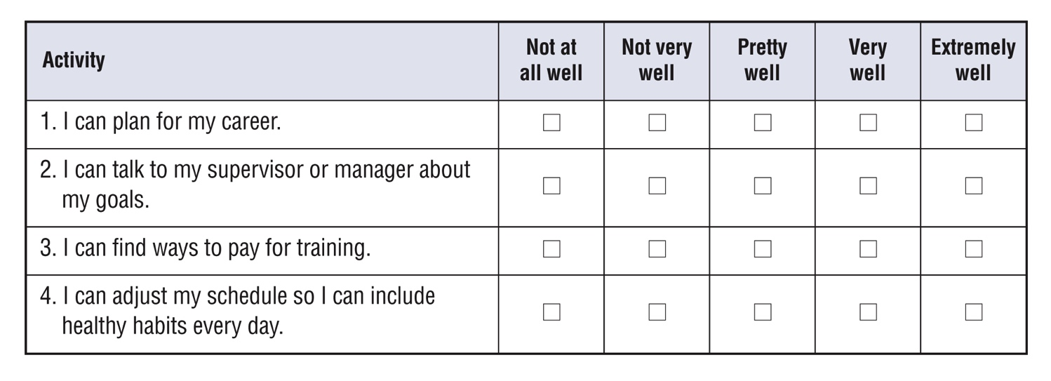
Self-evaluation
Self-evaluation
How well can you do these activities?
This self-evaluation will help you think about your adaptability skills.
You will do this again at the end of the unit to see how you benefited from the material.
Notes:
Instructor guide, page 3 – scoring information
Instructor guide, page 4 – how to use the self-evaluation
Workbook, page 4 – Self-evaluation activity for participants
Explain to the learners what self-evaluation is and its purpose.
Explain the layout of the table and provide examples of how to complete the self-evaluation.
Allow them 2-3 minutes to complete it.

Slide 8
Jaspreet’s story
Notes:
Workbook, page 5 – Jaspreet’s story
Let the learners know that in this unit, they will read about Jaspreet. Jaspreet is learning how to thrive at work. She needs some help and strategies to do it effectively.
Allow learners 3-5 minutes to read Jaspreet’s story on their own.
Note: If some of the participants are struggling with reading, you can offer to read the story out loud or ask for someone to volunteer to read to the class (or group).
Go over key points and vocabulary to make sure everyone understood the story.
These are some questions you can ask:
Who is this story about?
What type of work does Jaspreet do?
What is Jaspreet’s career plan? What does she want to do in the future?
What are some challenges Jaspreet is facing?
Check with the learners if there are any words in the story they found confusing or they did not understand. Discuss/explain them as a class.
Activity time: 5 minutes

Slide 9
Jaspreet’s story
What to adapt to? Identify areas
Jaspreet wants to grow at work. To do this, she needs to be able to adapt.
Where does Jaspreet need to be able to adapt?
Do the task on page 6.
Notes:
Workbook, page 6
Task
Ask a learner to read the instructions for the task. Then ask the learners what they need to do, to check if they understood the instructions.
Let learners know they should use the information from Jaspreet’s story to find the right answers. Allow them 3-5 minutes to complete the task.
Pair up learners to compare their answers or check the answers as a class.

Slide 10
Jaspreet’s story
What to adapt to? Identify areas
Reflect
Think of your goals.
How is Jaspreet’s experience similar to your own?
Are there any differences?
What are your goals?
What are three areas where you need to be able to adapt so you can achieve your goals?
Notes:
NOTE: This slide has animation.
Workbook, page 7
Vocabulary:
Check to see if learners understand the word “reflect” and what they should be doing when asked to “reflect on” something
Click to show the reflection questions.
Reflect
Ask learners to think about their goals.
Click to show reflection questions.
Allow the learners 5 minutes to reflect on the questions. Then ask them to work in pairs and discuss their answers.
They can use the space in the workbook to write down their answers/ideas.

Slide 11
Jaspreet’s story
What does adapting look like?
Identify actions
What actions could Jaspreet take to adapt?
Do the task on page 8.
Notes:
Workbook, page 8
Task
Ask a learner to read the instructions for the task. Then ask them what they need to do, to check if they understood the instructions. Point out the example done.
Allow the learners 3-5 minutes to complete the task. Ask them to share their answers in pairs or as a class.

Slide 12
Jaspreet’s story
What does adapting look like?
Identify actions
Reflect
Think of your goals.
Think of the three areas where you need to adapt to achieve them.
What would you do to adapt?
Think of one action for each area.
Notes:
NOTE: This slide has animation.
Workbook, page 8
Reflect
Click to show the questions of the reflection activity.
Ask the learners to reflect on the questions. Remind them that they have already thought about their goals and the three areas where they need to adapt in previous reflection activity.
Ask learners to now think of the actions they need to take to adapt.
Learners can use the space in the workbook to write down their answers/ideas.
When they have completed, ask them to discuss their answers in pairs.

Slide 13
Jaspreet’s story
Why adapt? Identify the purpose
Thriving at work is important. It allows you to grow as an employee and respond to changes in the workplace in a positive way. You learn more skills and do your tasks better. It becomes more likely that you can take on more responsibilities or get a promotion.
Thriving at work requires a lot of effort. When you get busy at work or in everyday life, it can be hard to make the extra effort.
However, if you keep in mind how you can benefit from thriving at work, you can adapt, learn new things and achieve your goals.
Notes:
NOTE: This slide has animation.
Workbook, page 9
To elicit prior knowledge and understanding, ask the learners:
Why is thriving at work important? Why should you learn how to adapt to thrive at work?
Discuss with the whole class or in groups.
Click to show the paragraph.
Ask a volunteer to read it out.

Slide 14
Jaspreet’s story
Why adapt? Identify the purpose
Why should Jaspreet be able to adapt?
Do the task on page 9.
Reflect
Notes:
Workbook, pages 9 and 10
Task
Ask a learner to read the instructions for the task. Then ask the learners what they need to do, to check if they understood the instructions. Point out the first sentence that has been done as an example. Or give the learners 1 minute to read it to themselves.
Allow them 5-6 minutes to complete the task.
When the learners complete the task, ask them to share their ideas as a class or in pairs.
Reflect
Allow the learners 5 minutes to reflect on the questions on page 10. Then ask them to work in pairs and discuss their answers.
They can use space in the workbook to write down their answers/ideas.

Slide 15
Jaspreet’s story
How can you adapt effectively?
Identify and practise strategies
Reflect
Think of the challenges that Jaspreet is facing.
How can she adapt better?
Do you know of any strategies she could use?
Notes:
NOTE: This slide has animation.
Workbook, page 11
Check your learners’ understanding by asking:
What is a strategy?
If you have done previous units on Adaptability or Collaboration you can use this opportunity to review what learners remember about strategies.
Reflect
Allow the learners 5 minutes to reflect on the questions.
Remind learners that they can find the answer the first question in Jaspreet’s story on page 5 in their workbooks.
Ask the learners to share their thoughts as a class or in pairs.
Learners can use space provided in the workbook to write down their ideas.

Slide 16
Jaspreet’s story
How can you adapt effectively?
Identify and practise strategies
There are many strategies that can help you adapt more easily.
Strategies to plan for your career
Strategies to talk about your goals
Strategies to cover the cost of training
Strategies to fit healthy habits into your schedule
Notes:
NOTE: This slide has animations.
Workbook, pages 12-35
Strategies to plan for your career (page 12)
Strategies to talk about your goals (page 22)
Strategies to cover the cost of training (page 26)
Strategies to fit healthy habits into your schedule (page 32)
Say:
There are many strategies that can help you adapt more easily. You can choose the ones that work for you. Experts recommend you use different types of strategies.
Ask learners to share some of the strategies to adapt they know or they have used in the past. If the learners did previous units on Adaptability, you can use this as a review and ask them to think back on what they have learned in previous units on Adaptability.
Allow some time for sharing, then click to show the strategies you will be working on in this lesson:
Say:
These are the strategies we will explore and practice in this section:
Click to show the first set: Strategies to plan for your career
Click to show the second set: Strategies to talk about your goals
Click to show the third set: Strategies to cover the cost of training
Click to show the fourth set: Strategies to fit healthy habits into your schedule

Slide 17
Jaspreet’s story
Identify and practise strategies
Strategies to plan for your career
Set your goals
Read job descriptions
List the skills, experience and training you have
List the skills, experience and training you need
Notes:
NOTE: This slide has animations.
Workbook, page 12
Ask different learners to read the strategies on page 12 one by one. Click to show the strategies on the slide one by one as they read them.
Alternatively, give the learners 3-5 minutes to read the strategies to themselves.

Slide 18
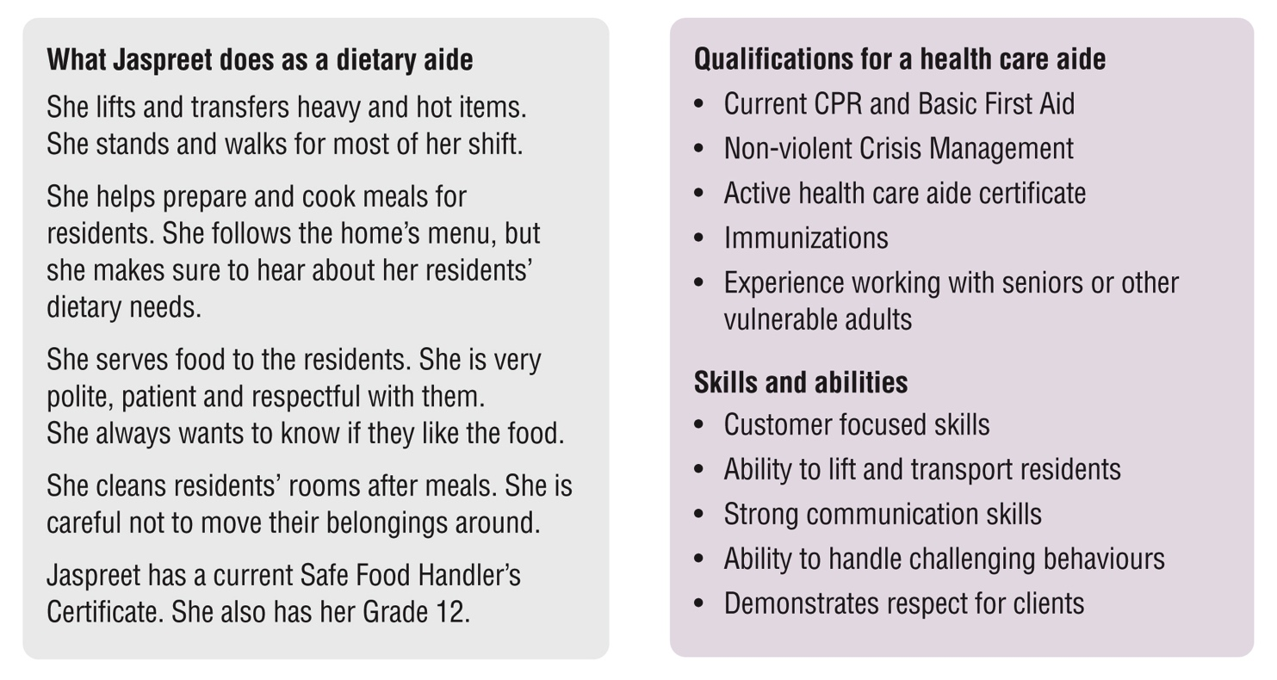
Jaspreet’s story
Identify and practise strategies
Strategies to plan for your career
Help Jaspreet make the list of skills she has and the skills she needs to move to a new position at work.
Do task 1 on pages 13 and 14
Notes:
Workbook, page 13 - 14
Give learners time to read the information in the two text boxes in the workbook.
Discuss the vocabulary if needed to make sure learners understand the terms:
Skills, qualifications, transferrable skills, abilities, experience
Ask learners to answer questions 1 and 2 in their workbooks (pages 13 and 14).
Discuss as a class what skills and qualifications Jaspreet has.

Slide 19
Jaspreet’s story
Identify and practise strategies
Strategies to plan for your career
How to choose a training program
Time
When does the program start? Can you apply by the deadline?
How long is the program? Do you have that much time?
How many hours a week would you need? Do you have that much time?
Cost
How much does the program cost?
Do you have to pay the fees all at once? Can you pay in smaller amounts?
Will there be extra expenses?
Can you pay for the program yourself? Can you get help to cover the cost?
Format and schedule
Is the program online or in person?
Do you need to participate in sessions?
Do the hours work with your job?
Notes:
NOTE: This slide has animations.
Workbook, page 14
Say:
When thinking about choosing a training program to improve your skills and get qualifications so that you can thrive at work, pay attention to these three areas: time, cost, and format and schedule.
Ask learners what type of questions they should be asking when it comes to “time” .
Allow a few minutes for the whole class discussion.
Then click to show suggested questions.
Repeat the same steps for “cost” and “format and schedule”.

Slide 20
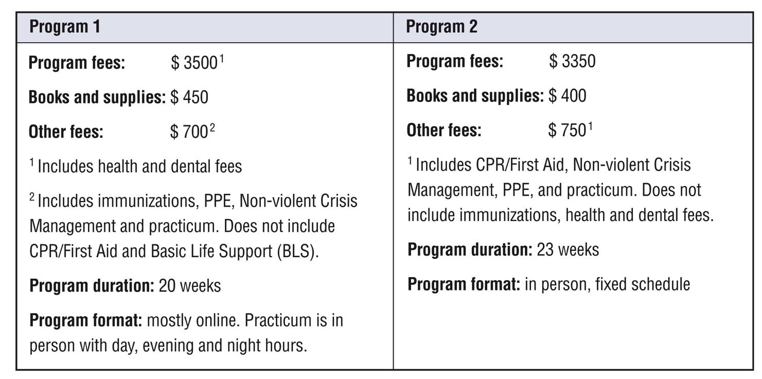
Jaspreet’s story
Identify and practise strategies
Strategies to plan for your career
Help Jaspreet make a decision.
Do task 2 on pages 15 and 16.
Do task 3 on page 17.
Notes:
Workbook, pages 15 - 18
Task 2
Read the instructions for task 2.
Ask learners to repeat what they need to do.
Answer the first two questions together as a class to make sure everyone understands what to do.
Point out the numeracy tip:
To calculate the total, add all the amounts.
Ask learners to explain what numbers they need to include to be able to provide answer for the “total cost” of each program.
Allow time for learners to do the task.
Check answers as a class.
Task 3
Note: decision making was practiced in Adaptability Unit 2. If you did this unit in class, remind learners about it. If you have not done it, you can introduce practice/activities from that unit to build skills for decision making.
Ask learners to read the instructions. Ask a volunteer to explain what needs to be done. Make sure learners understand what “advantages” and “disadvantages” mean.
Ask learners to work in pairs.
Discuss a few answers regarding “Jaspreet’s decision” together as a class.
Ask:
Why do you think this is the right course for Jaspreet?

Slide 21
Jaspreet’s story
Identify and practise strategies
Strategies to plan for your career
Reflect
Think of your goals.
Do you have a plan to achieve them?
If you have a plan, what strategies did you use?
If you don’t have a plan, what strategies will you use to make one?
Notes:
Workbook, page 18
Ask learners to think again about their goals and to answer the questions.
Allow for 3-5 minutes for the task.
Ask learners to share their answers in pairs or small groups.

Slide 22
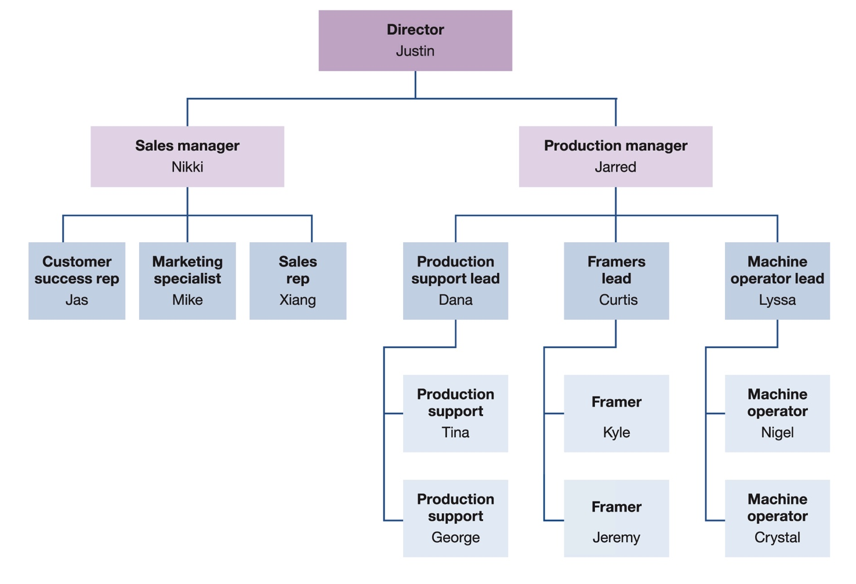
Jaspreet’s story
Identify and practise strategies
Practise reading an organizational chart
What is an organizational chart?
An organizational chart shows the structure of the company. It shows how jobs and employees are connected.
Notes:
Note: This slide has animations.
Workbook, page 19
Read the questions on the slide:
What is an organizational chart?
Allow the class to share their ideas.
Click to show the answer. Read it out loud.
Click to show the chart. Say: This is an example of what an organizational chart looks like.

Slide 23
Jaspreet’s story
Identify and practise strategies
What does an organizational chart look like?
An organizational chart has boxes for employees and their jobs.
The box at the top is the head of the company.
Lines show how jobs are connected. They show who manages other employees and who employees report to.
The chart shows that Justin supervises Nikki (sales manager) and Jarred (production manager). George and Tina report to Dana.
Do the task on page 20.
Do the task on page 20.
Notes:
Note: This slide has animations.
Workbook, page 20
Ask learners to use the chart in their workbooks to follow along.
Click to show the first sentence. Ask a learner to read it out loud. Use the chart on the slide and point to the boxes.
Click to show the second sentence. Ask a learner to read it out loud. Use the chart on the slide and point to the top box. Tell the learners who the head of the organization is in this chart.
Click to show the third sentence. Ask a learner to read it out loud. Use the chart on the slide and point to the lines.
Click to show the fourth sentence.
Discuss vocabulary:
Report to: work under someone’s supervision
You report to your manager or supervisor, and they oversee your work.
Ask a few questions about who supervises who and who reports to whom to see if the learners understand the layout and the relationships in the chart.
Ask learners to do the task on page 20.
Check the answers together with the whole class.

Slide 24
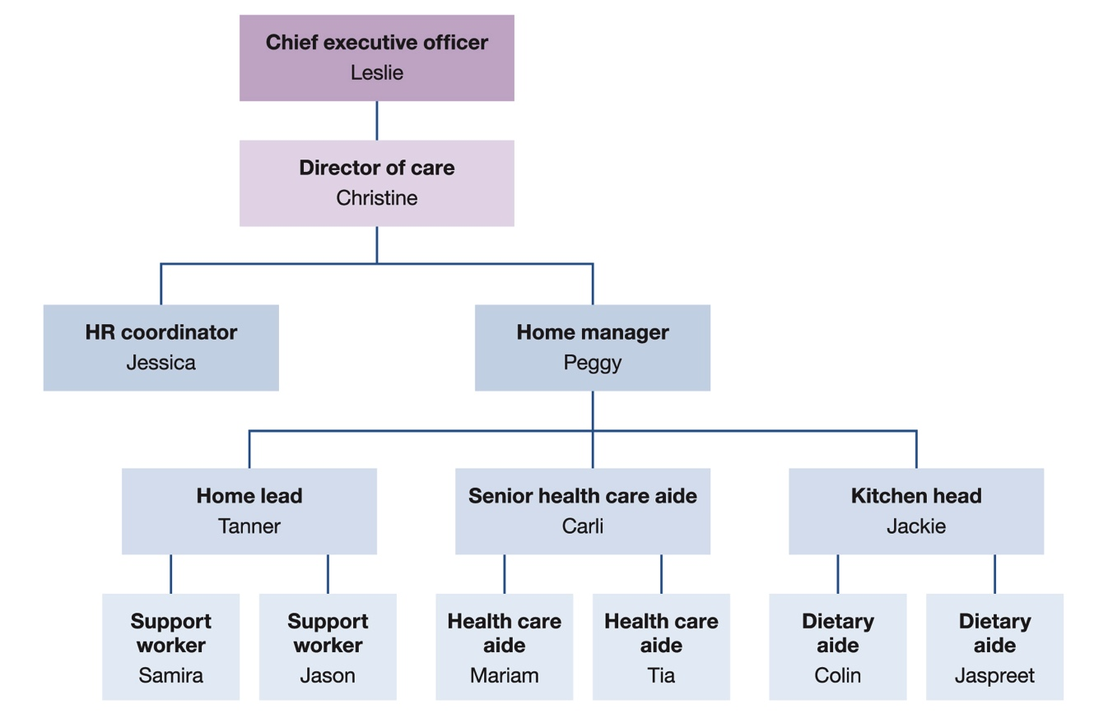
Jaspreet’s story
Identify and practise strategies
Practise reading an organizational chart
Help Jaspreet use the chart to see what career opportunities she may have with the company.
Do the task on page 21.
Notes:
Workbook, page 21
Ask the learners to read the paragraph on page 21 under the heading “How can an organizational chart help you with your career goal?”
Then tell them to look at the chart and occupations listed and to think about Jaspreet and her situation.
Ask learners to do the task on page 21.
Remind them to use the chart to answer the questions.
Discuss the answers as class.

Slide 25
Jaspreet’s story
Identify and practise strategies
Strategies to talk about your goals
Pick the right time
Ask about opportunities
Talk about the benefits of what you want to do
Follow up
Ask about next steps
Stay positive
Do task 1 on page 23.
Do tasks 2 and 3 on pages 24 and 25.
Reflect
Notes:
NOTE: This slide has animations.
Workbook, pages 22-24
Ask different learners to read the strategies on page 23 one by one. Click to show the strategies on the slide one by one as they read them.
Alternatively, give the learners 3-5 minutes to read the strategies to themselves.
Vocabulary:
Prioritize tasks: understand which tasks are more important and do them first
Job shadow: watch a co-worker do their job and learn from them
Task 1 (page 23)
Do the first example of this task with the class to make sure learners understand what they need to do.
Ask learners to write the answers to the mini scenarios in their workbooks.
Invite a few volunteers to share their answers with the class.
Task 2 (page 24)
Ask learners to read the instructions and do the task.
Check answers with the class.
Task 3 (page 24-25)
Ask learners to work in pairs, read the mini scenarios and answer the questions.
Invite a few volunteers to share with the class.
Reflect (page 25)
Ask learners to answer the questions in the reflection activity on page 25.
Ask learners to share the answers in pairs or small groups.

Slide 26
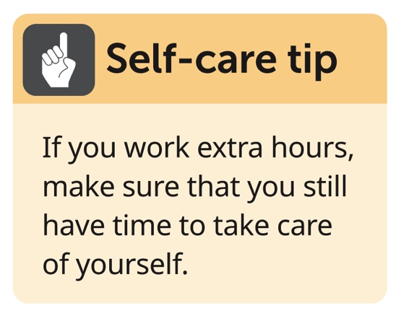
Jaspreet’s story
Identify and practise strategies
Strategies to cover the cost of training
Ask your employer
Adjust your spending habits
Work extra hours
Work shifts with extra pay
Notes:
NOTE: This slide has animations.
Workbook, page 26
Ask different learners to read the strategies on page 26 one by one. Click to show the strategies on the slide one by one as they read them.
Alternatively, give the learners 3-5 minutes to read the strategies to themselves.
Click to show the tip:
Self-care tip
If you work extra hours, make sure that you still have time to take care of yourself.
Talk with the learners about what this means.
Ask
Which strategy did you already know and use?
Which strategy did you not know about?
Which one will you start using?

Slide 27
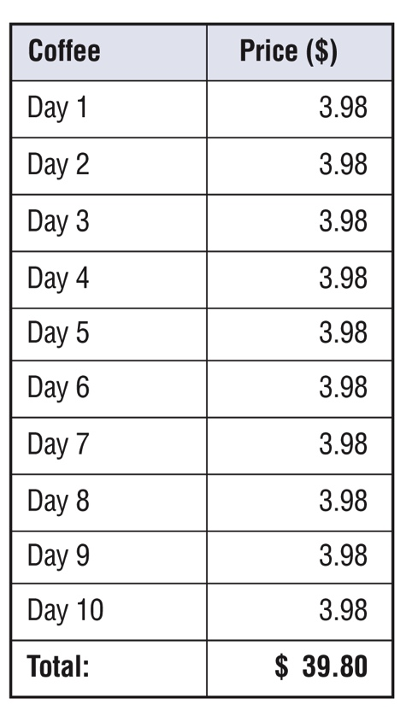
Jaspreet’s story
Identify and practise strategies
How Jaspreet can adjust her spending habits
Buying coffee
Making coffee at home
This pay period, Jaspreet made her coffee at home.
She bought ground coffee from the store.
She paid $8.97 for enough coffee for 10 working days.
How much did Jaspreet save?
Notes:
Workbook, page 27
Ask learners to read information on page 27.
Ask:
How much money did Jaspreet spend when she bought coffee from a coffee shop?
How much money did Jaspreet spend when she made coffee at home?
How much did she save?
Allow the class to share their answers. Ask them how they know how much she saved.
If they say they read it in the workbook, ask them how they would calculate the savings on their own.
Point out the numeracy tip.
Numeracy tip
To calculate the difference, subtract the smaller amount from the bigger.

Slide 28
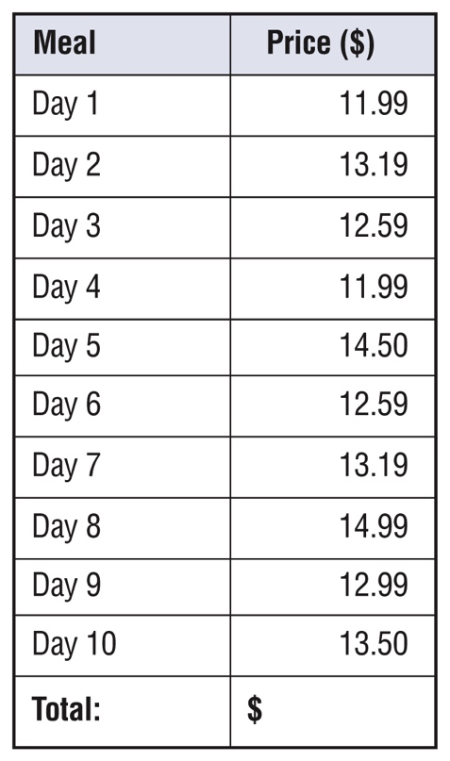
Jaspreet’s story
Identify and practise strategies
How Jaspreet can adjust her spending habits
Do the task on page 28.
How much did Jaspreet spend on lunch last pay period?
Notes:
Workbook, page 28
Task (page 28)
Ask learners to calculate how much Jaspreet spent on lunch this pay period.
Check answers with the whole class.
Ask learners to calculate how much Jaspreet saved on lunch this pay period.
Remind them how to calculate the difference if necessary.

Slide 29
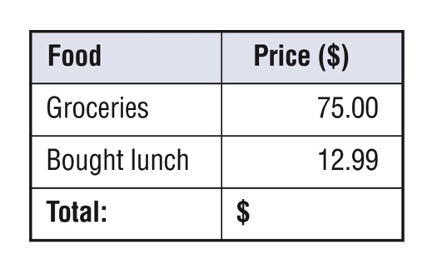
Jaspreet’s story
Identify and practise strategies
How Jaspreet can adjust her spending habits
How much did she spend on lunch this pay period?
How much did Jaspreet save on lunch this pay period?
Reflect
Notes:
NOTE: This slide has animations.
Workbook, page 29
Reflect (page 29)
Ask learners to think about their own goals and answer the reflection questions.
Ask learners to share their answers in pairs or small groups.

Slide 30
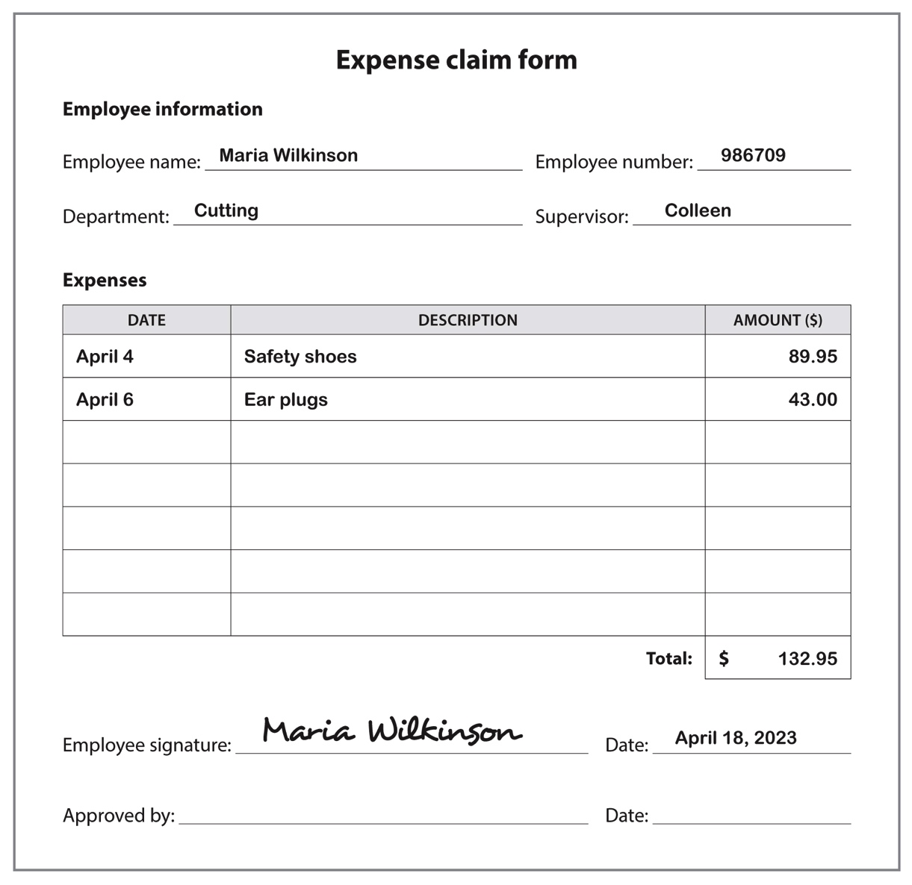
Jaspreet’s story
Identify and practise strategies
Practise filling out an expense claim form
Personal information
Information about each expense
Total amount
Signature
Date
Do the task on page 31.
Notes:
Workbook, page 30-31
Ask learners what an expense form is and when they would use it.
Let them know they can find the answers to that in their workbooks on page 30.
Discuss the layout of the form and the key information that needs to be written on the form.
Ask learners to identify on the slide or in their workbooks where each type of information is entered.
Task (page 31)
Ask learners to use the information in the short scenario to fill out the form on page 31.
Go around the class to monitor the progress and offer help when/if needed.
Ask the learners to share their answers in pairs or small groups.

Slide 31
Jaspreet’s story
Identify and practise strategies
Strategies to fit healthy habits into your schedule
Wake up earlier
Set an alarm to do stretches during the day
Take time off
Reflect
Notes:
NOTE: This slide has animations.
Workbook, pages 32 and 33
Ask different learners to read the strategies on page 32 one by one. Click to show the strategies on the slide one by one as they read them.
Alternatively, give the learners 3-5 minutes to read the strategies to themselves.
Ask
Which strategy did you already know and use?
Which strategy did you not know about?
Reflect (page 33)
Ask learners to answer the questions in the reflection activity on page 33.
Ask a few volunteers to share their self-care strategies in pairs or small groups.

Slide 32
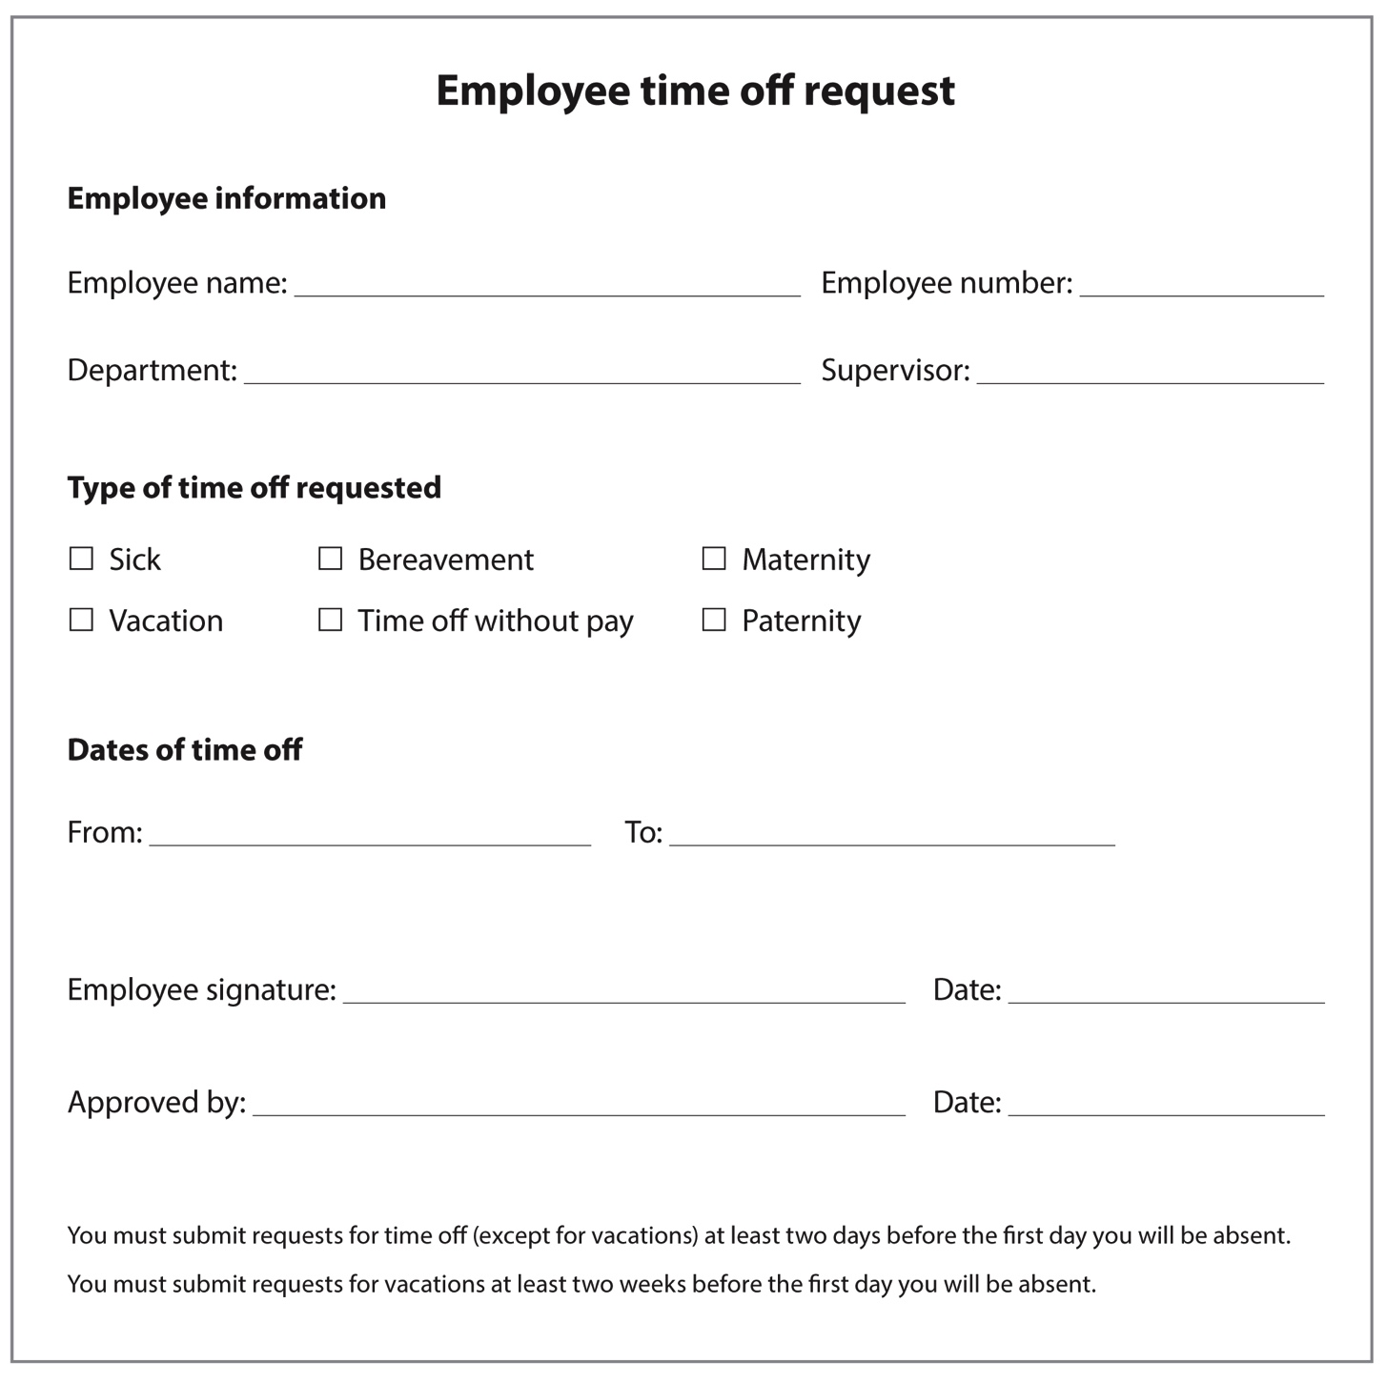
Jaspreet’s story
Identify and practise strategies
Practise filling out a time off request form
Personal information
Type of leave
First and last days
Signature
Date
Do the task on page 35.
Notes:
Workbook, pages 34 and 35
Ask learners what a time-off form is and when they would use it.
Let them know they can find the answers to that in their workbooks on page 34.
Discuss the layout of the form and the key information that needs to be written on the form.
Ask learners to identify on the slide or in their workbooks where each type of information is entered. You can use the slide to point out the parts.
Discuss vocabulary that explains different types of leave.
Task (page 35)
Ask learners to use the information in the short scenario to fill out the form on page 35.
Go around the class to monitor the progress and offer help when/if needed.

Slide 33
Jaspreet’s story
Apply what you’ve learned
Apply what you’ve learned
Now that you know more about how to adapt, how would you handle the situations described in your workbook on page 36?
Notes:
Workbook, page 36
Allow the learners 7-10 minutes to complete the quiz.
Encourage them to use the strategies and tips that they have learned in this unit.
As the learners are completing the quiz, you can go around and check the answers with them one-on-one. There is no right or wrong answer. However, if the learner chooses an answer that indicates that they are not applying the strategies discussed in the unit, you can ask follow-up or probing questions to identify needs for coaching or other wraparound supports.

Slide 34
What’s next?
What’s next?
What’s next?
Talking about what you’ve achieved at work
Examples of what you can achieve at work are:
Taking on a challenge
Learning something new and using it in your work
Setting a goal and achieving it
Prepare short stories about how you did things with success in challenging situations.
Do task 1 on pages 37 and 38.
Do task 2 on page 38.
Notes:
Workbook, pages 37 and 38
Say:
- When you want to grow with the company, you may need to talk to your supervisor or manager about what you have achieved. Examples can be:
Taking on a challenge
Learning something new and using it in your work
Setting a goal and achieving it
Note: If learners did previous units, you can remind them that they learned how to tell stories about your skills in Adaptability and Collaboration: Unit 1. If they have not done previous units, you can use some of the activities from there to build up their skills.
Task 1 (page 37-38)
Ask learners to think about how they would tell a story of their own success.
Ask them to read the instructions on page 37. Then ask someone to repeat back what they need to do.
Go around the class to monitor the progress and offer help when/if needed.
Ask a few volunteers to share their answers with the class.
Task 2 (page 38)
Assign this task as homework.

Slide 35
Self-evaluation
Self-evaluation
How well can you do these activities?
Notes:
NOTE: If you used this self-evaluation at the beginning of the unit, learners can repeat it now to reflect on their skills and see if there was any improvement by comparing their answers from the first self-evaluation to this one.
Remind the learners what self-evaluation is and its purpose.
Review the layout of the table and provide examples to the learners on how to complete self-evaluation.
Give them time (2-3 minutes) to complete the Self-evaluation 1 (page 39). Show them how to compare answers to the Self-evaluation they did at the beginning of this unit (page 4).

