Slide 1
﻿SKILLS FOR SUCCESS: Adaptability

Slide 2
Adaptability Introduction
Welcome to this unit on adaptability!
Instructor’s intro
Participants’ intro

Slide 3
Adaptability Introduction
What is adaptability?
Adaptability is your ability to respond to situations that are new or challenging for you.
Notes:
NOTE: This slide has animation.
Workbook, page 2
Determine prior knowledge by asking learners: “What is adaptability?”
Allow them 2-3 minutes to brainstorm and share ideas as a class.
Click to show the definition on the slide.
Let learners know they will be learning about strategies for adapting to a new workplace.

Slide 4
Adaptability Introduction
When do you show adaptability?
You show adaptability when you:
Help your body adjust to hard physical work
Learn from your mistakes
Adapt to the new workplace culture
Notes:
NOTE: This slide has animations.
Workbook, page 2
Explain vocabulary
Probationary period: the first three to six months of employment. This is when you learn the job. It gives you and the employer time to decide if the job is a good fit.
Ask learners to brainstorm ideas on when/how they show they can adapt when they start a new job. Allow 2-3 minutes for brainstorming.
Click to show the answers on the slide one by one.
Explain vocabulary when you get to the last bullet point.
Workplace culture: how people in the workplace think, communicate and approach their work. This is what makes it different from other workplaces.

Slide 5
Adaptability Introduction
Learning outcomes
After completing this unit, you will be able to:
Identify when you may need to adapt when you start a new job
Identify the purpose for adapting
Use strategies to adapt
Notes:
Workbook, page 2
NOTE: This slide has animations.
Let the class know what they will be learning.

Slide 6
Adapting to pass the probationary period
Give yourself time
Help your body adapt
Learn from your mistakes
Ask your employer to meet your needs
Notes:
Workbook, page 3
Ask learners to read the first example from the slide.
Ask learners to explain how they can show adaptability in the first situation or what they understand when someone says, “Give yourself time.”
Ask a learner to read the explanation of the example from the workbook out loud.
Repeat for all the other examples on the slide.
Explain the vocabulary when you get to the last example.
Accommodate: make changes to meet a worker’s needs. For example, your employer may change a break time for your medical needs.
Activity time: 7-10 minutes

Slide 7
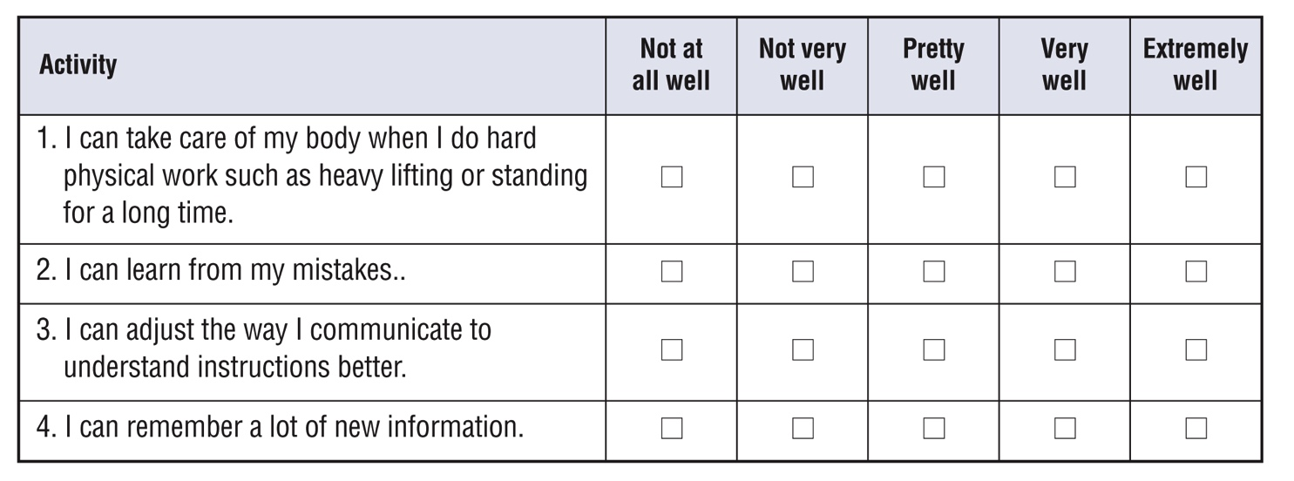
Self-evaluation
Self-evaluation
How well can you do these activities?
This will help your instructor target the lesson material to your needs. That is why you should answer the questions as honestly as you can.
Notes:
Instructor guide, page 3 – scoring information
Instructor guide, page 4 – how to use the self-evaluation
Workbook, page 4 – Self-evaluation activity for participants
Explain to the learners what self-evaluation is and its purpose.
Explain the layout of the table and provide examples of how to complete self-evaluation.
Allow them 5-7 minutes to complete Self-evaluation 1 and Self-evaluation 2 (page 4).

Slide 8
Janet’s story
Kim’s story
Notes:
Instructor guide, page 4 – Stories
Instructor guide, page 5 – How to use the stories
Instructor guide, page 5 – How to determine the learner’s needs
Workbook, page 5 – Janet’s story
Workbook, page 27 – Kim’s story
Let the learners know that in this unit, they will read about Janet and/or Kim. Janet and Kim started their new jobs and are learning how to adapt to the new workplace. They need strategies and tips to do it effectively.

Slide 9
Janet’s story
Notes:
Workbook, page 5 – Janet’s story
Allow learners 3-5 minutes to read Janet’s story on their own.
Note: If some of the participants are struggling with reading, you can offer to read the story out loud or ask for someone to volunteer to read to the class (or group).
Go over key points and vocabulary to make sure everyone understood the story.
These are some of the questions you can ask:
Who is this story about?
What type of work does Janet do?
How long has Janet been in this job?
What are some challenges Janet is facing?
Check with the learners if there are any words in the story they found confusing or they did not understand. Discuss/explain them as a class.
Activity time: 5 minutes

Slide 10
Janet’s story
What to adapt to? Identify areas
Janet wants to pass her probationary period and succeed in the job. To do this, she needs to adapt to the new job and workplace.
What does Janet need to adapt to?
Do the task on page 6
Notes:
Workbook, page 6
Task
Ask a learner to read the instructions for the task. Then ask the learners what they need to do, to check if they understood the instructions.
Let learners know they should use the information from Janet’s story to find the right answers. Allow them 3-5 minutes to complete the task.
Pair up learners to compare their answers or check the answers as a class.

Slide 11
Janet’s story
What to adapt to? Identify areas
Reflect
Think of a new job or volunteer experience you had.
How is Janet’s experience similar to your own?
Are there any differences? What are they?
What were three new things you had to adapt to?
Notes:
NOTE: This slide has animations.
Workbook, page 7
Vocabulary:
Check to see if learners understand the word “reflect” and what they should be doing when asked to “reflect on” something
Click to show the reflection questions.
Reflect
Ask learners to answer the first set of questions. Point out that these questions are about the past.
Allow the learners 5 minutes to reflect on the questions. Then ask them to work in pairs and discuss their answers.
They can use space in the workbook to write down their answers/ideas.
Ask if there is anyone who wants to share their answers with the class/group.

Slide 12
Janet’s story
What to adapt to? Identify areas
Reflect
Think of your future job.
What are three new things you may need to adapt to?
Notes:
Workbook, page 7
Reflect
Ask learners to answer the second set of questions. Point out that these questions are about the future.
Allow the learners 5 minutes to reflect on the questions. Then ask them to work in pairs and discuss their answers.
They can use space in the workbook to write down their answers/ideas.
Ask if there is anyone who wants to share their answers with the class/group.

Slide 13
Janet’s story
What does adapting look like? Identify actions
What actions could Janet take to adapt?
Do the task on page 8
Notes:
Workbook, page 8
Task
Ask a learner to read the instructions for the task. Then ask the learners what they need to do, to check if they understood the instructions. Point out the example done.
Allow the learners 3-5 minutes to complete the task. Ask them to share their answers in pairs or as a class.

Slide 14
Janet’s story
What does adapting look like? Identify actions
Reflect
Think of the new job or volunteer experience that you had.
What did you do to adapt to the three new things?
Think of one action for each.
Think of your future job.
What would you do to adapt to the three new things?
Think of one action for each.
Notes:
NOTE: This slide has animations.
Workbook, page 9
Reflect
Click to show the first set of questions of the reflection activity.
Ask the learners to reflect on the questions. Remind them that they should think of the same job or volunteer experience they reflected on in the previous reflection activity.
Learners can use the space in the workbook to write down their answers/ideas.
When they have completed, ask them to discuss their answers in pairs.
Click to show the second set of questions of the reflection activity.
Ask the learners to reflect on the questions. Remind them that they should think of the same (future job) job in the previous reflection activity.
When they have completed, ask them to discuss their answers in pairs.

Slide 15
Janet’s story
Why adapt? Identify the purpose
The probationary period is one of the most important times in your job. You need to learn a lot of new things and find your place in the team. You need to make a lot of effort to adapt. You can get overwhelmed and lose motivation. When you remember why you need to adapt, you can stay motivated. You can focus on your goal to learn the job, perform well and pass your probationary period.
Each time you adapt, you will get closer to your goal. For example, if you stretch and exercise every day, it will become easier for your body to handle the hard physical work. If you have a hot bath when you get home after work, your body will get a chance to relax. The next day, you will have more energy and can focus on your tasks better.
Notes:
NOTE: This slide has animation.
Workbook, page 10
To elicit prior knowledge and understanding, ask the learners:
Why should people adapt when they start a new job?
Discuss with the whole class or in groups.
Click to show the paragraph.
Ask a volunteer to read it out.

Slide 16
Janet’s story
Why adapt? Identify the purpose
Why should Janet adapt?
Do the task on page 10
Reflect
Notes:
NOTE: This slide has animations.
Workbook, pages 10 and 11
Click to show the question, “Why should Janet adapt?” and tell learners that they will be completing a task to help Janet identify why she needs to adapt.
Task
Ask a learner to read the instructions for the task. Then ask the learners what they need to do, to check if they understood the instructions. Point out the first sentence that has been done as an example. Or give the learners 1 minute to read it to themselves.
Allow them 5 minutes to complete the task. When the learners complete the task, ask them to share their ideas as a class or in pairs.
Reflect
Allow the learners 5 minutes to reflect on the questions on page 11. Then ask them to work in pairs and discuss their answers.
They can use space in the workbook to write down their answers/ideas.

Slide 17
Janet’s story
How can you adapt effectively?
Identify and practise strategies
Strategy: a plan or way to do something so you can achieve a goal
Reflect
Think of the challenges that Janet is facing.
How can she adapt better?
Do you know of any strategies she could use?
Notes:
NOTE: This slide has animations.
Workbook, page 12
Check your learners’ understanding by asking:
What is a strategy?
If you have done Adaptability Unit 1 or Collaboration Unit 1 you can use this opportunity to review what learners remember about strategies.
Click to show the vocabulary for “strategy.”
Reflect
Allow the learners 5 minutes to reflect on the questions.
Remind learners that they can find the answer to the first question in Janet’s story on page 5 in their workbooks.
Ask the learners to share their thoughts as a class or in pairs.
Learners can use the space provided in the workbook to write down their ideas.

Slide 18
Janet’s story
How can you adapt effectively?
Identify and practise strategies
There are many strategies that can help you adapt more easily.
Strategies to help your body adapt
Strategies to learn on the job
Strategies to understand instructions
Notes:
NOTE: This slide has animations.
Workbook, pages 12-21
Strategies to help your body adapt (page 13)
Strategies to learn on the job (page 15)
Strategies to understand instructions (page 18)
Say:
- Many strategies can help you adapt more easily. You can choose the ones that work for you. Experts recommend you use different types of strategies. Why not try and see what happens!
Say:
These are the strategies we will explore and practice in this section:
Click to show the first set: Strategies to help your body adapt
Click to show the second set: Strategies to learn on the job
Click to show the third set: Strategies to understand instructions

Slide 19
Janet’s story
Identify and practise strategies
Strategies to help your body adapt
Stretch and exercise
Take a hot bath
Get enough sleep
Drink plenty of water and eat healthy food
Reflect
Notes:
NOTE: This slide has animations.
Workbook, pages 13 and 14
Ask different learners to read the strategies on page 13 one-by-one. Click to show the strategies on the slide one-by-one as they read them.
Alternatively, give the learners 3-5 minutes to read the strategies to themselves.
Ask
Which strategy did you already know and use?
Which strategy did you not know about?
Which one will you start using?
Reflect
Ask learners to work in pairs and answer the questions in the reflection activity on page 14.
Invite a few volunteers to share their answers with the class.

Slide 20
Janet’s story
Identify and practise strategies
Strategies to learn on the job
Write down details
Learn from your mistakes
Look for ways to learn
Do the task on page 16
Reflect
Notes:
NOTE: This slide has animations.
Workbook, pages 15-17
Ask different learners to read the strategies on page 15 one-by-one. Click to show the strategies on the slide one-by-one as they read them.
Alternatively, give the learners 3-5 minutes to read the strategies to themselves.
Ask
Which strategy did you already know and use?
Which strategy did you not know about?
Which one will you start using?
Task (page 16)
Do the first example of this task with the class to make sure learners understand what they need to do.
Ask learners to write the answers to the mini scenarios in their workbooks.
Invite a few volunteers to share with the class.
Reflect (page 17)
Ask learners to answer the questions in the reflection activity on page 17.
Invite a few volunteers to share their answers with the class.

Slide 21
Janet’s story
Identify and practise strategies
Strategies to understand instructions
Explain that you don’t understand
Ask your co-workers to repeat
Ask your co-workers to speak slower
Repeat the information back to make sure you understand
Ask for feedback
Use polite words
Do the task on page 19 and 20
Reflect
Notes:
NOTE: This slide has animations.
Workbook, pages 18-21
Ask different learners to read the strategies on page 18 one-by-one. Click to show the strategies on the slide one-by-one as they read them.
Alternatively, give the learners 3-5 minutes to read the strategies to themselves.
Ask
Which strategy did you already know and use?
Which strategy did you not know about?
Task (page 19)
Do the first example of this task with the class to make sure learners understand what they need to do. Ask learners to write the answers to the mini scenarios in their workbooks. Invite a few volunteers to share with the class.
Reflect (page 21)
Ask learners to answer the questions in the reflection activity on page 21.
Invite a few volunteers to share their answers with the class.

Slide 22
Janet’s story
Identify and practise strategies
Skill building
Practise making decisions
Notes:
Workbook, pages 22 and 23
Ask learners to read step 1 example in the workbook.
Ask:
What is the first step?
What did Janet write in the “good” column
NOTE: you can use this to revise or teach filling out tables and explain columns and rows.
Ask learners to read step 2 example in the workbook.
Ask:
What is the second step?
What did Janet write in the “bad” column
Ask learners to read step 3 example in the workbook.
Ask:
What is the third step?
Are there more “good” or “bad” things in Janet’s table?
Ask learners to read step 4 example in the workbook.
Ask:
What is the fourth step?
What decision did Janet make?
Why do you think Janet made that decision?
Ask if anyone uses this strategy to make decisions.
Activity time: 5 – 7 minutes

Slide 23
Janet’s story
Identify and practise strategies
Skill building
Practise making decisions
Do the task on page 24
Looking at both the good and bad sides of a situation is a transferable skill. Use it in your employment program, in your job and in your daily life.
Notes:
NOTE: This slide has animation.
Workbook, pages 24 and 25
Ask learners to do the task on page 24.
Let them know that they should use the steps discussed to help them complete the task.
Go around the classroom and offer help to those who are struggling.
When they complete, ask if anyone would like to share.
Click to show the blue box. Have a learner read the text in the blue box.
Activity time: 7 – 10 minutes

Slide 24
Janet’s story
Apply what you’ve learned
Apply what you’ve learned
Now that you know more about how to adapt, how would you handle the situations described in your workbook on page 26?
Notes:
Workbook, page 26
Allow the learners 7-10 minutes to complete the quiz.
Encourage them to practise the strategies and tips that they have learned in this unit.
As the learners are completing the quiz, you can go around and check the answers with them one-on-one. There is no right or wrong answer. However, if the learner chooses an answer that indicates that they are not applying the strategies discussed in the unit, you can follow up by asking probing questions to identify needs for coaching or other wraparound supports.

Slide 25
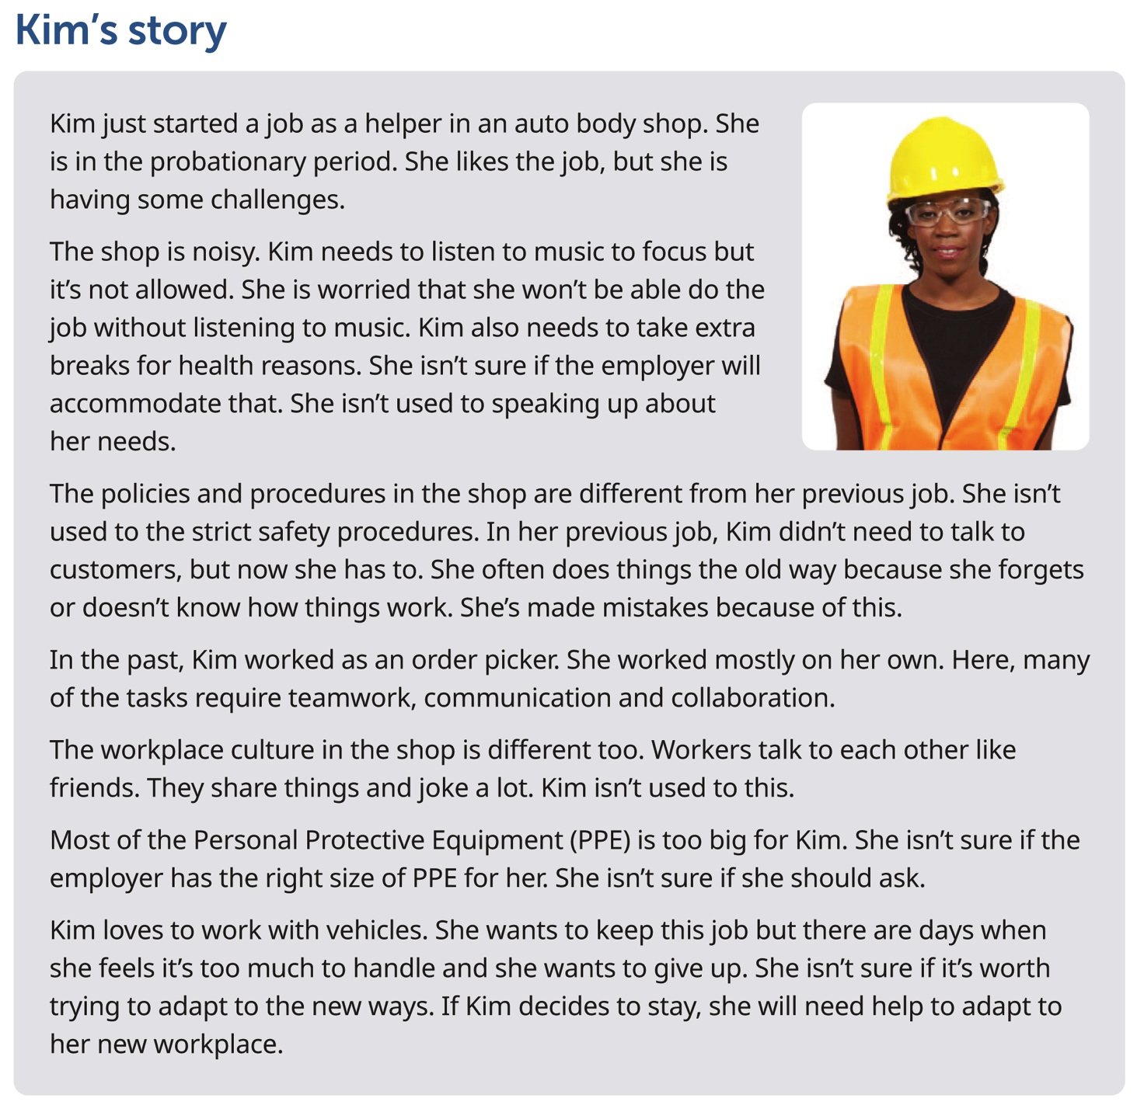
Kim’s story
Notes:
Workbook, page 27
Kim’s story
Give learners 3-5 minutes to read Kim’s story or ask a learner to read it out.
Note: If some of the learners are struggling with reading, you can offer to read the story out loud or ask for someone to volunteer to read to the class (or group).
Explain vocabulary:
Personal Protective Equipment (PPE): Things that you wear to protect yourself from workplace hazards. Some examples are protective gloves, respirators and safety boots.
Ask:
Who is this story about?
What type of work does Kim do?
How long has Kim been in this job?
What are some challenges Kim is facing?
Inform the learners that the next set of activities will focus on Kim’s story.

Slide 26
Kim’s story
What to adapt to? Identify areas
Kim wants to pass her probationary period and do well in her job. To do this, she needs to adapt to the new workplace.
What does Kim need to adapt to?
Do the task on page 28
Kim’s story
Notes:
Workbook, page 28
Task
Ask a learner to read the instructions for the task. Then ask the learners what they need to do, to check if they understood the instructions.
Let the learners know they will find answers in Kim’s story.
Allow them 3-5 minutes to complete the task.
Ask the learners to share their answers in pairs or as a class.

Slide 27
Kim’s story
What to adapt to? Identify areas
Reflect
Think of a new job or volunteer experience you had.
How is Kim’s experience similar to your own?
Are there any differences? What are they?
What were three new things you had to adapt to?
Notes:
NOTE: This slide has animations.
Workbook, page 29
Vocabulary:
Check to see if learners understand the word “reflect” and what they should be doing when asked to “reflect on” something.
Reflect
Click to show the first set of reflection questions.
Ask learners to answer the first set of questions. Point out that these questions are about the past.
Allow the learners 5 minutes to reflect on the questions. Then ask them to work in pairs and discuss their answers.
They can use space in the workbook to write down their answers/ideas.
Ask if there is anyone who wants to share their answers with the class/group.

Slide 28
Kim’s story
What to adapt to? Identify areas
Reflect
Think of your future job.
What are three new things you may need to adapt to?
Notes:
Workbook, page 29
Click to show the second set of reflection questions:
Ask learners to answer the second set of questions. Point out that these questions are about the future.
Allow the learners 5 minutes to reflect on the questions. Then ask them to work in pairs and discuss their answers.
They can use space in the workbook to write down their answers/ideas.
Ask if there is anyone who wants to share their answers with the class/group.

Slide 29
Kim’s story
What does adapting look like?
Identify actions
What actions could Kim take to adapt?
Do the task on page 30
Notes:
Workbook, page 30
Task
Ask learners to read the instructions for the task. Then ask them what they need to do, to check if they understood the instructions. Allow them 5 minutes to complete the task.
Ask the learners to share their answers in pairs or as a class.

Slide 30
Kim’s story
What does adapting look like?
Identify actions
Reflect
Think of the new job or volunteer experience that you had.
What did you do to adapt to the three new things?
Think of one action for each.
Think of your future job.
What three things do you think you might have to adapt to?
Think of one action for each.
Notes:
NOTE: This slide has animations.
Workbook, page 31
Reflect
Click to show the first set of questions of the reflection activity.
Ask the learners to reflect on the questions. Remind them that they should think of the same job or volunteer experience they reflected on in the previous reflection activity.
Learners can use the space in the workbook to write down their answers/ideas.
When they have completed, ask them to discuss their answers in pairs.
Click to show the second set of questions of the reflection activity.
Ask the learners to reflect on the questions. Remind them that they should think of the same (future job) job in the previous reflection activity.
When they have completed, ask them to discuss their answers in pairs.

Slide 31
Kim’s story
Why adapt? Identify the purpose
The probationary period is one of the most important times in your job. You need to learn a lot of new things and find your place on the team. You need work hard to adapt. You can get overwhelmed and lose motivation. When you keep in mind why you need to adapt, you can stay motivated. You can focus on your goal to learn the job, perform well and pass your probationary period.
Each time you adapt, you will get closer to your goal. For example, if you adjust your communication style and politely speak up about your health needs, you will be less stressed at work. When you are less stressed, you can focus on your tasks better.
Notes:
NOTE: This slide has animation.
Workbook, page 32
To elicit prior knowledge and understanding, ask the learners:
Why should people adapt when they start a new job?
Discuss with the whole class or in a group.
Click to show the paragraph.
Ask a volunteer to read it out.

Slide 32
Kim’s story
Why adapt? Identify the purpose
Why should Kim adapt?
Do the task on page 32
Reflect
Notes:
Workbook, page 32 and 33
NOTE: If you have completed the same activity when working on Janet’s story, you can skip this reflection, or you can use it as a revision.
Tell learners that they will be completing a task to help Kim identify why she needs to adapt.
Task (page 32)
Have a learner read the instructions and the first sentence that has been done as an example. Or allow the learners 1 minute to read it to themselves.
Ask the learners to repeat what they need to do, to check if they understood the instructions. Allow them 5 minutes to complete the task. When the learners complete the task, ask them to share their ideas as a class or in pairs.
Reflect (page 33)
Allow the learners 5 minutes to reflect on the questions. They can use the space to write their answers/ideas.
When they complete, ask them to share their answers in pairs or as a class.

Slide 33
Kim’s story
Identify and practise strategies
How can you adapt effectively?
Identify and practise strategies
Strategy: a plan or way to do something so you can achieve a goal
Reflect
Think of the challenges that Kim is facing.
How can she adapt better?
Do you know of any strategies she could use?
Notes:
NOTE: This slide has animations.
Workbook, page 34
Check your learners’ understanding by asking:
What is a strategy?
If you have done Adaptability Unit 1 or Collaboration Unit 1, you can use this opportunity to review what learners remember about strategies.
Click to show the vocabulary for “strategy.”
Reflect
Allow the learners 5 minutes to reflect on the questions.
Remind learners that they can find the answer to the first question in Kim’s story on page 27 in their workbooks.
Ask the learners to share their thoughts as a class or in pairs.
Learners can use the space provided in the workbook to write down their ideas.

Slide 34
Kim’s story
Identify and practise strategies
How can you adapt effectively?
Know who should make changes
When do you need to adapt?
When you start a new job, you may need to change your routine to do the job. The employer will not accommodate your needs if you can adapt but choose not to. For example, if you are a late riser, the employer will not change your shift hours. You need to change your sleep schedule.
When should the employer accommodate?
There are times when employers should make changes so you can work. This is called the duty to accommodate. For example, the employer should accommodate employees who have a disability or need to take a family member to doctor’s appointments regularly.
Notes:
NOTE: This slide has animations.
Workbook, page 35
Explain vocabulary: Duty to accommodate: responsibility to change rules, policies and procedures so you can participate fully in the workplace
Explain to the learners that there are times when the worker needs to make changes and adapt, and there are times when the employer needs to accommodate.
Click to show the questions. Ask:
When do you need to adapt?
Let the class share their ideas/understanding.
Click to show the answer.
Ask someone to read it out.
Click to show the next question.
Ask:
When should the employer accommodate?
Let the class share their ideas/understanding.
Click to show the answer.
Ask someone to read it out.
NOTE: You can discuss more examples of when the worker needs to adapt, and when the employer needs to accommodate.

Slide 35
Kim’s story
Identify and practise strategies
How can you adapt effectively?
Who should make changes?
Do the task on page 35
Notes:
Workbook, page 35
Read mini scenario 1 and discuss with the class if “Kim should adapt” or “Employer should accommodate”.
Ask learners to do the other scenarios on their own.
Ask learners to check their answers in pairs.
Ask the learners to share their answers with the class.

Slide 36
Kim’s story
Identify and practise strategies
How can you adapt effectively?
Identify and practise strategies
There are many strategies that can help you adapt more easily.
Strategies to ask your employer to accommodate
Strategies to follow policies and procedures
Strategies to adapt to a new workplace culture
Notes:
NOTE: This slide has animations.
Workbook, pages 36 - 48
Strategies to ask your employer to accommodate (page 36)
Strategies to follow policies and procedures (page 42)
Strategies to adapt to a new workplace culture (page 45)
Say:
- Many strategies can help you adapt more easily. You can choose the ones that work for you. Experts recommend you use different types of strategies. Why not try and see what happens!
Say:
These are the strategies we will explore and practice in this section:
Click to show the first set: Strategies to ask your employer to accommodate
Click to show the second set: Strategies to follow policies and procedures
Click to show the third set: Strategies to adapt to a new workplace culture

Slide 37
Kim’s story
Identify and practise strategies
Strategies to ask your employer to accommodate
Find out how to ask
Know what to say
Do task 1 on page 38
Do task 2 on page 39
Reflect
Notes:
NOTE: This slide has animations.
Workbook, page 36 - 41
Click to show the strategies. Ask different learners to read the strategies from the workbook one-by-one.
Alternatively, give the learners 3-5 minutes to read the strategies to themselves.
Ask
Which strategy did you already know and use?
Which strategy did you not know about?
Which one will you start using?
Task 1 (page 38)
Ask a learner to read the instructions for the task.
Confirm everyone understood the instructions by asking them to repeat what they need to do. Allow them 3-5 minutes to do the task.
When they have completed, ask them to share their answers as a class or in pairs.
Task 2 (page 39)
Ask a learner to read the instructions for the task.
Confirm everyone understood the instructions by asking them to repeat what they need to do. Allow them 3-5 minutes to do the task.
Go around the classroom to observe the work and offer help when/if needed.
Reflection (page 41)
Point out to learners that the first set of questions refer to their past experience and the second to their future.
Invite a few volunteers to share their answers to the first set of questions with the class, then ask everyone to write their own answers in the workbook. If participants aren't comfortable to share their own experiences, they can share about someone they know.
Invite another few volunteers to share their answers to the second set of questions with the class, then ask everyone to write their own answers in the workbook.

Slide 38
Kim’s story
Identify and practise strategies
Strategies to follow policies and procedures
Read onboarding documents
Practise good habits
Do the task on page 43 and 44
Notes:
NOTE: This slide has animations.
Workbook, page 42 - 44
Click to show the strategies on the slide one-by-one. Ask different learners to read the strategies from the workbook.
Alternatively, give the learners 3-5 minutes to read the strategies to themselves.
Ask
Which strategy did you already know and use?
Which strategy did you not know about?
Which one will you start using?
Task (page 43)
Ask a learner to read the instructions for the task.
Confirm everyone understood the instructions by asking them to repeat what they need to do. Allow them 3-5 minutes to do the task. Learners can work alone or in pairs.
Go around the classroom to observe the work and offer help when/if needed.

Slide 39
Kim’s story
Identify and practise strategies
Strategies to adapt to a new workplace culture
Watch how people work
Find out who makes decisions
Learn workplace words
Use the same way to communicate
Use the same style to communicate
Do the task on page 47
Reflect
Notes:
NOTE: This slide has animations.
Workbook, pages 45 - 49
Click to show the strategies on the slide one-by-one. Ask different learners to read the strategies from the workbook. Alternatively, give the learners 3-5 minutes to read the strategies to themselves.
Ask
Which strategy did you already know and use?
Which strategy did you not know about?
Which one will you start using?
Task (page 47)
Read the instructions and do the first mini scenario together with the class.
Confirm everyone understood the instructions by asking them to repeat what they need to do. Allow them 3-5 minutes to do the task. Learners can work alone or in pairs.
Ask a few learners to share their answers with the class or in small groups.
Reflect (page 48)
Ask learners to think about reflection questions and write down the answers into their workbooks.

Slide 40
Kim’s story
Identify and practise strategies
Do the task on page 49
Reflect
Notes:
Workbook, pages 49 and 50
Ask:
What is positive self-talk?
Why is positive self-talk important?
Let the class briefly discuss the answers.
Ask learners to read the information about practising positive self-talk.
Ask:
How can you practise positive self-talk?
Task (page 49)
Ask a learner to read the instructions and the example.
Confirm everyone understood the instructions by asking them to repeat what they need to do. Allow them 3-5 minutes to do the task. Learners can work alone or in pairs.
Ask a few learners to share their answers with the class or in small groups.
Reflect (page 50)
Ask learners to think about reflection questions and write down the answers in their workbooks.

Slide 41
Kim’s story
Apply what you’ve learned
Apply what you’ve learned
Now that you know more about how to adapt, how would you handle the situations described in your workbook on page 51?
Notes:
Workbook, page 51
Allow the learners 7-10 minutes to complete the quiz.
Encourage them to practise the strategies and tips that they have learned in this unit.
As the learners are completing the quiz, you can go around and check the answers with them one-on-one. There is no right or wrong answer. However, if the learner chooses an answer that indicates that they are not applying the strategies discussed in the unit, you can ask follow-up or probing questions to identify needs for coaching or other wraparound supports.

Slide 42
What’s next?
What’s next?
What’s next?
Employee performance review
Employers do performance reviews regularly. The first performance review in your new job will be at the end of your probationary period. This is the time when your supervisor or manager will officially speak about how they have rated your performance, what you have done well and what you need to improve.
Notes:
NOTE: This slide has animations.
Workbook, page 52
Ask:
What do you think comes next, after the probationary period is over?
Let learners share ideas with the class.
Click to show the answer
Ask a learner to read the paragraph from the slide

Slide 43
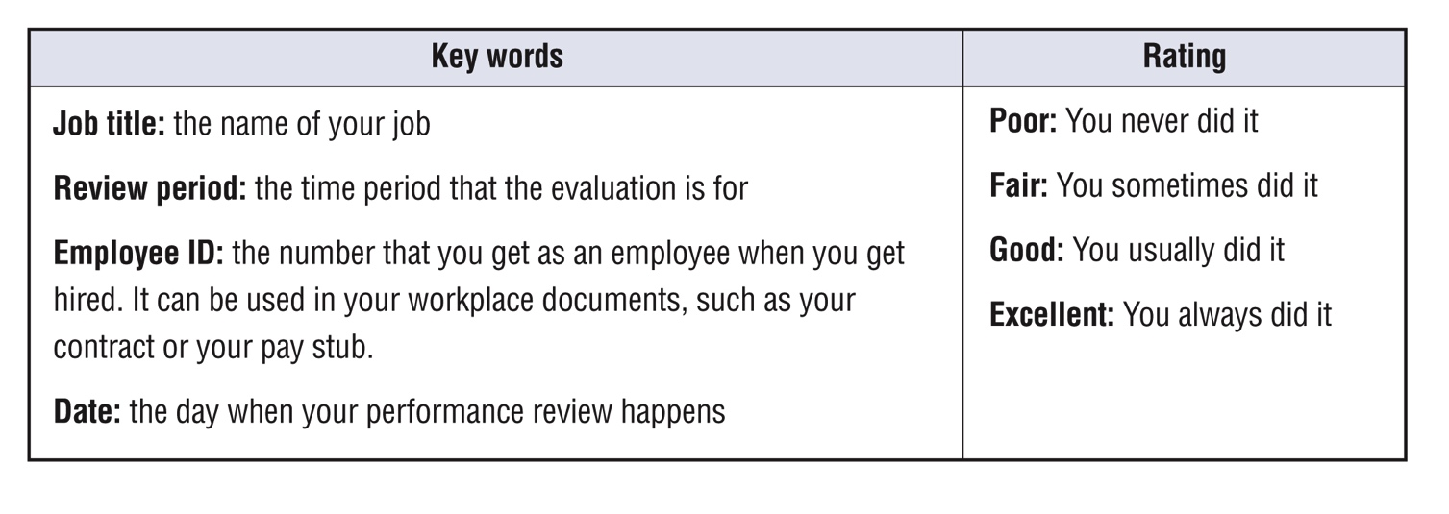
What’s next?
What’s next?
Notes:
Workbook, page 52
Discuss key words with the learners.
Ask them to read information about the performance reviews in their workbooks.

Slide 44
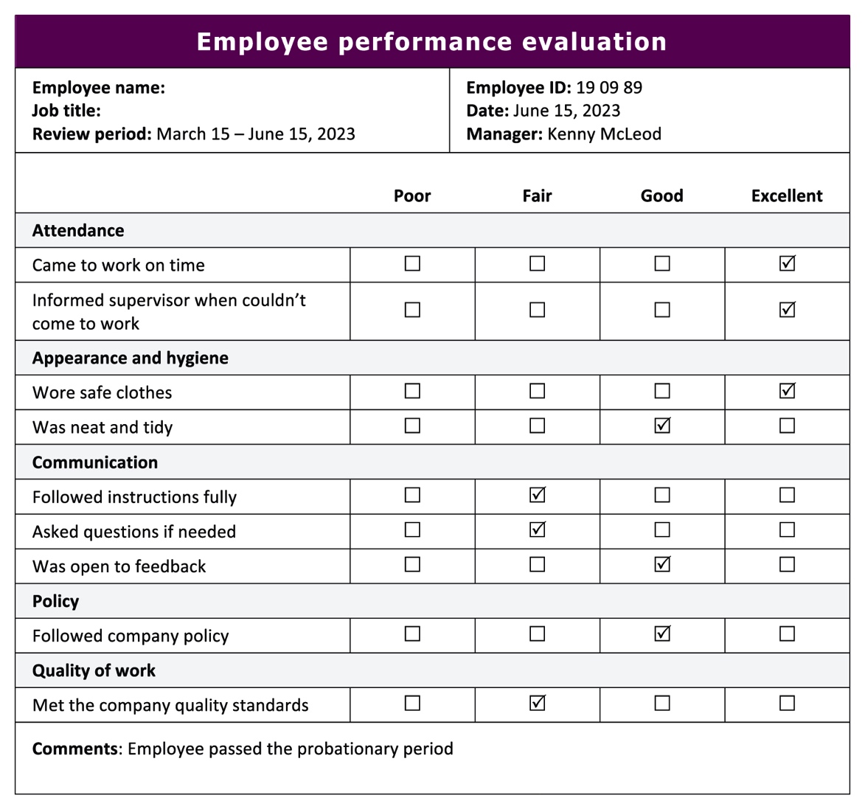
What’s next?
What’s next?
How to read an employee performance evaluation
Find the activity. For example, “Came to work on time.”
Move your eyes or finger across and stop when you see a checkmark (R).
Then follow straight up to see the rating. For example, for “Came to work on time” you did “Excellent”.
Do the task on page 54
Notes:
Workbook, pages 53 and 54
Walk the learners through the process of reading the performance evaluation.
Point out the key words and key parts of the table. Go over the sections.
Show learners how to trace/move their finger over the table to read the information.
Task (page 54)
Explain the task to the learners.
Ask them to answer the questions as if the performance review is theirs.
Go around the classroom to observe the progress. Offer help if/when needed.

Slide 45
What’s next?
What’s next?
Passing your probationary period will be a big success. Most likely by then you will have learned how to do your job. You will have adapted to the new workplace.
Then it will be time to thrive in the job. Most employers like it when their employees stay and grow with their company.
Keep improving your adaptability skills so you can get more training and education, a promotion or a pay raise.
You are on to exciting things!
Notes:
Congratulate the learners on finishing this unit.
Read the text from the slide.

Slide 46
Self-evaluation
Self-evaluation
How well can you do these activities?
Notes:
NOTE: If you used this self-evaluation at the beginning of the unit, learners can repeat it now to reflect on their skills and see if there was any improvement by comparing their answers from the first self-evaluation to this one.
Remind the learners what self-evaluation is and its purpose.
Review the layout of the table and provide examples to the learners on how to complete self-evaluation.
Depending on which story the learners completed, they may repeat Self-evaluation 1 or Self-evaluation 2 or both.
Give them time (5-7 minutes) to complete Self-evaluation 1 and Self-evaluation 2 (page 55). Show them how to compare answers to the Self-evaluation 1 and/or Self-evaluation 2 (page 4) they have done before.

