Slide 1
﻿SKILLS FOR SUCCESS: Adaptability

Slide 2
Adaptability Introduction
Welcome to this unit on adaptability!
Instructor’s intro
Participants’ intro

Slide 3
Adaptability Introduction
What is adaptability?
Adaptability is your ability to adjust day-to-day activities, habits and the way you do things when change happens.
Change can be expected and unexpected.
Notes:
NOTE: This slide has animation.
Workbook, page 2
Determine prior knowledge by asking learners: “What is adaptability?”
Allow them 2 minutes to brainstorm and share ideas as a class.
Click to show the definition on the slide.

Slide 4
Adaptability Introduction
When do you show adaptability?
You show adaptability when you:
Use your time effectively
Focus on your tasks and commitments
Handle your emotions well
Learn new skills
Notes:
NOTE: This slide has animations.
Workbook, page 2
Determine prior knowledge by asking learners if they know what actions show adaptability.
Allow them 2 minutes to brainstorm and share ideas as a class.
Click to show the answer on the slide.

Slide 5
Adaptability Introduction
Learning outcomes
After completing this unit, you will be able to:
List changes to make to prepare for employment
Identify the purpose of those changes
Use strategies to make those changes effectively
Notes:
Workbook, page 2
NOTE: This slide has animations.
Let the class know what they will be learning.

Slide 6
Adapting to prepare for
employment
Adjust your day-to-day activities
Plan your time
Arrange childcare
Focus on preparing for employment
Keep going
Notes:
Workbook, page 3
Ask learners to find examples and explanations in the workbook.
Ask if anyone wants to volunteer to read first example out loud.
Ask learners to explain how they can show adaptability in the first situation. They can use the examples in the workbook, or they can share their own ideas.
Repeat the same steps for each example.
Activity time: 7-10 minutes

Slide 7
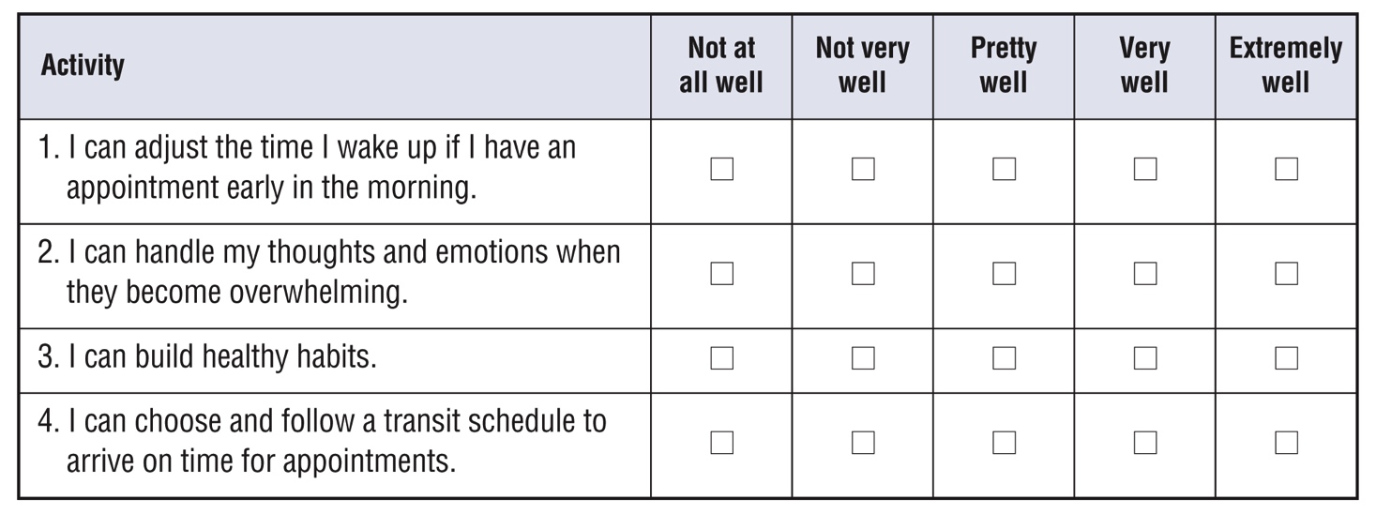
Self-evaluation
Self-evaluation
How well can you do these activities?
This will help your instructor target the lesson material to your needs. That is why you should answer the questions as honestly as you can.
Notes:
Instructor guide, page 3 – scoring information
Instructor guide, page 2 – how to use self-evaluations
Workbook, page 4 – Self-evaluation activity for participants
Explain to the learners what self-evaluation is and its purpose.
Explain the layout of the table and provide example to the learners on how to complete self-evaluation.
Allow them 5-7 minutes to complete Self-evaluation 1 and Self-evaluation 2 (page 4).

Slide 8
Elaine’s story
Jenny’s story
Notes:
Instructor guide, page 4 – Stories
Instructor guide, page 5 – How to use the stories
Instructor guide, page 5 – How to determine the learner’s needs
Workbook, page 5 – Elaine’s story
Workbook, page 26 – Jenny’s story
Let the learners know that in this unit, they will read about Elaine and/or Jenny. Elaine and Jenny are looking for a job. In the past, they have both struggled with making changes to the way they do things. They need strategies and tips to do it effectively.

Slide 9
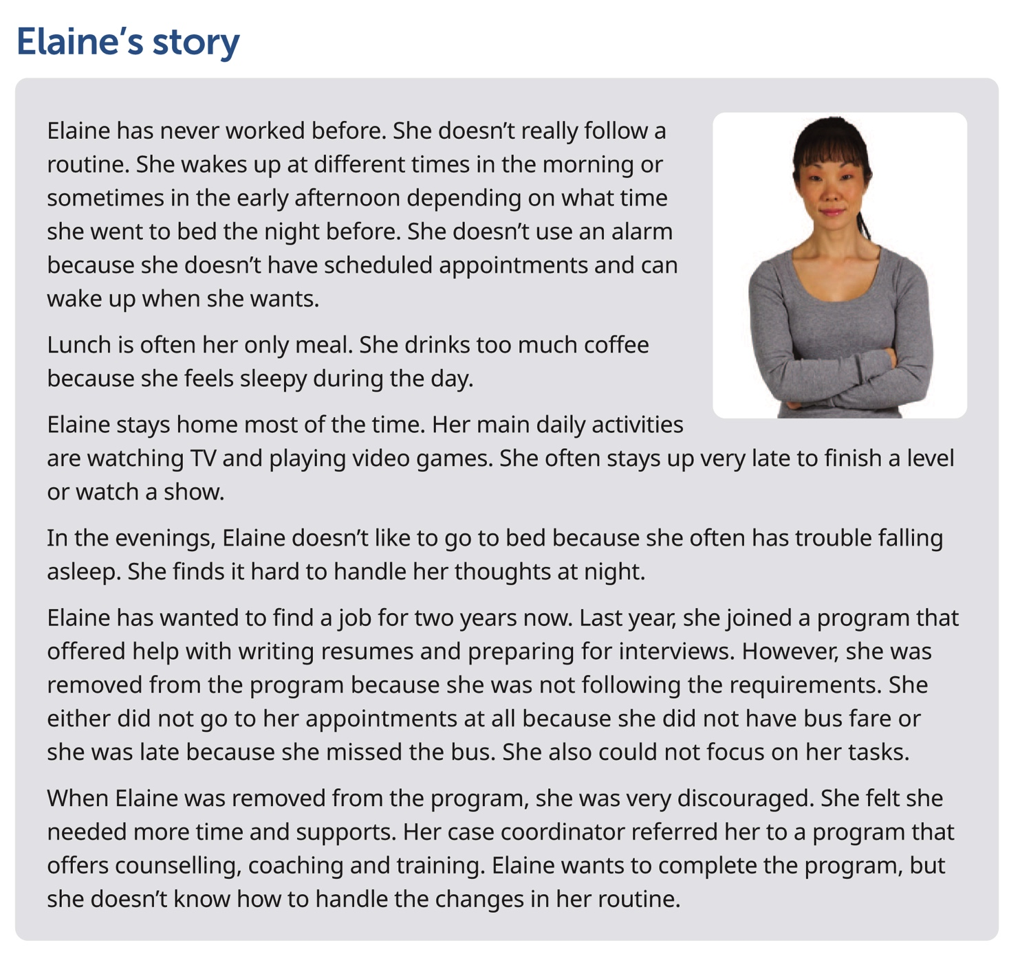
Elaine’s story
Notes:
Workbook, page 6 – Elaine’s story
Allow learners 3-5 minutes to read Elaine’s story on their own.
Note: If some of the participants are struggling with reading, you can offer to read the story out loud or ask for someone to volunteer to read to the class (or group).
Go over key points and vocabulary from the scenario to make sure everyone understood the story. These are some of the questions you can ask:
Who is this story about?
What does Elaine’s routine look like now? / What does Elaine usually do during the day?
What time does Elaine get up every day?
How many meals does Elaine usually have?
Does Elaine have a job? / Is Elaine looking for work?
What are some challenges Elaine faced when she was in a training program?
Vocabulary: Routine = the activities that we do every day
Other potentially confusing words: Valuable, Requirements, Discouraged
Check with the learners if there are any other words they found confusing or they did not understand. Discuss/explain them as a class.
Activity time (for vocabulary and questions): 5 minutes

Slide 10
Elaine’s story
What to change? Identify areas for change
Elaine wants to fully engage in the program and get a job. To do so, she needs to make changes to her day-to-day activities.
What does Elaine need to change?
Do the task on page 6
Notes:
Workbook, page 6
Task
Ask a learner to read the instructions for the task. Then ask the learners what they need to do, to check if they understood the instructions.
Let learners know they should use the information from Elaine’s story to find the right answers. Allow them 3-5 minutes to complete the task.
Pair up learners to compare their answers or check the answers as a class.

Slide 11
Elaine’s story
What to change? Identify areas for change
Think about yourself.
Are there any similarities and differences between Elaine’s story and your own?
Reflect
Notes:
Workbook, page 7
Vocabulary:
Check to see if learners understand the word “reflect” and what they should be doing when asked to “reflect on” something
Reflect
Allow the learners 5 minutes to reflect on the questions. Then ask them to work in pairs and discuss their answers.
They can use space in the workbook to write down their answers/ideas.

Slide 12
Elaine’s story
What does adapting look like? Identify actions
What actions could Elaine take to improve?
Do the task on page 8
Notes:
Workbook, page 8
Task
Ask a learner to read the instructions for the task. Then ask the learners what they need to do, to check if they understood the instructions. Point out the example done on page 8.
Allow the learners 3-5 minutes to complete the task. Ask them to share their answers in pairs or as a class.

Slide 13
Elaine’s story
What does adapting look like? Identify actions
What actions could you take to make positive changes in the areas that you identified for yourself?
Reflect
Notes:
Workbook, page 8
Reflect
Allow 5 minutes for learners to think about actions they could take to make the changes they identified in the reflection activity on page 8. Learners can use the space in the workbook to write down their answers/ideas.
When they have completed, ask them to discuss their answers in pairs.

Slide 14
Elaine’s story
Why adapt? Identify the purpose
Making changes to the way you do things can be hard and overwhelming. When you understand why you need to make them it helps you stay motivated and focus on your goal.
Each intentional change you choose to make can take you closer to your goal.
Notes:
NOTE: This slide has animations.
Workbook, page 9
Ask:
Is it easy or difficult for you to make changes?
How do you think Elaine is feeling having to make all those adjustments?
Possible answers: anxious, nervous, scared, unconfident, excited, happy
Ask a few learners to share their answers.
Click to show the first paragraph. Affirm and read, “Making changes to the way you do things can be hard and overwhelming. When you understand why you need to make them it helps you stay motivated and focus on your goal.”
Click to show the second paragraph.
Read
- Each intentional change you choose to make can take you closer to your goal.
Activity time: 5 minutes

Slide 15
Elaine’s story
Why adapt? Identify the purpose
Why should Elaine adjust?
Do the task on page 9-10
Reflect
Notes:
Workbook, page 9-10
Show the question, “Why should Elaine adjust?” and tell learners that they will be completing a task to help Elaine identify why she needs to make the changes.
Task
Ask a learner to read the instructions for the task. Then ask the learners what they need to do, to check if they understood the instructions. Point out the first sentence that has been done as an example. Or give the learners 1 minute to read it to themselves.
Allow them 5 minutes to complete the task.
When the learners complete the task, ask them to share their ideas as a class or in pairs.
Reflect
Allow the learners 5 minutes to think of answers to the reflection questions on page 10. Then ask them to work in pairs and discuss their answers.
They can use space in the workbook to write down their answers/ideas.

Slide 16
Elaine’s story
How can you adapt effectively?
Identify and practise strategies
Vocabulary
Strategy: a plan or way to do something so you can achieve a goal
Reflect
Notes:
NOTE: This slide has animations.
Workbook, page 11
Ask:
- What does ‘strategy’ mean?
Click to show the vocabulary box for “strategy.”
Reflect
Allow the learners 5 minutes to reflect on the questions.
Ask the learners to share their thoughts as a class or in pairs.

Slide 17
Elaine’s story
How can you adapt effectively?
Identify and practise strategies
There are many strategies that can help you adapt more easily.
Strategies to make positive changes to your habits
Strategies to handle your anxiety better
Strategies to use transit
Notes:
NOTE: This slide has animations.
Workbook, pages 12-15
Strategies to make positive changes to your habits (page 12)
Strategies to handle your anxiety better (page 14)
Strategies to use transit (page 15)
Say:
- There are many strategies that can help you adapt more easily. You can choose the ones that work for you. Experts recommend you use different types of strategies. Why not try and see what happens!
Say:
These are the strategies we will explore and practice in this section:
Click to show the first set: Strategies for making positive changes to your habits
Click to show the second set: Strategies is for handling anxiety better
Click to show the third set: Strategies is for planning out your time by navigating transit schedules effectively

Slide 18
Elaine’s story
Identify and practise strategies
Strategies to make positive changes to your habits
Habits are things you do regularly. It can be hard to change habits because you are used to doing them all the time. It takes time, effort and practice. However, there are many strategies that can help you make positive changes to your habits more easily. Why not try them out and see what happens!
Notes:
Workbook, page 12
Read or ask a learner to read the text in the pink box.
Ask learners if they can relate to it.

Slide 19
Elaine’s story
Identify and practise strategies
Strategies to make positive changes to your habits
Start small
Practise every day
Combine your habits
Don’t feel guilty
Do task 1 on page 13
Do task 2 on page 13
Notes:
NOTE: This slide has animations.
Workbook, pages 13
Ask different learners to read the strategies on page 13 one by one. Click to show the strategies on the slide one by one as they read them.
Alternatively, give the learners 3-5 minutes to read the strategies to themselves.
Ask
Which strategy did you already know?
Which strategy did you not know about?
Which one will you start using?
Task 1
Ask a learner to read the instructions for the task. Then ask the learners what they need to do, to check if they understood the instructions.
When they have completed, ask them to share their answers as a class or in pairs.
Task 2
Ask another learner to read the instructions for the task. Then ask the learners what they need to do, to check if they understood the instructions.
When they have completed, ask them to share their answers as a class or in pairs.
Allow the learners 5-6 minutes to complete both tasks.

Slide 20
Elaine’s story
Identify and practise strategies
Strategies to handle your anxiety better
Vocabulary
Anxiety: an emotion of strong fear, worry and tension
Anxious: worried, nervous
Notes:
NOTE: This slide has animation.
Workbook, page 14
Check for prior knowledge and understanding by asking:
- What is anxiety?
- How do you feel when you are anxious?
Click to show the explanation.
Ask a few learners to share. Affirm the answers.

Slide 21
Elaine’s story
Identify and practise strategies
Strategies to handle your anxiety better
When you feel anxious, you are unable to relax physically and mentally. Your anxiety may get worse at night because it’s easier to avoid your feelings when you’re busy during the day.
Anxiety affects your sleep and ability to focus. You get irritated at small things. You lose your motivation. You should not ignore feelings of anxiety. You should use strategies to handle them better.
Notes:
Workbook, page 15
Read or ask a learner to read the text in the pink box.
Ask learners if they can relate to how Elaine feels at night.
Ask a few learners to share what they do to handle anxiety.
Tell the learners that the next set of strategies is about how to handle anxiety better. They are borrowed from Canadian Mental Health Association. They may or may not be the same as the ones that they shared.

Slide 22
Elaine’s story
Identify and practise strategies
Strategies to handle your anxiety better
Recognize your feelings throughout the day
Listen to soothing music before you go to bed
Remember happy memories
Reflect
Notes:
NOTE: This slide has animations.
Workbook, Page 15
Ask different learners to read the strategies one by one. Click to show the strategies on the slide as they read them.
Alternatively, allow the learners 3-5 minutes to read the strategies to themselves.
Ask
Which strategies did you already know?
Which ones were new?
Which ones will you start practising?
Reflect
Allow the learners 5 minutes to reflect on the questions. They can use space in the workbook to write down their answers/ideas.
Ask volunteers to share. If there are no volunteers, encourage the learners to practice this and the other strategies when they feel anxious.
Remind them that it takes consistent practice.

Slide 23
Elaine’s story
Identify and practise strategies
Strategies to use transit
To arrive on time for work or appointments, you may depend on public transit. You may get anxious when you have to use transit because it doesn’t only mean getting on and off the bus. It also means looking at schedules, comparing them and deciding which one to follow to arrive on time.
Once you have decided which schedule to follow, you can work backwards to plan when to wake up to have enough time to prepare. This can help you reduce your anxiety and get to work or appointments on time.
Notes:
Workbook, page 15
Ask the learners to raise their hands if they use transit.
Read the text in the box.
Tell the learners that the next set of strategies is about how to navigate transit effectively. This will help them plan their time better to get to appointments and other scheduled events on time.

Slide 24
Elaine’s story
Identify and practise strategies
Strategies to use transit
Check the bus schedule the night before
Allow yourself enough time to prepare
Take an earlier bus
Don’t delay buying tickets
Consider carpooling
Reflect
Notes:
NOTE: This slide has animations.
Workbook, page 15
Ask different participants to read the strategies one by one or allow them about 3-5 minutes to read the strategies on their own.
Show the strategies on the slide as they read them.
Which strategy did you already know?
Which strategy did you not know about?
Which one will you start using?
Reflect
Allow the learners 5 minutes to reflect on the questions on page 15.
Learners can write their answers in the space provided or in a notebook.
Ask learners to share their answers in pairs or as a class.

Slide 25
Elaine’s story
Identify and practise strategies
Practise reading transit schedules
Start: where your trip begins (place, location)
End: where your trip ends (place, location)
Date: the day of your trip
Duration: how long your trip lasts
Departure time: when you leave home (includes walking time)
Arrival time: when you get to the destination (includes walking time)
Mode: type of transportation (for example, a bus or a streetcar)
Notes:
NOTE: This slide has animations.
Workbook, pages 16-23
Key words for transit schedules (page 16)
Tell the learners that they can use key words to navigate transit schedules. Remind them that using schedules can help them manage their time effectively and get to scheduled events on time. It is one of the ways they can show that they can adapt.
Go over the key words with the participants. Click to show them one by one.

Slide 26
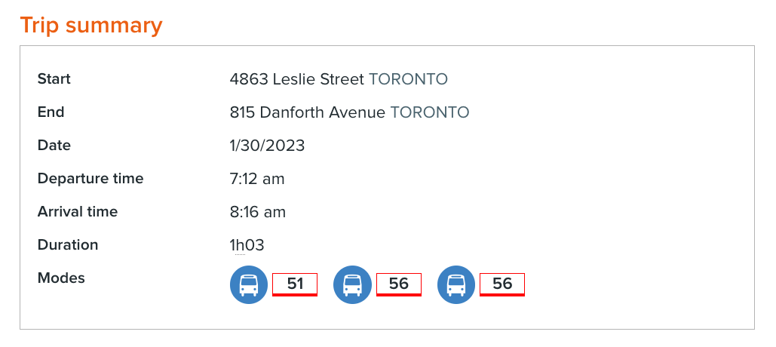
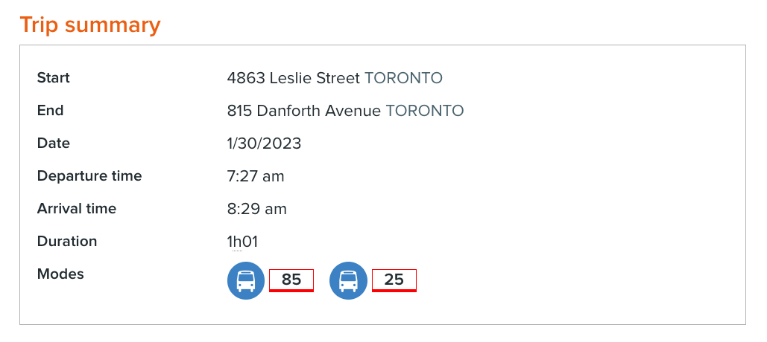
Elaine’s story
Identify and practise strategies
Practise reading transit schedules
Schedule 1
Schedule 2
Do the task on page 16
Notes:
Workbook, pages 16 and 17
Task
Ask a learner to read the instructions for the task. Then ask the learners what they need to do, to check if they understood the instructions. Allow them 5-7 minutes to write down their answers for the questions listed on page 17.
Ask the learners to share their answers as a class or in pairs.
Ask a follow up question about how they make sure they get to scheduled events on time.

Slide 27
Elaine’s story
Identify and practise strategies
Workplace culture tip
Workplace culture tip
Workplaces expect employees to arrive 10 to 15 minutes before their shift. If you arrive at the exact time of the start of your shift, the employer will consider that you are late.
When you arrive at work, you need some time to settle and get ready for work. For example, if you work in a manufacturing company and your shift starts at 7:00 AM, your employer will expect you to be at work at about 6:45AM so that you have time to put your lunch in the fridge and put on your safety shoes and other Personal Protective Equipment before the start of your shift.
Practise arriving to appointments and job interviews 15 minutes early to make it a habit.
Notes:
Workbook, page 17
Read or ask a learner to read the workplace culture tip.
Discuss the “controversial” aspects of it: if you arrive at the exact time of the start of your shift, the employer will consider that you are late. Explain why.
Discuss how being late can affect their success and others’ work. For example, their counsellor may have back-to-back scheduled appointments with other learners who need help. If one participant arrives late, they either will not receive the full time of their scheduled service, or another participant will have to wait to get the counsellor’s service.
Tell learners that when they adjust their schedule to arrive on time, they show that they can adapt. As well, when they arrive on time, they show collaboration.
Encourage the participants to practise arriving to appointments and job interviews 15 minutes early to make it a habit.

Slide 28
Elaine’s story
Identify and practise strategies
Practise looking up transit schedules
Steps of looking up transit schedules
Do task 1 on page 22
Do task 2 on page 22
Notes:
NOTE: This slide has animations.
Workbook, pages 18-22
Steps for looking up transit schedule (pages 18-21)
Tasks 1 and 2 (page 22)
Steps for looking up transit schedules
The steps are based on Winnipeg Transit. It would be best to adapt them to your area. However, learners can still practise by following the steps based on Winnipeg Transit.
Ask the learners to follow the steps in pairs to practise looking up transit schedules online.
Task 1
Ask a learner to read the instructions for the task. Then ask the learners what they need to do, to check if they understood the instructions. Allow them 7-10 minutes to complete the task.
Ask the learners to share their answers in pairs.
Task 2
Ask a learner to read the instructions for the task. Then ask the learners what they need to do to check if they understood the instructions. Allow them 7-10 minutes to complete the task.
Ask the learners to share their answers in pairs.

Slide 29
Elaine’s story
Apply what you’ve learned
Apply what you’ve learned
Now that you know more about how to adapt, how would you handle the situations described in your workbook on page 23?
Notes:
Workbook, page 23
Allow the learners 7-10 minutes to complete the quiz.
Encourage them to practice the strategies and tips that they have learned in this section.
As the learners are completing the quiz, you can go around and check the answers with them one-on-one. If the learner chooses an answer that indicates that they are not applying the strategies discussed in the unit, you can follow up with probing questions to identify needs for coaching or other wraparound supports.

Slide 30
Action plan
Action plan
An action plan helps you identify clear steps to take and strategies to use to achieve your goal. An action plan also helps you stay on track.
Notes:
NOTE: This slide has animation.
Workbook, page 24
Ask:
Who has ever developed an action plan?
What was it for?
How did it help?
Click to show the explanation of what an action plan is. Read the text from the slide.
Inform the learners that they will do a few tasks that will lead to developing an action plan. The action plan will be personalized. It will help them adapt effectively.

Slide 31
Action plan
Action plan
Do task 1 on page 24
Do task 2 on page 25
Notes:
NOTE: This slide has animations.
Workbook, pages 24 and 25
Task 1 (page 24)
Ask a learner to read the instructions for the task. Then ask the learners what they need to do, to check if they understood the instructions. Allow them 5 minutes to complete the task.
Ask the learners to share their answers as a class or in pairs.
Task 2 (page 25)
Ask a learner to read the instructions for the task. Then ask the learners what they need to do to check if they understood the instructions. Allow them 3-5 minutes to complete the task.
Ask the learners to share their answers as a class or in pairs.

Slide 32
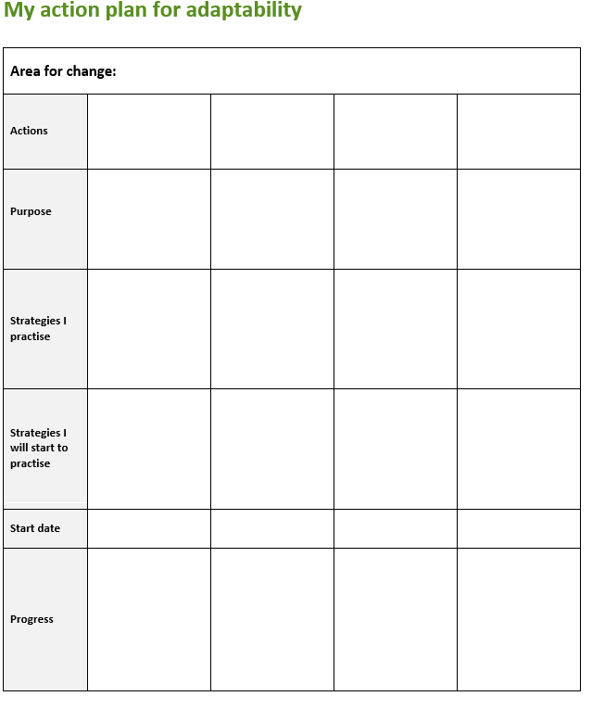
Action plan
﻿My action plan for adaptability
Action plan
You can find the action plan in your workbook on page 56
Do task 3 on page 25
Notes:
Workbook, page 25
NOTE: The task has animation.
Action plan template can be found in the workbook on page 56
Tell the learners where they can find the Action plan.
Discuss the sections in the Action plan with the learners. Talk about what kind of information would go in each cell/row.
If the learners have struggled using tables before, ask them questions like:
How many columns does the Action plan have?
What are the subheadings?
How is the information in the same column connected? What should they write in each column?
How is the information in the same row connected? What should they write in rows/cells?
Use the picture of the Action Plan on this slide to point to key areas.
Task 3 (page 25)
You can facilitate Task 3 in two ways depending on the dynamics of the group:
1. If the participants need a lot of guidance, have them complete the steps one by one. Allow them 3-5 minutes to do each step. Follow up after each one.
Write the areas where you need to make changes.
Write specific actions that can help you make those changes.
Write why you want to make the changes.
Write one or more strategies that you already practise for each action.
Write one or more strategies that you will start to practise.
Set a start date for your action plan.
2. If the participants don’t need much guidance, discuss the instructions for all steps in Task 3, and allow them 25-30 minutes to complete the tasks.
Ask them to check each other’s answers as they complete the tasks and encourage each other on their efforts.

Slide 33
Action plan
Action plan
You just made your own Action Plan!
Good luck!
Notes:
Workbook, page 25
Praise the learners for making their Action plan.
Ask
How often are you going to check if you are following the plan?
Who can you share it with to hold yourself accountable?
Encourage them to share their Action plan with their Employment counsellor, coach or other program staff working with them. They can check back with them to see if they are making progress or if they need to make any changes.

Slide 34
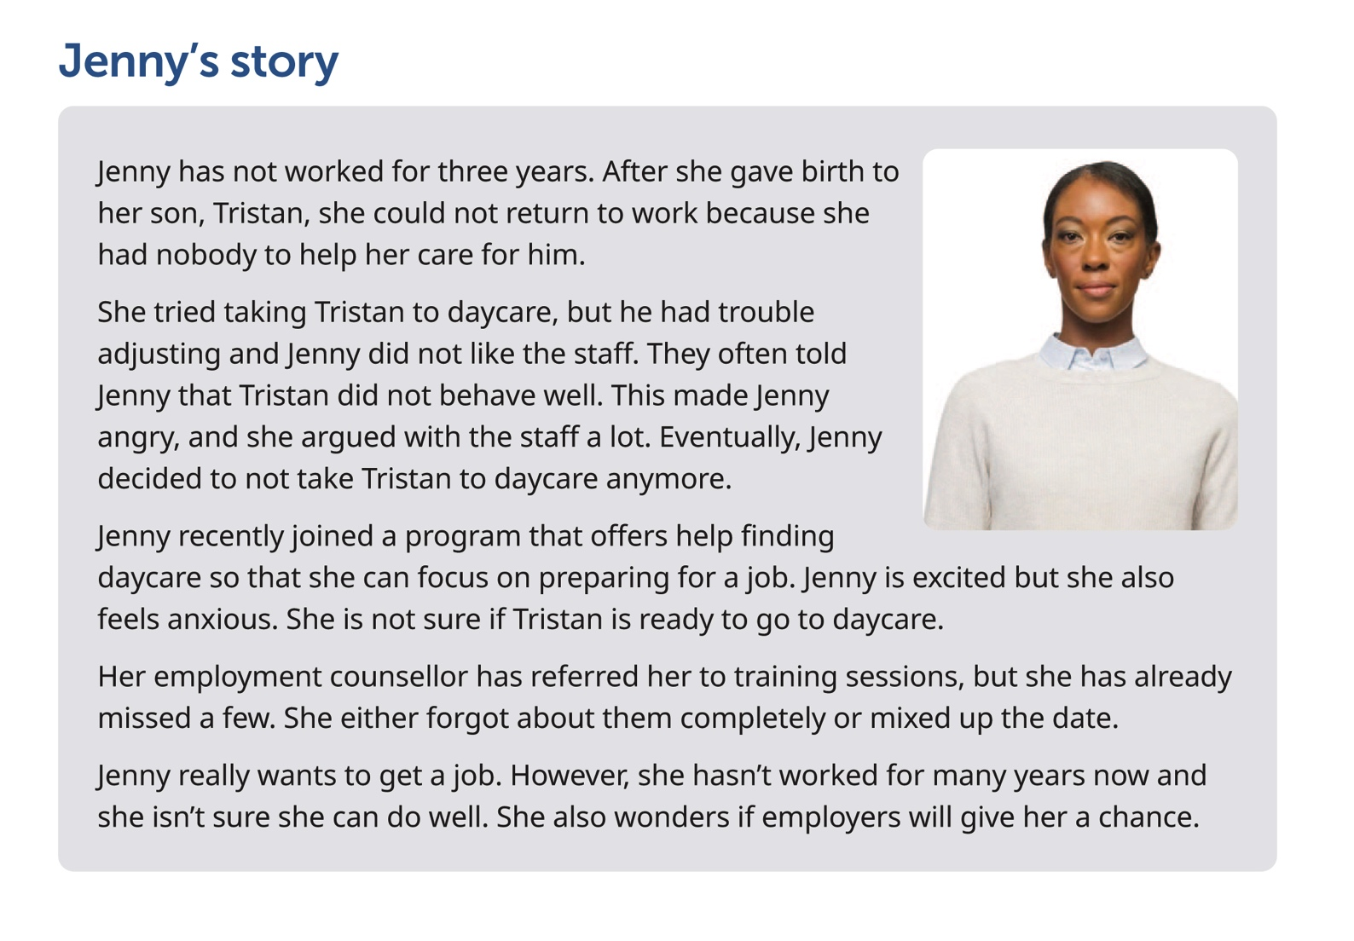
Jenny’s story
Notes:
Workbook, page 26
Jenny’s story
Give learners 3-5 minutes to read Jenny’s story or ask a learner to read it out loud.
Note: If some of the learners are struggling with reading, you can offer to read the story out loud or ask for someone to volunteer to read to the class (or group).
Go over key points and vocabulary from the scenario to make sure everyone understood the story.
Ask:
Who is this story about?
Why was Jenny not able to return to work after her son’s birth?
Why did Jenny stop taking Tristan to daycare?
Why is Jenny feeling anxious now?
How is the program going for her?
Inform the learners that the next set of activities will focus on Jenny’s story.

Slide 35
Jenny’s story
What to change? Identify areas for change
Jenny wants to fully engage in the program and get a job. To do so, she needs to make changes in the way she does things.
What does Jenny need to change?
Do the task on page 27
Notes:
Workbook, page 27
Task
Ask a learner to read the instructions for the task. Then ask the learners what they need to do, to check if they understood the instructions.
Allow them 3-5 minutes to complete the task.
Ask the learners to share their answers in pairs or as a class.

Slide 36
Jenny’s story
What to change? Identify areas for change
Think about yourself.
Are there any similarities and differences between Jenny’s story and your own?
Reflect
Notes:
Workbook, page 28
Vocabulary:
Check to see if learners understand the word “reflect” and what they should be doing when asked to “reflect on” something
Reflect
Allow learners 5 minutes to reflect on the questions. Then ask to discuss their answers in pairs or as a class.
They can use space in the workbook to write down their answers/ideas.

Slide 37
Jenny’s story
What does adapting look like? Identify actions
What actions could Jenny take to improve?
Do the task on page 29
Notes:
Workbook, page 29
Task
Ask learners to read the instructions for the task. Then ask them what they need to do, to check if they understood the instructions. Allow them 5 minutes to complete the task.
Ask the learners to share their answers in pairs or as a class.

Slide 38
Jenny’s story
What does adapting look like? Identify actions
What actions could you take to make positive changes in the areas that you identified for yourself?
Reflect
Notes:
Workbook, page 29
Reflect
Allow the learners 5 minutes to reflect on the question. They can use the space in the workbook to write down their answers/ideas.
They should write at least one action for each area for improvement they identified in the reflection task on page 29. Ask learners to discuss their answers in pairs or as a class.

Slide 39
Jenny’s story
Why adapt? Identify the purpose
﻿It can be hard to make big changes in your life. When you understand how you can benefit if you adapt and prepare for these changes, you can stay motivated and focused on your goal. For example, learning new skills can take a lot of your time, but it can help you gain confidence to start a job and do well.
Notes:
NOTE: This slide has animations.
NOTE: If you have completed the same activity when working on Elaine’s story, you can skip this slide, or you can use it as a revision
Workbook, page 30
Ask:
Is it easy or difficult for you to make changes?
How do you think Jenny is feeling having to make all those adjustments?
Possible answers: anxious, nervous, scared, unconfident, excited, happy
Ask a few learners to share their answers.
Click to show the first paragraph. Affirm and read, “Making changes to the way you do things can be hard and overwhelming. When you understand why you need to make them it helps you stay motivated and focus on your goal.”
Click to show the second paragraph.
Read:
- Each intentional change you choose to make can take you closer to your goal.
Activity time: 5 minutes

Slide 40
Jenny’s story
Why adapt? Identify the purpose
Why should Jenny adjust?
Do the task on page 30 and 31
Reflect
Notes:
Workbook, page 30 and 31
NOTE: If you have completed the same activity when working on Elaine’s story, you can skip this reflection, or you can use it as a revision
Show the question, “Why should Jenny adjust?” and tell learners that they will be completing a task to help Jenny identify why she needs to make the changes.
Task
Have a learner read the instructions (on PAGE 31) and the first sentence that has been done as an example. Or allow the learners 1 minute to read it to themselves.
Ask the learners to repeat what they need to do, to check if they understood the instructions. Allow them 5 minutes to complete the task. When the learners complete the task, ask them to share their ideas as a class or in pairs.
Reflect
Allow the learners 5 minutes to reflect on the questions (on PAGE 32). They can use the space to write their answers/ideas.
When they complete, ask them to share their answers in pairs or as a class.

Slide 41
Jenny’s story
How can you adapt effectively?
Identify and practise strategies
Vocabulary
Strategy: a plan or way to do something so you can achieve a goal
Reflect
Notes:
NOTE: This slide has animations.
Workbook, page 32
NOTE: If you have completed the same activity when working on Elaine’s story, you can skip this question, or you can use it as a revision
Ask the learners:
- What does “strategy” mean?
Click to show the vocabulary box for “strategy.”
Reflect
Allow the learners 5 minutes to reflect on the questions.
They can use the space in the workbook to write their ideas.
Ask them to share their answers/ideas in pairs or as a class.

Slide 42
Jenny’s story
How can you adapt effectively?
Identify and practise strategies
There are many strategies that can help you adapt more easily.
Strategies to prepare your child for daycare
Strategies to manage your anger
Strategies to improve your confidence
Notes:
NOTE: This slide has animations.
Workbook, pages 33 - 45
Strategies to prepare your child for daycare (page 33)
Strategies to manage your anger (page 35)
Strategies to boost confidence (page 37)
Say:
- There are many strategies that can help you adapt more easily. You can choose the ones that work for you. Experts recommend you use different types of strategies. Why not try and see what happens!
Say:
These are the strategies we will explore and practice in this section:
Click to show the first set: Strategies to prepare your child for daycare
Click to show the second set: Strategies to manage your anger
Click to show the third set: Strategies to boost confidence

Slide 43
Jenny’s story
Identify and practise strategies
Strategies to prepare your child for daycare
Spend some time with the child at daycare on the first day
Send a familiar item with the child
Teach your child how to follow instructions and how to be independent
Ask questions and make suggestions when staff talk to you about your child’s behaviour
Notes:
NOTE: This slide has animations.
Workbook, page 33-34
Ask different learners to read the strategies one by one. Click to show the strategies on the slide as they read them.
Alternatively, give the learners 3-5 minutes to read the strategies to themselves.
Ask
Which strategy did you already know?
Which strategy did you not know about?
Which one will you start using?
Task (page 34)
Ask a learner to read the instructions for the task.
Confirm everyone understood the instructions by asking them to repeat what they need to do. Allow them 3-5 minutes to do the task.
When they have completed, ask them to share their answers as a class or in pairs.

Slide 44
Jenny’s story
Identify and practise strategies
Communication tip
How to make suggestions
When you do not agree with someone about what they say or what they do, you can make suggestions instead of telling them what to do.
Start your sentence with:
Let me…, Let’s… How about I…, How about we, How about you… I could…, We could…, You could… Could I…, Could we…, Could you…
For example, the childcare assistant tells you that your child doesn’t eat snacks at snack time. You can say, “How about we try a different time?” or “Could we try a different time?”
Do the task on page 34
Notes:
NOTE: This slide has animation.
Workbook, pages 33 and 34
Communication tip (page 33)
Remind the learners that one of the strategies on the previous slide was to make suggestions instead of arguing.
Ask
How do you make suggestions?
Ask a learner to read out the communication tip or give them 3 minutes to read it to themselves. Follow up by asking learners to use the language structures shown in the communication tip and provide some more examples of suggestions

Slide 45
Jenny’s story
Identify and practise strategies
Strategies to manage your anger
Anger is a natural reaction to things that we really don’t like. It’s okay to feel angry but if you don’t express your anger in a healthy way, it can cause problems at work, and at home.
Yelling at others, breaking things and getting physical with others are some unhealthy ways of expressing anger. You shouldn’t ignore it if managing anger is hard for you.
Notes:
Workbook, page 35
Read or ask a learner to read the text in the pink box.
Ask learners if they can identify with Jenny’s story.
Ask a few learners to share how they handle their anger.
Tell the learners that the next set of strategies is about how to handle anger. They are borrowed from Canadian Mental Health Association.

Slide 46
Jenny’s story
Identify and practise strategies
Strategies to manage your anger
Count
Exercise
Name your emotions
Reflect
Notes:
NOTE: This slide has animations.
Workbook, Pages 35 and 36
Ask different learners to read the strategies one by one. Click to show the strategies on the slide as they read them.
Alternatively, give the learners 3-5 minutes to read the strategies to themselves.
Ask
Which strategies did you already know?
Which ones were new?
Which ones will you start practising?
Reflect
Allow the learners 5 minutes to reflect and write their answers/ideas. When they complete, ask them to share their answers in pairs or as a group.
Ask volunteers to share. If there are no volunteers, encourage the learners to practise this and the other strategies when they feel angry.
Remind them that it takes consistent practice.

Slide 47
Jenny’s story
Identify and practise strategies
Strategies to improve your confidence
Think of your transferrable skills
Transferrable skills are skills that you can use in different situations.
You can learn transferrable skills at home, at school, at cultural events, in your job. For example, you collaborate with your community members when participating in a cultural event.
Interview tip
Speak about your transferrable skills to employers at job interviews, especially if you haven’t worked before or are changing your career.
Learn new skills
Do task 1 on page 38
Do task 2 on page 39
Notes:
NOTE: This slide has animations.
Workbook, page 37 - 39
Ask :
What do you do to boost your confidence?
After some learners have shared, click to show the first strategy.
Ask the learners if they know what “transferable skills” are:
What are transferable skills?
Why do we call them “transferable?”
Where can you learn them?
Click to show the explanation for the transferable skills.
Ask
How can transferable skills help you at interviews and in your future job?
Click to show the answer.
Click to show the second strategy
Ask the learners to read the strategies from the workbook (page 38) out loud or give them 3-5 minutes to read them to themselves.
Task 1 (page 38)
Tell the learners that they will be completing a task about their skills.
Ask a learner to read out the instructions. Then ask what they need to do to confirm everybody has understood the instructions.
If necessary, explain what lists are, how they can help us and what types of lists there can be.
Allow them 5-7 minutes to write down their skills.
Ask the learners to share their answers in pairs, in small groups or as a class.
Task 2 (page 39)
Ask a learner to read out the instructions. Then ask what they need to do to confirm everybody has understood the instructions. Allow them 5-7 minutes to write down their skills.
Ask the learners to share their answers in pairs, in small groups or as a class.

Slide 48
Jenny’s story
Identify and practise strategies
Practise using calendars
Calendars give you information about the times and dates of events.
You read a workplace calendar to see when you have a shift.
You read a program calendar to find the times and dates of training and other events.
Notes:
NOTE: This slide has animations.
Workbook, page 40
Ask:
Do you use calendars?
What are calendars used for?
Let learners share their answers.
Click to show the first sentence on the slide.
Ask:
Why do you use calendars?
Let learners share their answers.
Click to show the rest of the information on the slide.

Slide 49
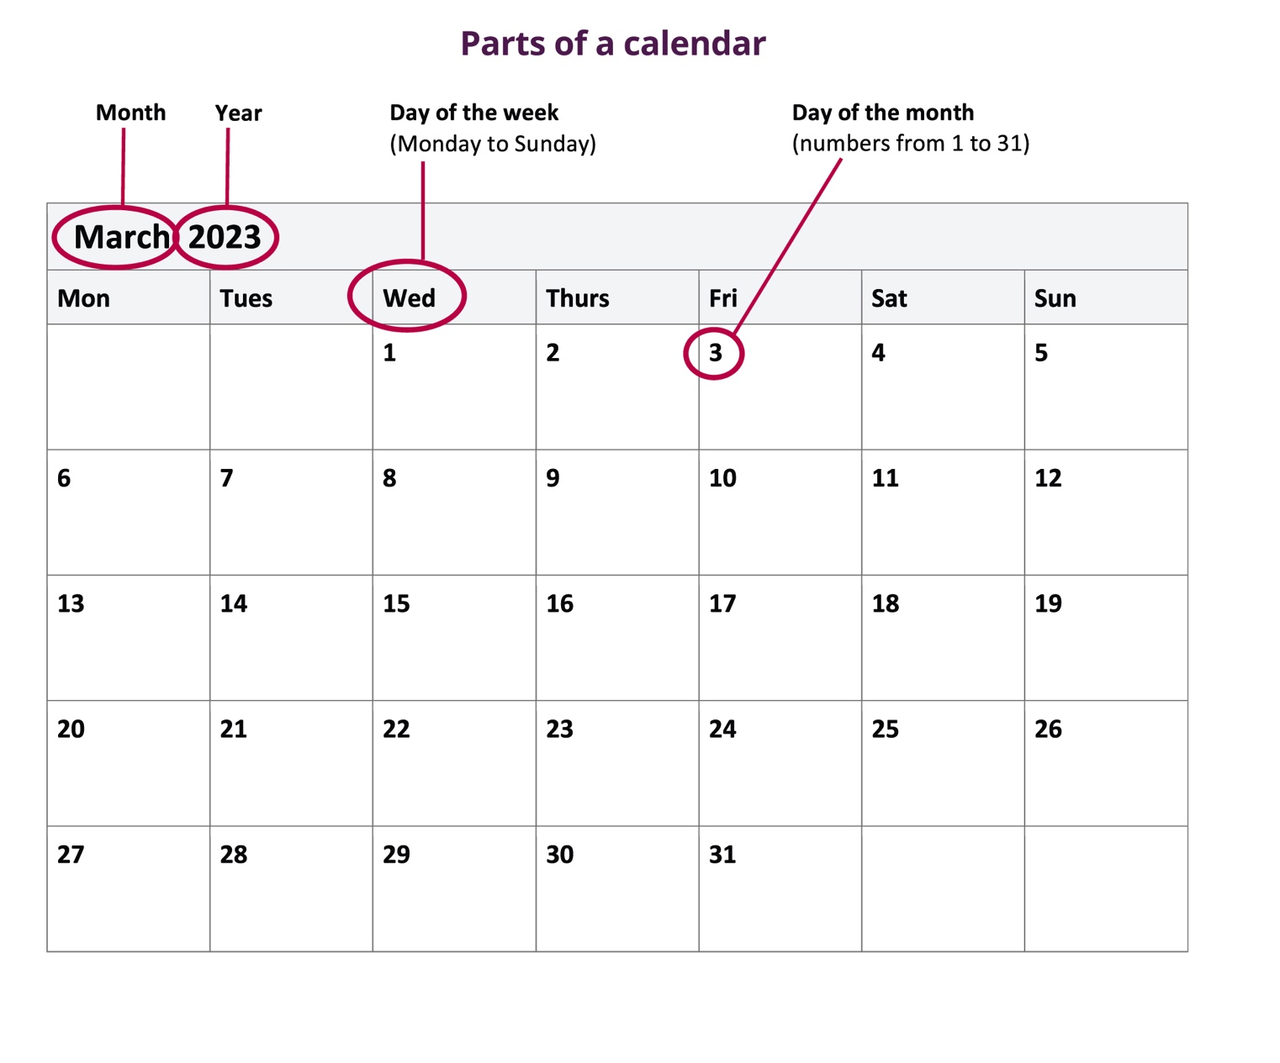
Jenny’s story
Identify and practise strategies
Practise using calendars
Notes:
Workbook, page 40
Discuss the parts of calendar with the participants.

Slide 50
Jenny’s story
Identify and practise strategies
How to find information on a calendar
Find the information you are looking for
Look at which day of the month it is on
Then follow straight up to find the day of the week
Do task 1 on page 42
Notes:
+NOTE: This slide has animations.
Workbook, pages 41 and 42
Let the learners know they should be looking at the Training Calendar on page 42.
Ask a learner to read the first step. Ask the class to find the name of the training in the calendar. Pick Lift Truck Theory training for this practice.
Ask another learner to read the second step. Ask the class to find the day of the month.
Ask a third learner to read the third step. Ask everyone to move their finger up and follow straight up to find the day of the week.
Task 1 (page 42)
Tell learners they need to use Training Calendar on page 41 to find information and answer the questions in task 1 on page 42.
Ask a learner to read the instructions for task 1. Ask learners to repeat what they need to do, to check everyone understood the instructions.
Allow the learners 3-5 minutes to do the task on their own.
Once done, check the answers with the whole class and go over the steps learners used to find the answers.

Slide 51
Jenny’s story
Identify and practise strategies
How to add events to your calendar
Find the day of the month. Look for the number
Write the name of the training
Write the time of the training
Do task 2 on page 43
Notes:
NOTE: This slide has animations.
Workbook, page 43
Let the learners know they should be looking at Jenny’s calendar on page 43.
Ask a learner to read the first step. Ask the class to look for the number and to find the day of the month. You can pick any day for this example.
Ask another learner to read the second step. Ask the class to write the name of the training. Use any training name.
Ask a third learner to read the third step. Ask everyone to write the time of the training. Pick any time for this example.
Task 2 (page 43)
Tell learners they need to use Training Calendar on page 43 and Jenny’s Calendar on page 44 to find information and to answer the questions in task 2 on page 43.
Ask a learner to read the instructions for task 1. Ask learners to repeat what they need to do, to check everyone understood the instructions.
Allow the learners 3-5 minutes to complete the task.
Once done, check the answers with the whole class and go over the steps learners used to mark the calendar.

Slide 52
Jenny’s story
Identify and practise strategies
Apply what you’ve learned
Now that you know more about how to adapt, how would you handle the situations described in your workbook on page 44?
Notes:
Workbook, page 44
Allow the learners 7-10 minutes to complete the quiz.
Encourage them to practice the strategies and tips that they have learned in this unit.
As the learners are completing the quiz, you can go around and check the answers with them one-on-one. If the learner chooses an answer that indicates that they are not applying the strategies discussed in the unit, you can ask follow up or probing questions to identify needs for coaching or other wraparound supports.

Slide 53
Action plan
Action plan
Do task 1 on page 45
Do task 2 on page 45
Notes:
NOTE: This slide has animations.
NOTE: If you have already done this activity as a part of Elaine’s story, use it now as an additional practice and allow learners more autonomy to see if they can complete the activity on their own.
Workbook, page 45
Task 1
Ask a learner to read the instructions for the task. Then ask the learners what they need to do, to check if they understood the instructions. Allow them 5 minutes to complete the task.
Ask the learners to share their answers as a class or in pairs.
Task 2
Ask a learner to read the instructions for the task. Then ask the learners what they need to do, to check if they understood the instructions. Allow them 3-5 minutes to complete the task.
Ask the learners to share their answers as a class or in pairs.

Slide 54
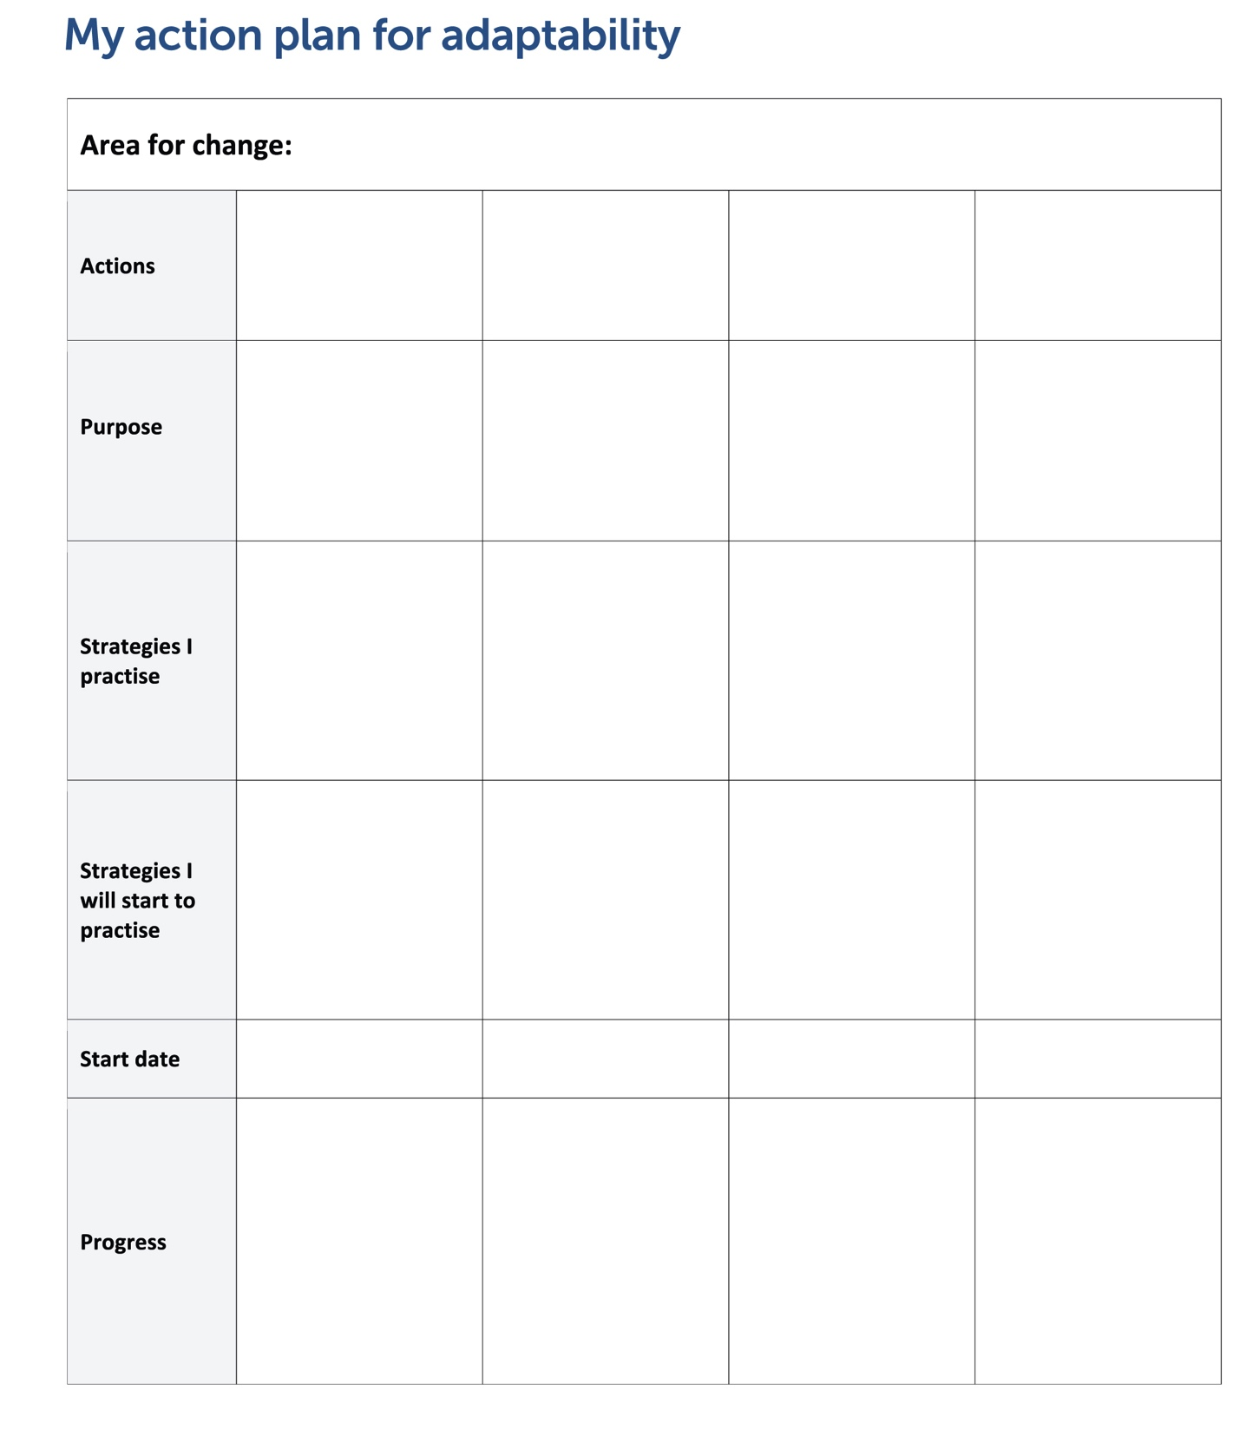
Action plan
Action plan
You can find the action plan in your workbook on page 56
Do task 3 on page 46
Notes:
NOTE: This slide has animation.
NOTE: If you have already done this activity as a part of Elaine’s story, use it now as an additional practice and allow learners more autonomy to see if they can complete the activity on their own.
Workbook, page 46
Action plan template can be found in the appendix on page 56.
Tell the learners where they can find the Action plan.
Discuss the sections in the Action plan with the learners. Talk about what kind of information would go in each cell/row.
If the learners have struggled using tables before, ask them questions like:
How many columns does the Action plan have?
What are the subheadings?
How is the information in the same column connected? What should they write in each column?
How is the information in the same row connected? What should they write in rows/cells
Use the picture of the Action Plan on this slide to point to key areas.
Task 3 You can facilitate Task 3 in two ways depending on the dynamics of the group:
1. If the participants need a lot of guidance, have them complete the steps one by one. Allow them 3-5 minutes to do each step. Follow up after each one.
Write the areas where you need to make changes.
Write specific actions that can help you make those changes.
Write why you want to make the changes.
Write one or more strategies that you already practise for each action.
Write one or more strategies that you will start to practise.
Set a start date for your action plan.
2. If the participants don’t need much guidance, discuss the instructions for all steps in Task 3, and allow them 25-30 minutes to complete the tasks.
Ask them to check each other’s answers as they complete the tasks, encourage each other on their efforts.

Slide 55
Action plan
Action plan
You just made your own Action Plan.
Good luck!
Notes:
Workbook, page 46
Praise the learners for making (if they are doing this for the first time) or for enhancing and adding to their Action plan (if they did this already as a part of Elaine’s story)
Ask:
How often are you going to check if you are following the plan?
Who can you share this with to hold yourself accountable?
Encourage them to share their Action plan with their Employment counsellor, coach or other program staff working with them. They can check back with them to see if they are making progress or if they need to make any changes.

Slide 56
Action plan
What’s next?
Connecting with a role model
Think of someone you know who has been successful adjusting to changes.
Connect with them and ask about their journey.
Notes:
NOTE: This slide has animations.
Workbook, page 47
Say:
- Your journey to adaptability does not end here. We are all on that journey all the time.
Ask learners if they can think of possible next steps on their journey in addition to the steps they identified in their Action plan.
Click to show the answer
Ask learners to share if they can think of someone who is their role-model

Slide 57
Action plan
What’s next?
Communication tip
﻿When you want to get more information from someone, ask open-ended questions. Open-ended questions start with question words such as who, what, why, when, where and how.
Asking open-ended questions allows the other person to give details instead of saying “yes” or “no”. “What strategies did you use?” is an open-ended question because it starts with a question word (what) and asks for details.
“Did you use strategies?” is a close-ended question because it does not start with a question word, and the answer is either “yes” or “no”.
Practise this tip with your employment counsellor, facilitator, coach, co-workers, supervisor and daycare staff. For example, you can ask your supervisor for feedback by saying, “What do I need to improve in my work?”
Connecting with a role model: How to ask good questions
Do task 1 on page 48
Do task 2 on page 49
Notes:
NOTE: This slide has animations.
Workbook, pages 47-50
Ask to elicit prior knowledge:
What is a good question? Why it is important to ask good questions?
Do you know what “open-ended” questions are?
Ask learners to read the communication tip on page 48. You can ask for a volunteer to read it to the whole class or give time to learners to read it to themselves.
Task 1 (page 48)
Ask learners to decide which questions are open-ended.
Check the answers with the whole class.
Task 2 (page 49)
Ask someone to read the instructions for this task. Ask the class to repeat what they need to do, to check if everyone has understood the instructions.
Allow the learners 7-10 minutes to think of the questions and write them down. While they are doing this, you can go around the class and work with learners one-on-one.

Slide 58
Action plan
What’s next?
Sharing stories at interviews
Prepare short stories about how you adapted, to share at job interviews.
Do task 1 on page 50
Do task 2 on page 51
Notes:
NOTE: This slide has animations.
Workbook, pages 50-51
Say:
- Adapting is an important skill in the workplace. That’s why at job interviews, employers may ask how you adapted in the past.
Ask:
How will you know (recognize) they are asking you about adaptability?
Let learners share some of their ideas before you ask them to read the answers in the workbook on page 50.
Say:
Sharing stories from a cultural activity, your volunteering experience, your school or a previous job is a very good way to show your interviewers how adaptable you are. Let’s complete task 1 on page 50 to practise how to prepare good stores.
Task 1 (pages 50-51)
Read each step and the example one by one.
After each step, ask the class if anyone has their own example to share.
Allow the learners 3-4 minutes to think of an example and to write it down in the workbook.
After all steps and examples have been done, ask learners to share their stories in small groups. You can walk around, listen to them sharing and provide feedback if/when necessary
Task 2 (page 51)
Encourage the learners to keep writing down their stories in a notebook.

Slide 59
Self-evaluation
Self-evaluation
How well can you do these activities?
Notes:
NOTE: If you used this self-evaluation at the beginning of the unit, learners can repeat it now to reflect on their skills and see if there was any improvement by comparing their answers from the first self-evaluation to this one.
Remind the learners what self-evaluation is and its purpose.
Review the layout of the table and provide examples to the learners on how to complete self-evaluation
Depending on which story the learners completed, they may repeat Self-evaluation 1 or Self-evaluation 2 or both.
Give them time (5-7 minutes) to complete Self-evaluation 1 (page 52) and Self-evaluation 2 (page 52). Show them how to compare answers to the Self-evaluation 1 and/or Self-evaluation 2 (page 4) they have done before.

